Slide 1

Delivering the Lake Essential Climate Variables – an update from the Lakes_cci
Stefan Simis (PML), Jean-Francois Cretaux (LEGOS), Claudia Giardino (CNR),
Chris Merchant (Reading), Herve Yesou (SERTIT), Claude Duguay (H2O Geomatics)
and the wider Lakes_cci consortium

Slide 2
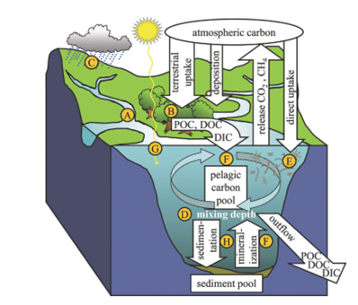
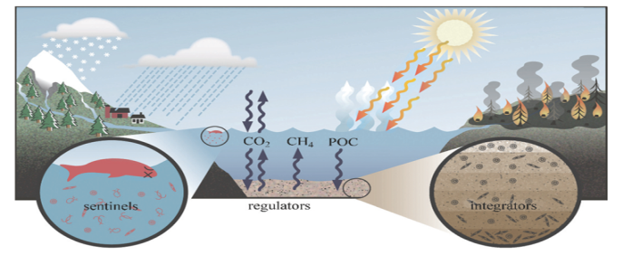
Lakes as sentinels of climate change
Lakes are sentinels, regulators and integrator of climate change (Williamson et al, 2009)
Many lake hydrological and biophysical variables are potential indicators of current climate change
Lakes regulate greenhouse gases (surface runoff, atmospheric deposition, and biogeochemical transformation)
Shrinkage of lakes amplifies GhG re-emission (shallow & small lakes are more active in GhG re-emission)
The stock of carbon in lake sediment is higher than in the oceans (Tranvik et al. 2009)
Lakes influence regional climate, e.g. local cooling effect (Micklin et al. 1980, Rouse et al. 2005)
Saline lakes contribute two times more to the emission of CO₂ than freshwater lakes (Duarte et al. 2008)
Lake sediments are archives of past climate (integration)

Slide 3
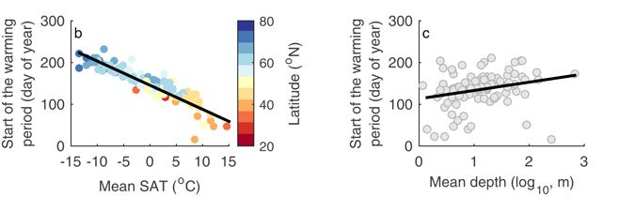
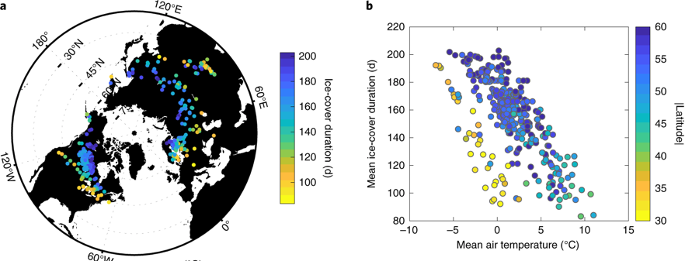
Lakes as regulators of climate change
Changes in the duration of the lake warming season are observable from space and used in models
20-yr satellite observations of lake surface water temperature (144 lakes): cold and deep lakes respond to changing air temperature with larger temperature anomalies in summer
(Woolway and Merchant, Nature 2017)
Modelling predicts reduced ice cover (25% to become ice-free by 2080–2100). Surface waters warming by about 2.5C and up to 5.5C. 100 out of 665 lakes will undergo changes in mixing regime, with 25 becoming permanently stratified.
(Woolway and Merchant, Nature Geoscience 2019)

Slide 4
Lakes as sentinels of climate change
New Lakes Essential Climate Variables
Science questions:
Are these variables measurable from remote sensing with sufficient confidence to address climate questions?
Water cycle
Greenhouse gas cycle
Biophysical processes
Do they show consistent climate signals?
Need for large and long observation dataset to disentangle natural and anthropogenic change
Water level: daily changes
Water extent: daily changes
Water temperature: weekly
Ice thickness: monthly
Ice freeze-up and break-up dates
Water colour: weekly

Slide 5
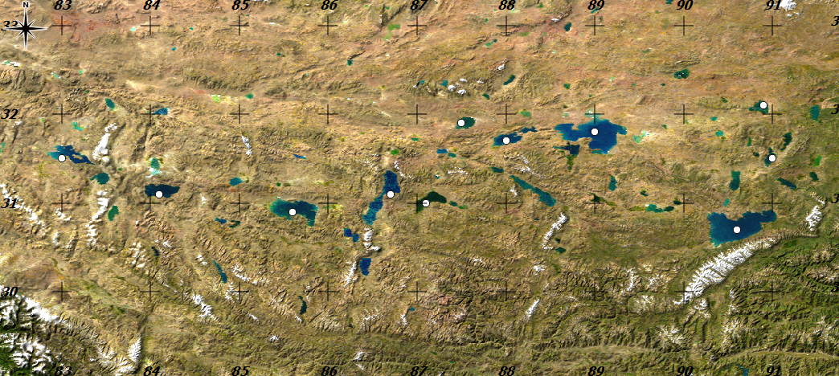
Lakes as sentinels of climate change (Level)
More than 1500 lakes > 1km² on the Tibetan Plateau
“Third pole” with high vulnerability to climate change
Glacier mass balance, permafrost thawing and changing precipitation are the principal drivers of Lake Water Level changes
Satellite altimetry potentially for ~100 lakes
Zige Tangco
Dagze Co
Urru Co
Ziling
Pung Co
Ngangla Ringco
Tangra Yumco
Taro Co
Zhari Namco
Ngangze
Namco

Slide 6
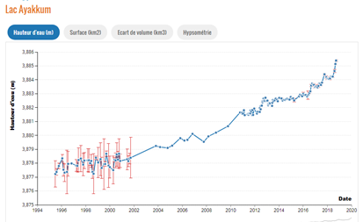
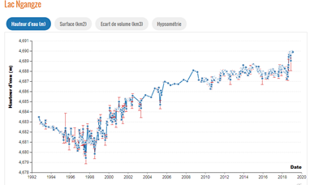
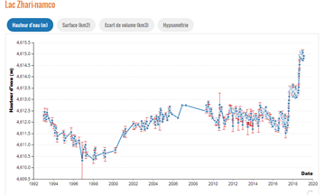
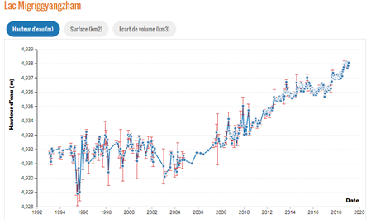
Lakes as sentinels of climate change (Level)
Attributing lake water level variations requires long observation time series.
Large-scale atmospheric oscillations (e.g. El Nino 2016) impact lakes everywhere.
Regional patterns over large areas are indicators of climate change.
Scarcity of in situ reference data is a challenge.

Slide 7
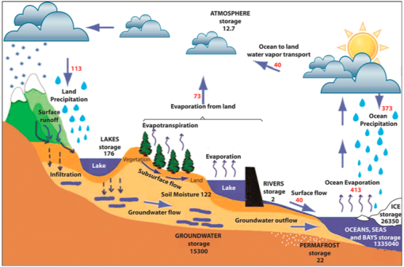
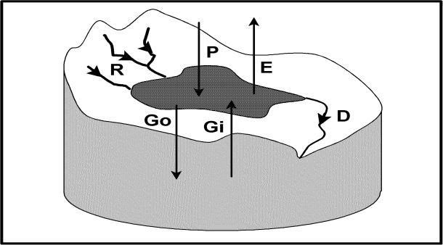
Lakes as sentinels of climate change (Extent)
Lakes are buffers in the regional water cycle
Changes in the hydro-meteorological parameters of the catchment will tend towards a new lake equilibrium
Lake in equilibrium:
Area = Runoff / (Evaporation – Precipitation)

Slide 8
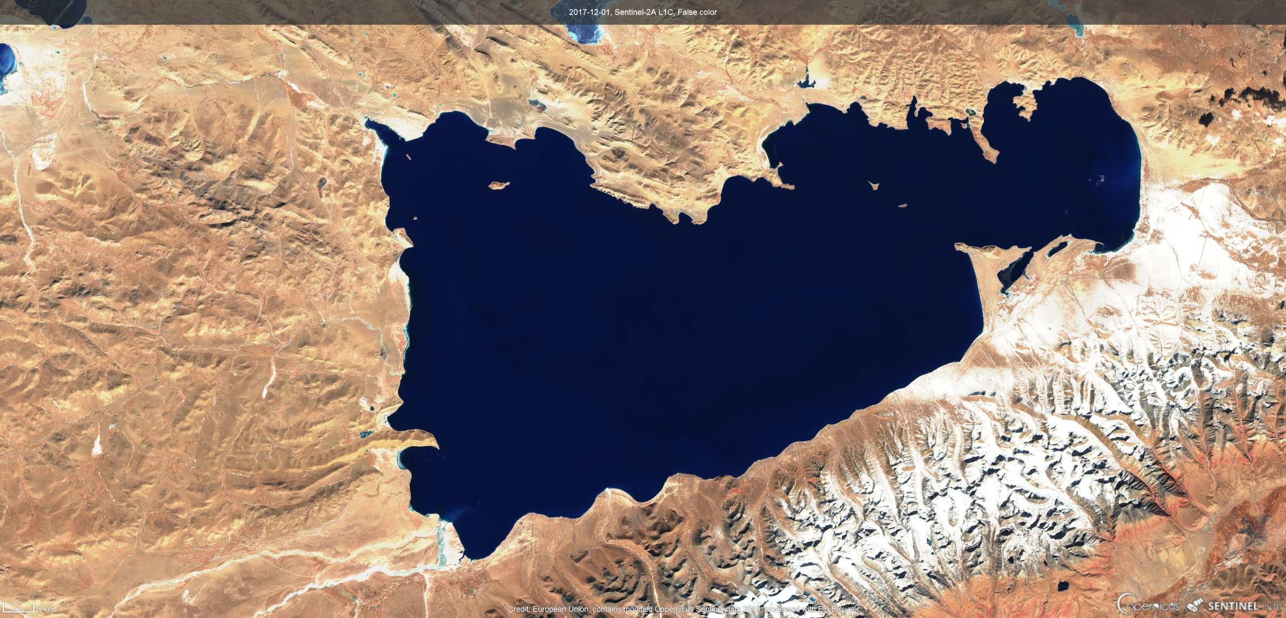
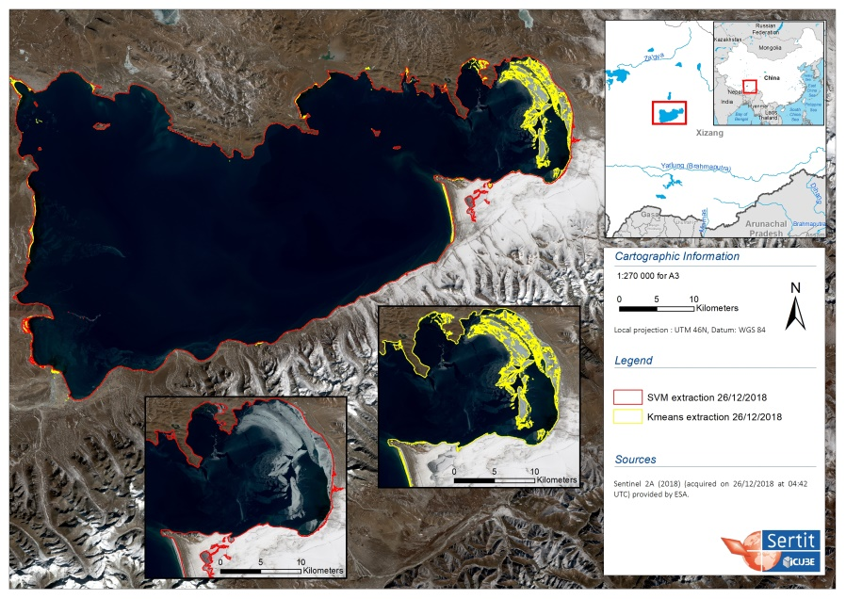
Lakes as sentinels of climate change (Extent)

Slide 9
Lakes as sentinels of climate change (Ice cover)
Freeze-up/break-up, (ice duration) are robust indicators of climate variability and change
Ice cover extent/concentration has an important impact on lake-atmosphere interactions
In situ observations of ice freeze/break-up dates
have drastically decreased over last decades
Ice cover in Lakes_cci using novel combinations of optical, thermal bands and machine learning approaches

Slide 10
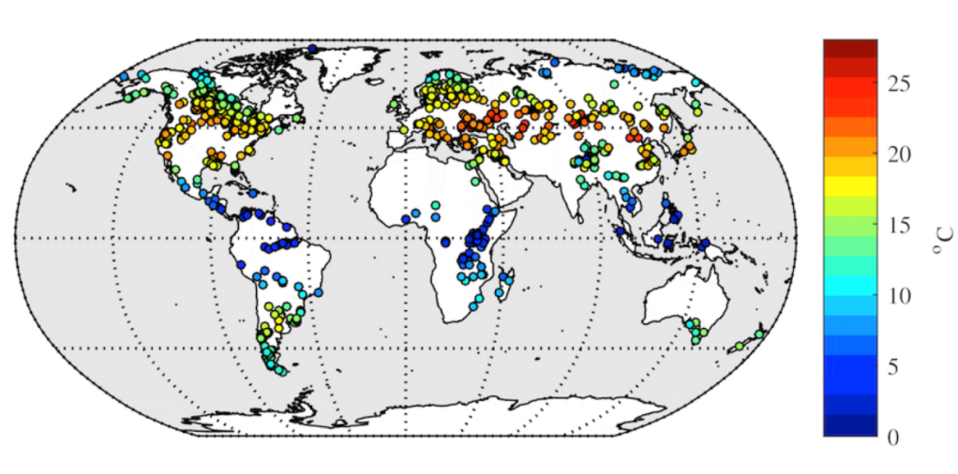
Lakes as sentinels of climate change (Temperature)
Seasonal (732 lakes; ARC-Lake)
Lake temperature varies with depth and in time from daily to millennial time scales.
Temperature structure is one of the most fundamental characteristics of a lake; temporal dynamics of surface temperature are diagnostic of 3-D temperature/mixing regime.
Global LSWT trends visible in seasonal observations.
LSWT time-series from ATSR2, AATSR and Metop-A for 678 environmental-change relevant lakes in project GloboLakes, building on ATSR record from ARC-Lakes.
Lakes_cci will harmonise and extend with ATSR1, Metop-B, SLSTR A and B, targeting >1000 lakes.

Slide 11
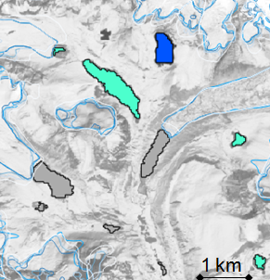
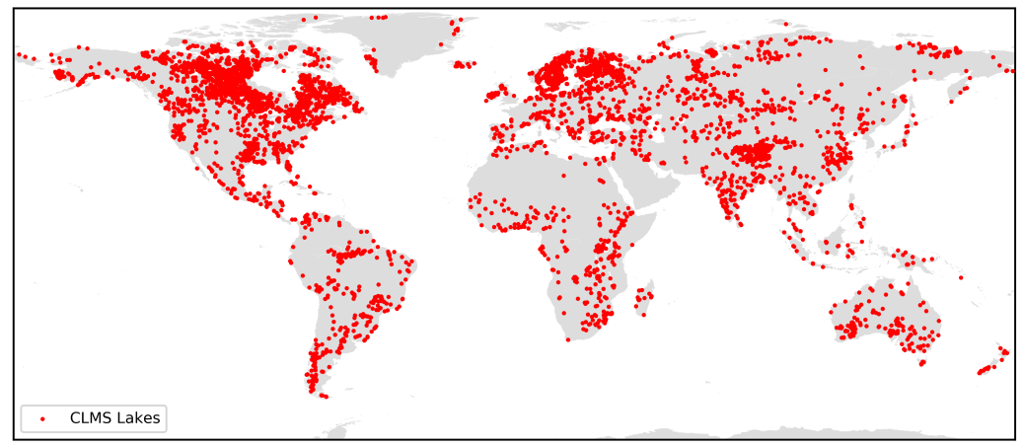
Lakes as sentinels of climate change (Colour)
Lake water-leaving reflectance (colour) links the physical, chemical and biological processes
Heat trapping potential (absorption and scattering of solar irradiance)
Long term indicators of biogeochemical responses to (changing) physical and hydrological regimes: phytoplankton bloom timing, community shifts, resuspension, terrestrial runoff and glacial melt, eutrophication, brownification. Long time-series without gaps needed.
67% increase over 6 years of grey waters in 116 Himalayan lakes (Matta et al. 2014)

Slide 12
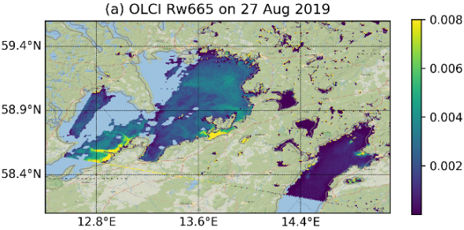
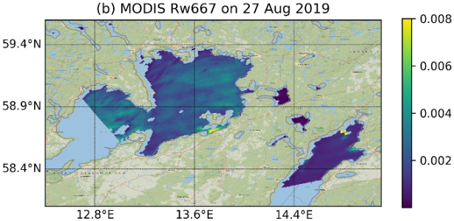
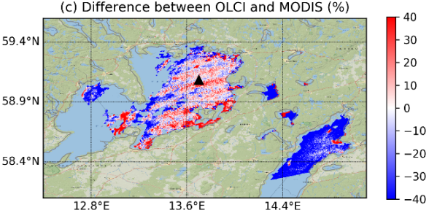
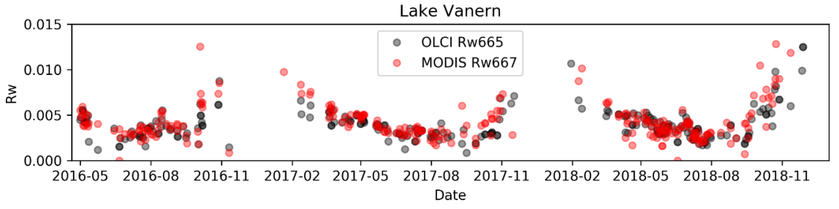
Lakes as sentinels of climate change (Colour)
Lakes_cci priorities
Address temporal gaps and sensor bias
Improve uncertainty characterization
Address water types with high product uncertainty
Identifying inter-sensor bias from sensors with different capabilities

Slide 13
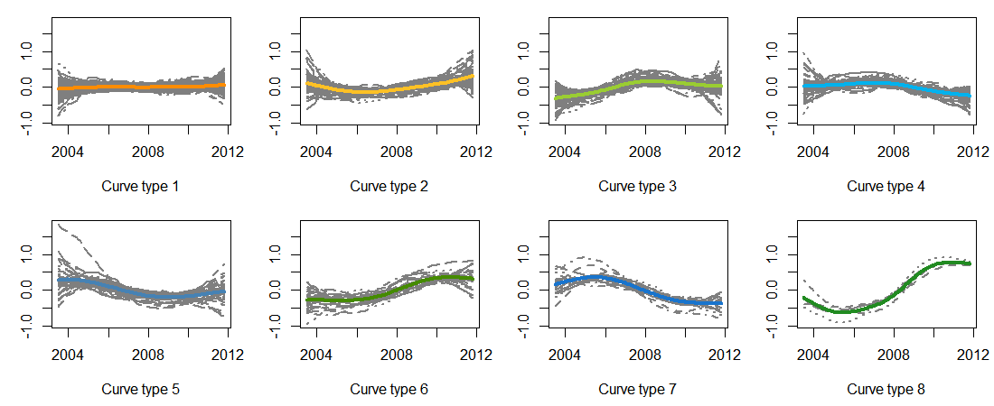
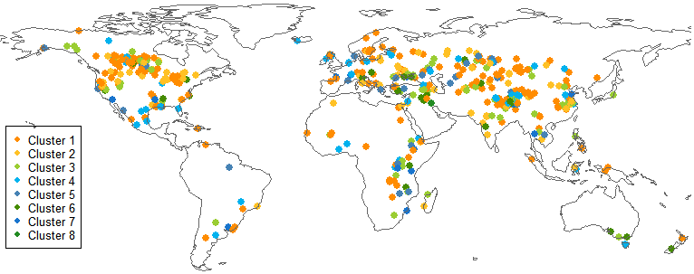
Lake biogeochemistry trends (chlorophyll-a)
Challenges
Attribution of change
Scarcity of in situ data hampers algorithm development and uncertainty characterization
little change
generally decreasing
generally increasing
Carvalho et al. in prep.
using GloboLakes 10-yr dataset

Slide 14
Lakes and climate – challenge summary
Lakes are integrators of catchment change
Lakes are sentinels of climate change
Lakes are disappearing*
Lakes are degrading**
Attribution of change requires long/large observation time-series
In situ data are generally scarce and/or biased
Satellite capabilities have seen tremendous improvement in capabilities
117 million lakes
Verpoorter et al. 2014 GRL
Notes:
*At high latitudes we can now see formation of new lakes due to melting permafrost and glaciers. In other places, decreasing snowfall and/or over-extraction causes lakes to disappear
**Eutrophication and salinization are big risks, but we also see recovery from the worst of eutrophication during the 1970s

Slide 15
Project objectives
Provide the first consistent, longest attainable time-series of the largest possible number of lakes covering all variables under the Lakes ECV
Lake Water Extent & Lake Level
Lake Ice Cover
Lake Surface Water Temperature
Lake Surface Water Reflectance
Consistency: Lake selection, common masks/boundaries, output formats (projection, resolutions), perform rule-based product checks
Limitations: Observations are not synchronous, revisiting times differ, there are continuity issues (no-sensor gaps) and newer satellites offer more capabilities
30+ instruments considered:
ERS2, T/P, Envisat, GFO, Jason-x, Cryosat-2, Icesat-1/2, Saral/AltiKa, S3A/B, Jason-CS, SRAL A/B, SWOT
AVHRR, MODIS A/T, VIIRS, OLCI A/B, C-SAR A/B
ATSR2, AATSR, Metop-A/B, SLSTR A/B, ATSR-1
MERIS, OLCI A/B, MODIS A, VIIRS, SeaWIFS

Slide 16
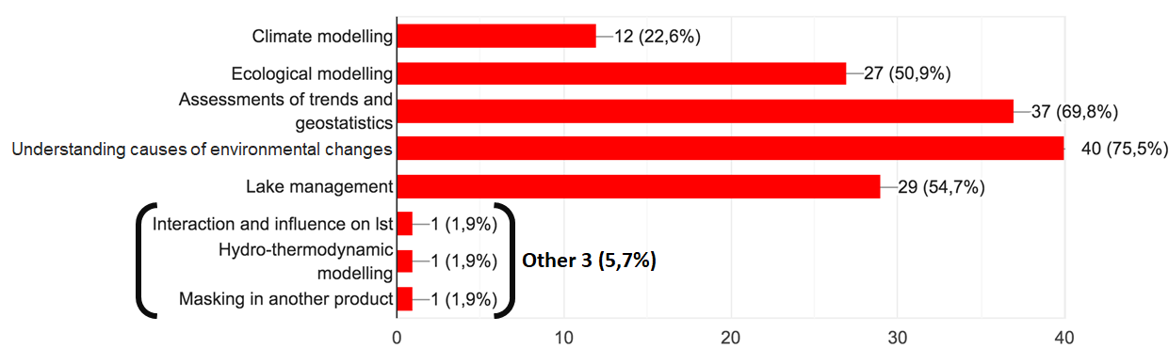
Timeline for Innovations and Outputs
First Lakes ECV climate data record Feb 2020
- Current state-of-the-art
- 250 lakes common for all variables (0.00021%)
- Coverage/temporal gaps possible
2019
2020
2021
KO
CMUG
WS
CMUG
CMUG
User consultation
User requirements updates
V1 – M12
Current state of the art in a common format and set of lakes
V2 – M27
Extended coverage,
Improved uncertainty characterization
Input from user groups needed to evolve v2
5 CRG use cases
User questionnaire: How will you use Lakes_cci data?

Slide 17
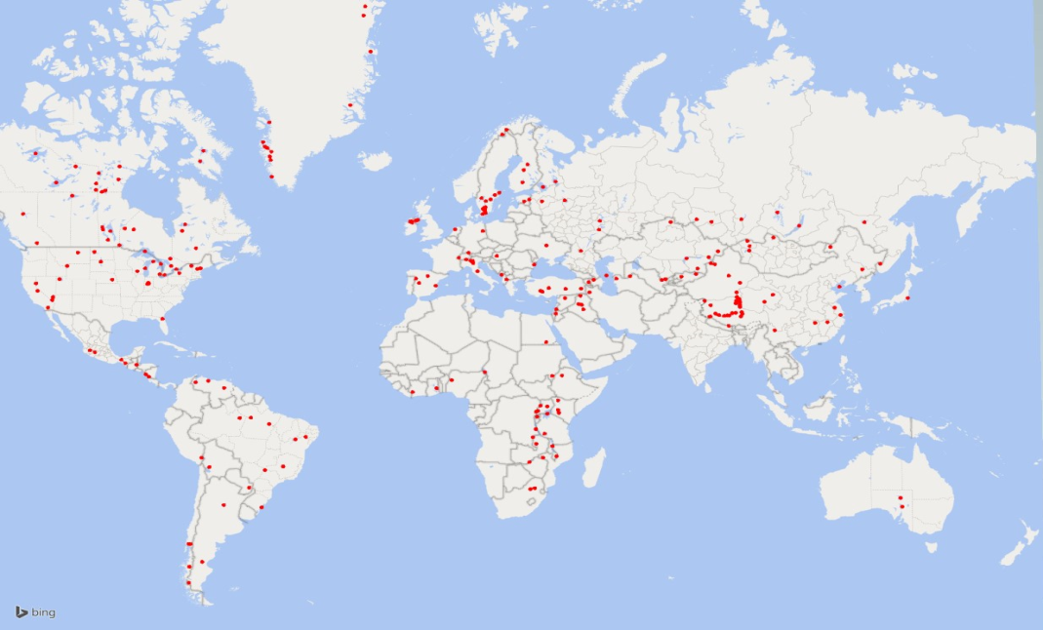
Lakes ECV Climate Data Record v1
250 lakes
common for all variables
1km daily gridded resolution (sub/super-sampled)
Level/Extent per lake
netCDF files
using climate vocabularies
Per-pixel product uncertainties

Slide 18
Climate Research Group – use cases
Five use cases:
Analysis of ECVs for lakes around the Tibetan Plateau
(Temperature, Ice Cover, Water Level)
Analysis and interpretation of ECVs for large lakes -> SDG 6
(Colour, Temperature over a climatic gradient)
Exploiting ECVs in Long Term Ecosystem Research
(integrating in situ and satellite data records)
Brownification in Scandinavian lakes
(Colour, Level, Ice on/off)
Consistency of ECVs in the Danube river-lake-lagoon
(Colour-derived biogeochemical products, Temperature)

Slide 19
Conclusions
Facts:
Lakes play the role of proxy, regulator and integrator of climate change
Impacts of lakes on climate are generally regional and complex
To attribute change we need consistent observation of level, extent, temperatures, ice, water colour, ..
Limnologists, climate modellers are end-users.
Perspectives:
Remote sensing techniques are most suitable to examine the role of lakes in global climate change.
There is no single consistent resource for Lake ECV data. Lakes_cci will be first to align techniques and products.
Key variables relate to Physical aspects (level, area, storage, water temperature, ice cover) and biogeochemistry

