Slide 1
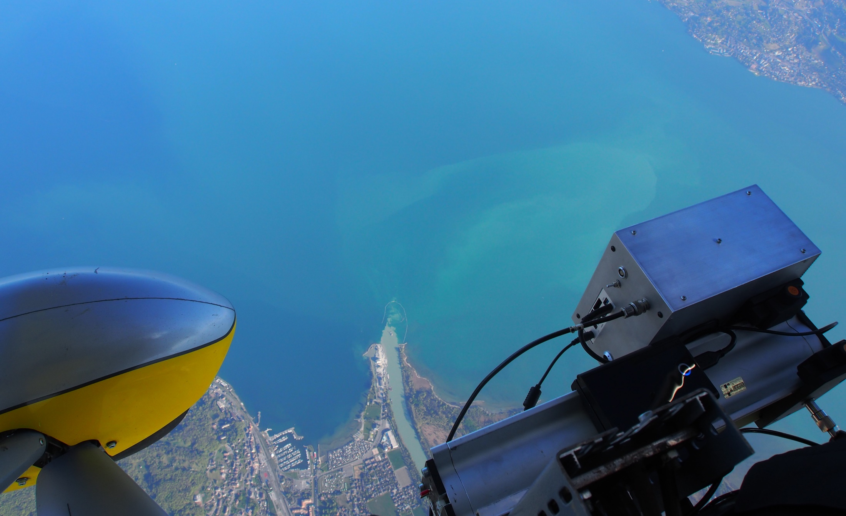
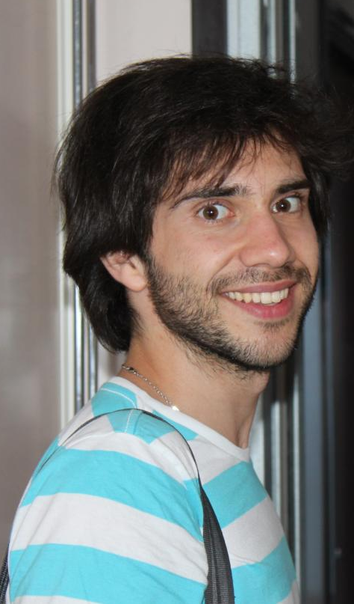
Meteolakes.ch
Main Contributors
Theo Baracchini
Adrien Gaudard*
Damien Bouffard

Slide 2
Need of an online operational 3D hydro model
Ex: calcite precipitation in Lake Geneva
Nouchi et al. AS (2019)

Slide 3
Need of an online operational 3D hydro model
Ex: calcite precipitation in Lake Geneva
Nouchi et al. AS (2019)

Slide 4
Need of an online operational 3D hydro model
Ex: calcite precipitation in Lake Geneva
→ Need operational model for event predictions
Nouchi et al. AS (2019)

Slide 5
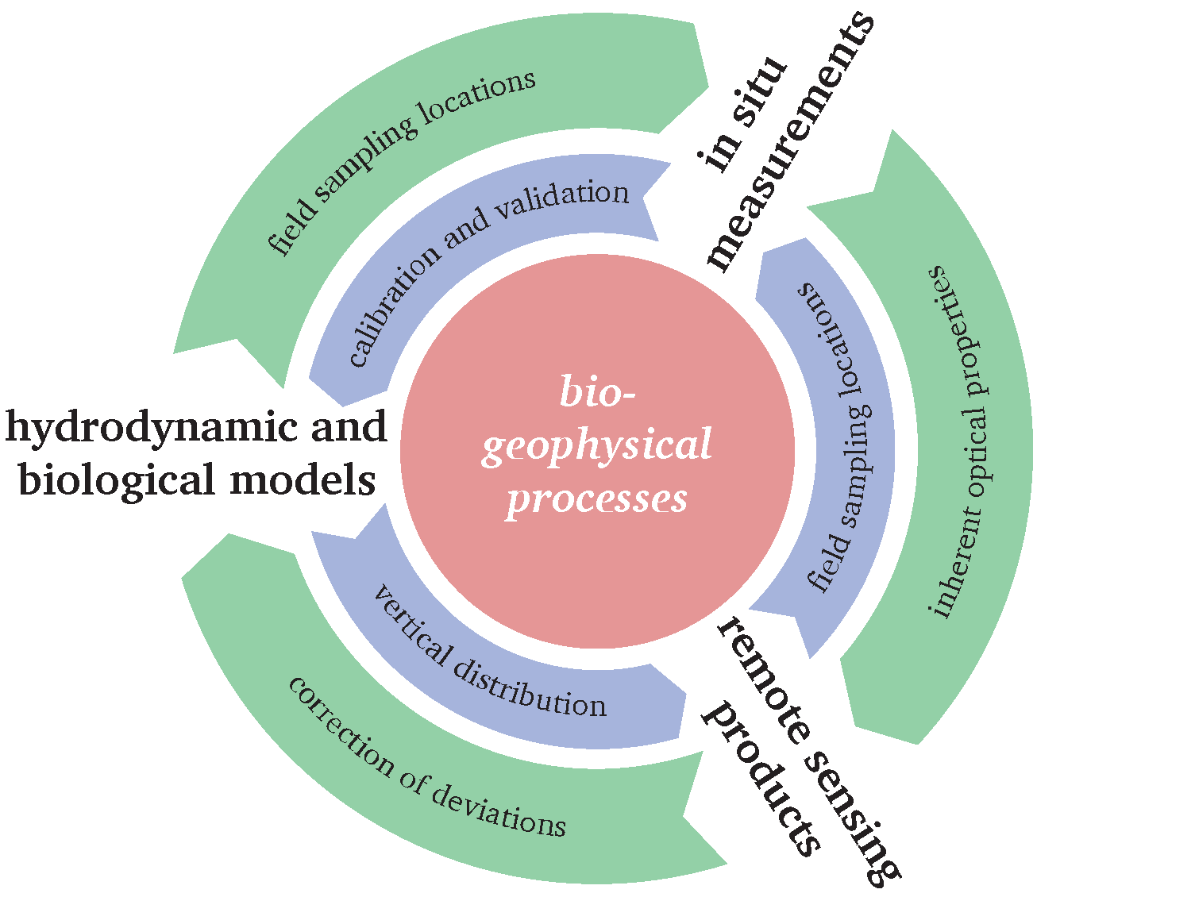
Meteolakes.ch
An online operational 3D hydrodynamic model

Slide 6
Meteolakes.ch
An online operational 3D hydrodynamic model
Model/System requirements
Operational
Data visualisation
Data extraction
Uncertainty quantification

Slide 7
Meteolakes.ch

Slide 8
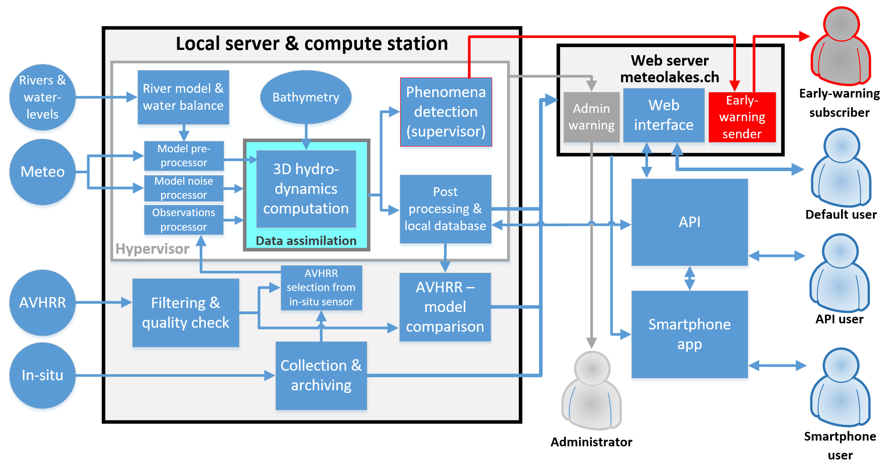
Meteolakes.ch
System process
Baracchini et al. WR (accepted)

Slide 9
Meteolakes.ch
Data Assimilation of LSWT from Satellites with EnKF
EnKF Ensemble Kalman Filters
Observation
Obs. uncertainty
Coupling of open-source tools (Delft3D-FLOW & OpenDA)
Ensemble Kalman Filter
20 ensembles
1 year temperature assimilation
124 AVHRR LWST images
2 stations with (bi-)monthly profiles
Run time: 1 month (on cluster)
Data: 1 TB
Analysis ensemble mean
Forecasted ensemble mean
t_{i-1}
Forecast
t_{i}
Forecast
t_{i+1}
Analysis
…

Slide 10
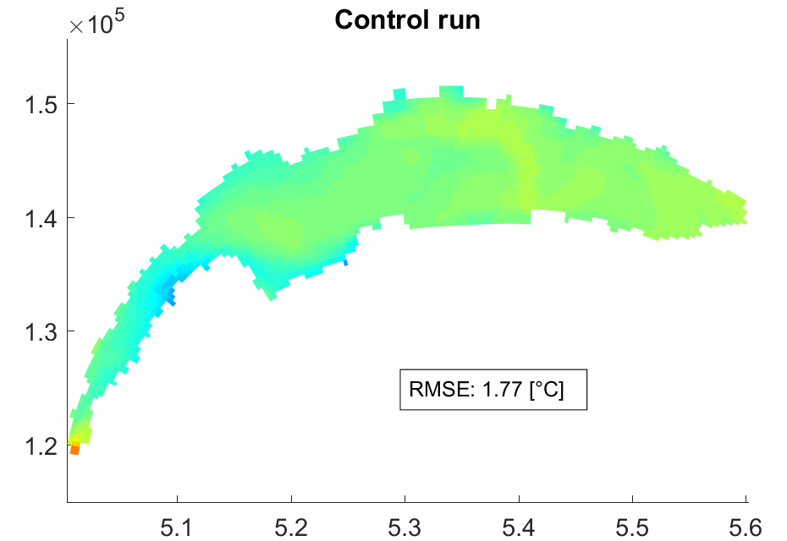
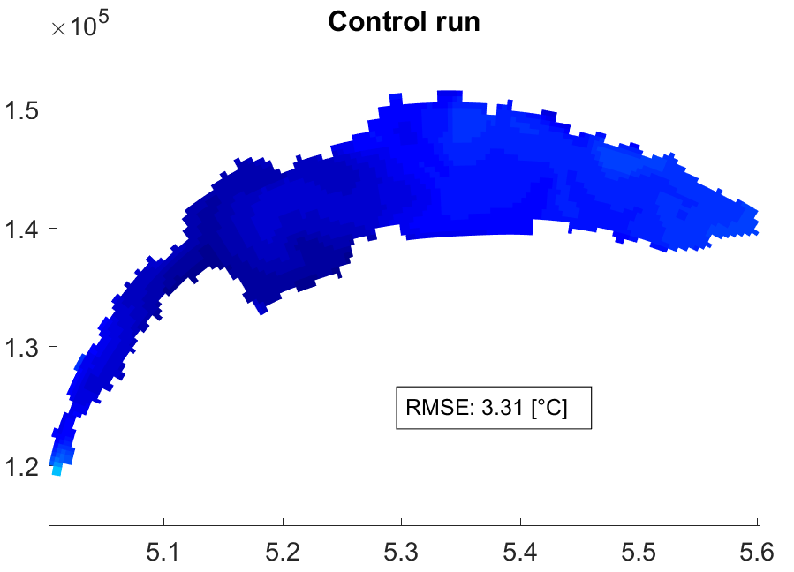
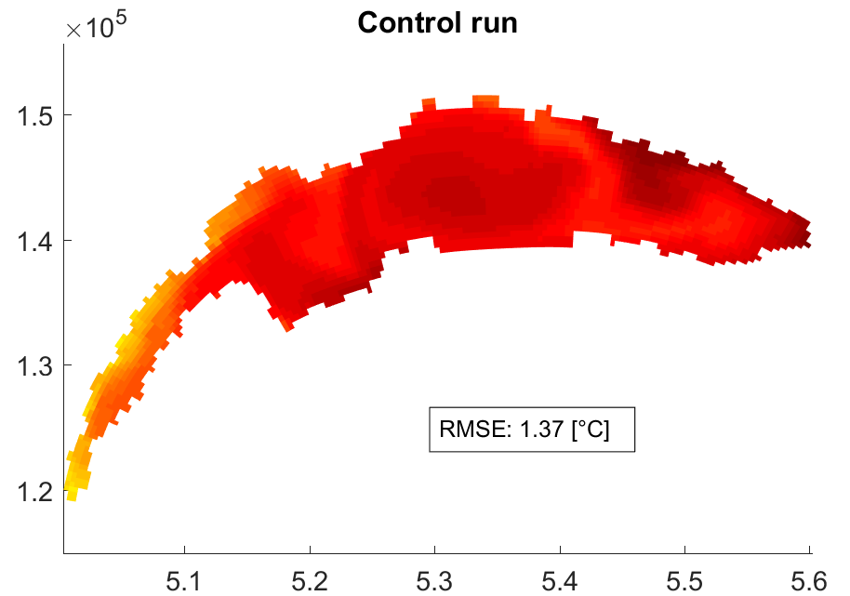
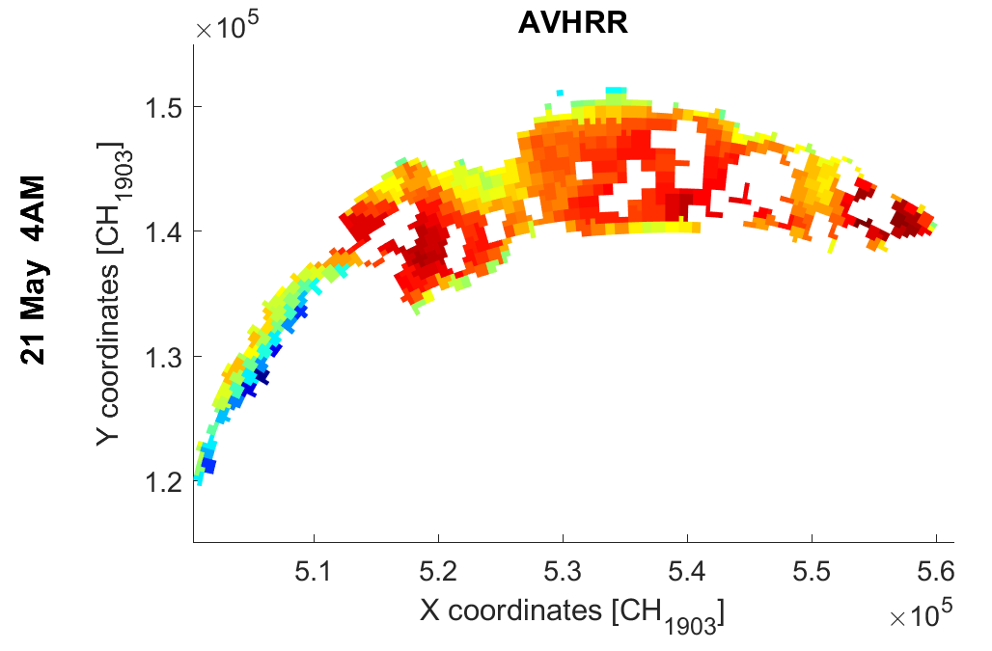
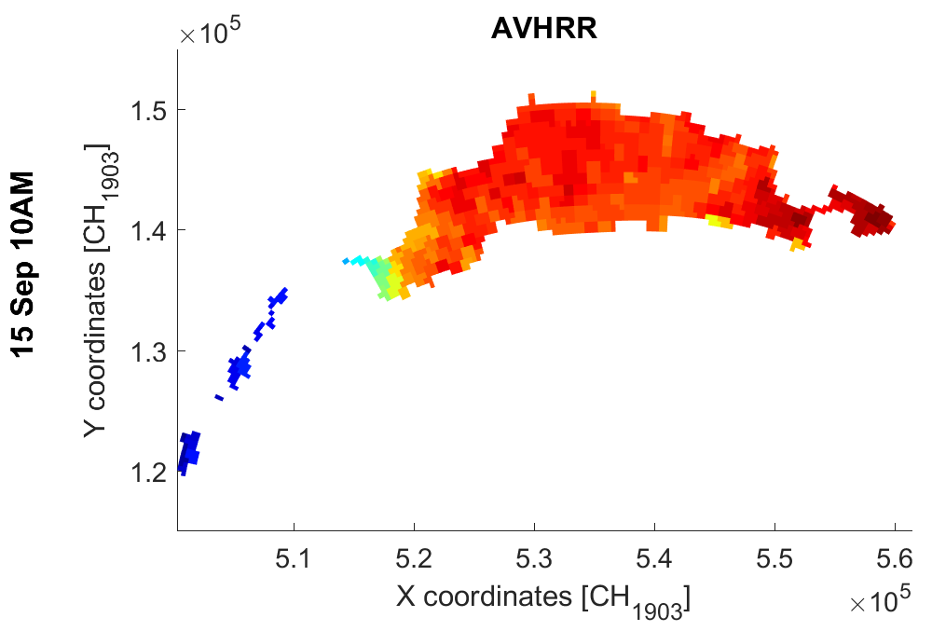
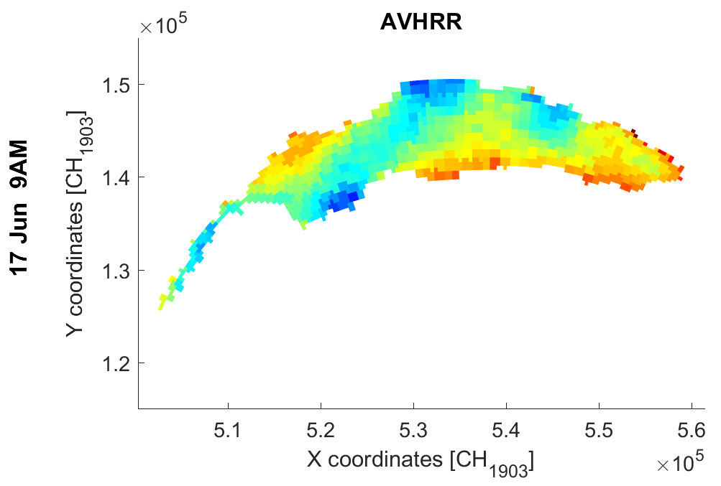
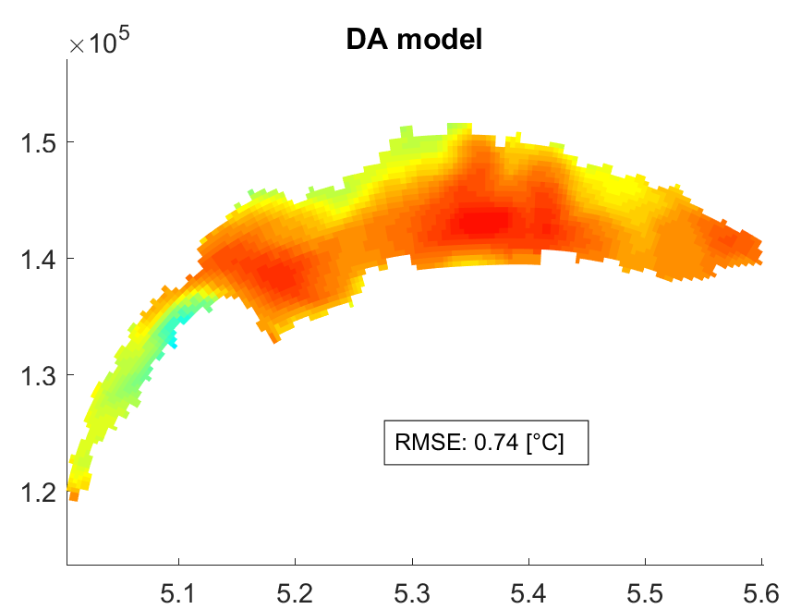
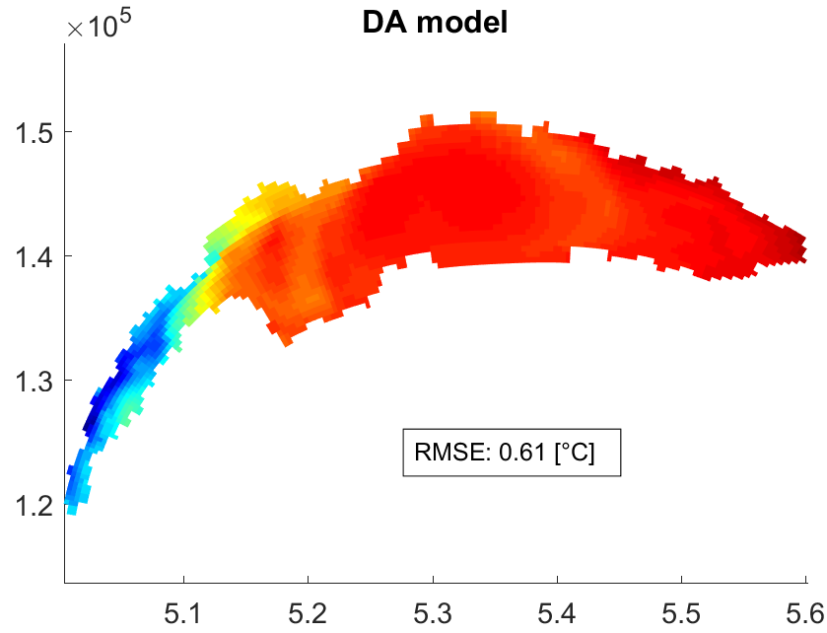
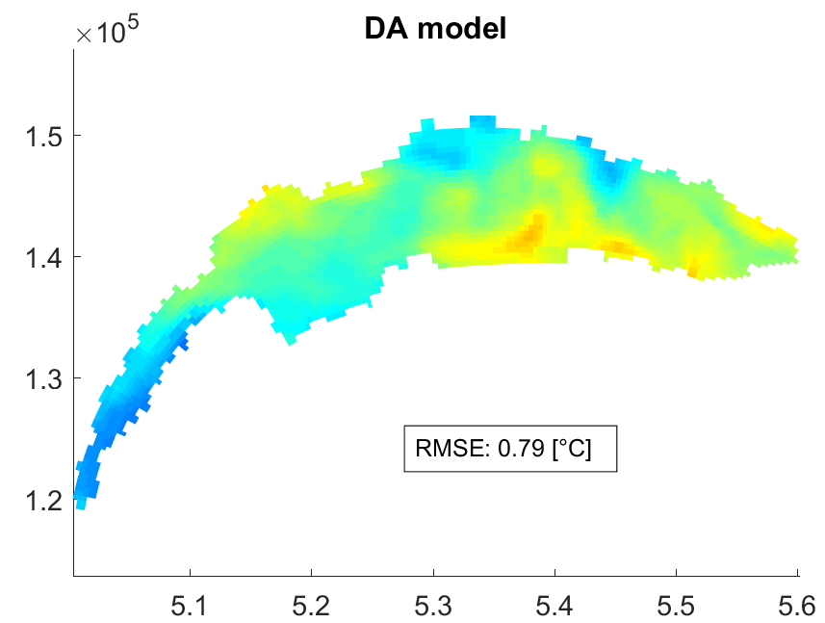
Meteolakes.ch
Data assimilation – EnKF - Satellites
Mean Absolute Error (MAE) reduced by 54% over entire year
MAE after DA: 0.7 °C

Slide 11
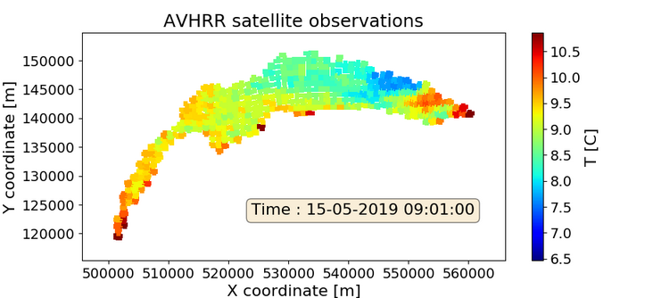
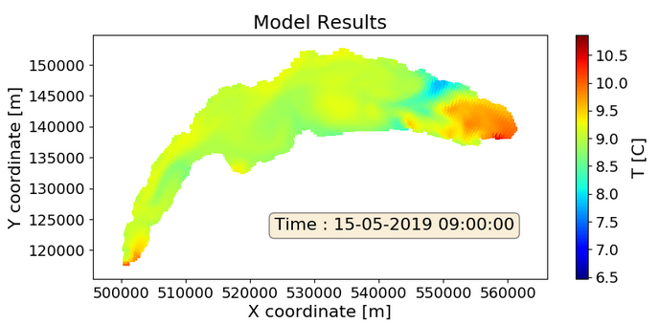
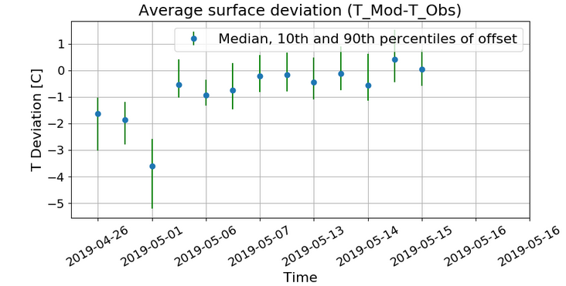
Meteolakes.ch
Operational data assimilation system
11

Slide 12
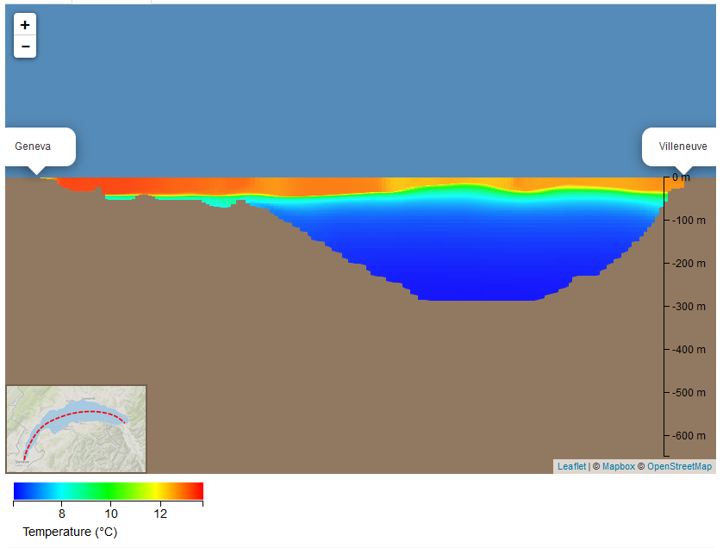
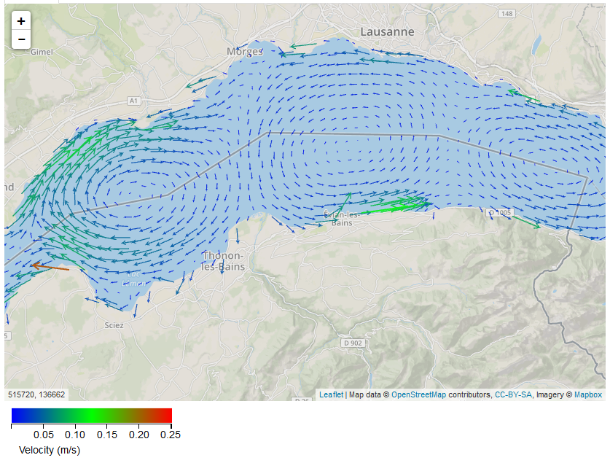
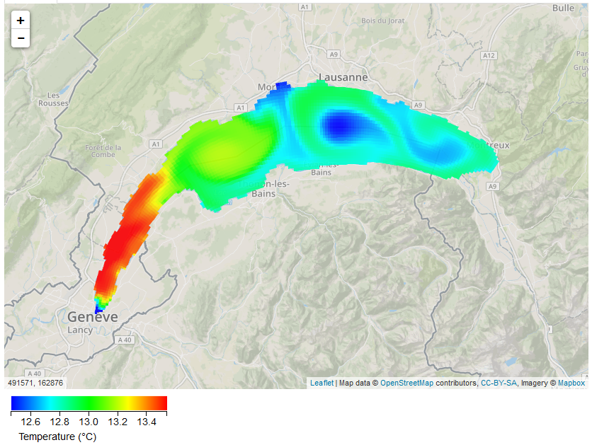
Online Operational Platform
System operation:
Daily computations (hydrodynamics + water quality)
5d forecasts
Data assimilation
Applications:
Scientists: in-situ measurements planning, understanding 3D physical phenomenon (e.g. upwellings)
Governmental agencies: monitoring lakes at every location in space and time, following the stratification and mixing
Public awareness: 800 daily users in summer on avg., total >220 000
https://meteolakes.ch/
Baracchini et al. WR (2019).

Slide 13
Meteolakes.ch
Main Contributors
Other Contributors
Theo Baracchini
Adrien Gaudard
Philip Chu
Alfred Wüest
Love Vinna Raman
Stefan Wunderle
And others
Damien Bouffard

Slide 14
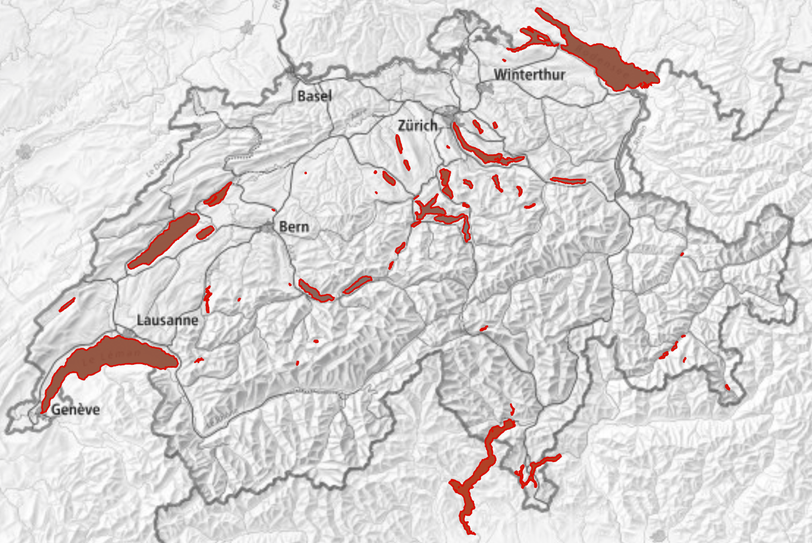
Swiss Lakes1-D Modelling
Toward a general use of high frequency data
Adrien Gaudard, Eawag
https://simstrat.eawag.ch/
Gaudard et al. GMD (2019)

Slide 15
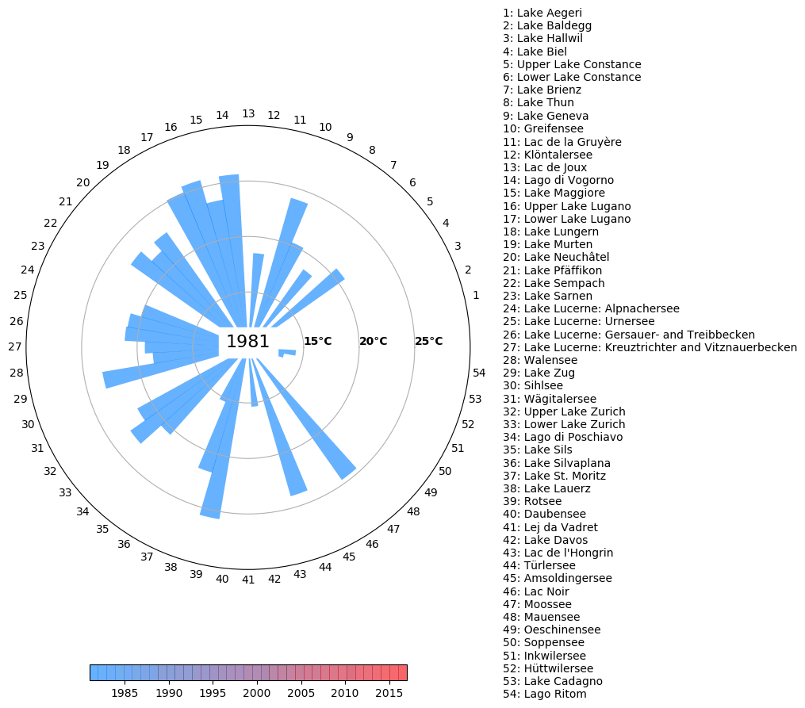
1-D Models
Swiss Lakes 1-D Modelling
Toward a general use of high frequency data
simstrat.eawag.ch

