Slide 1
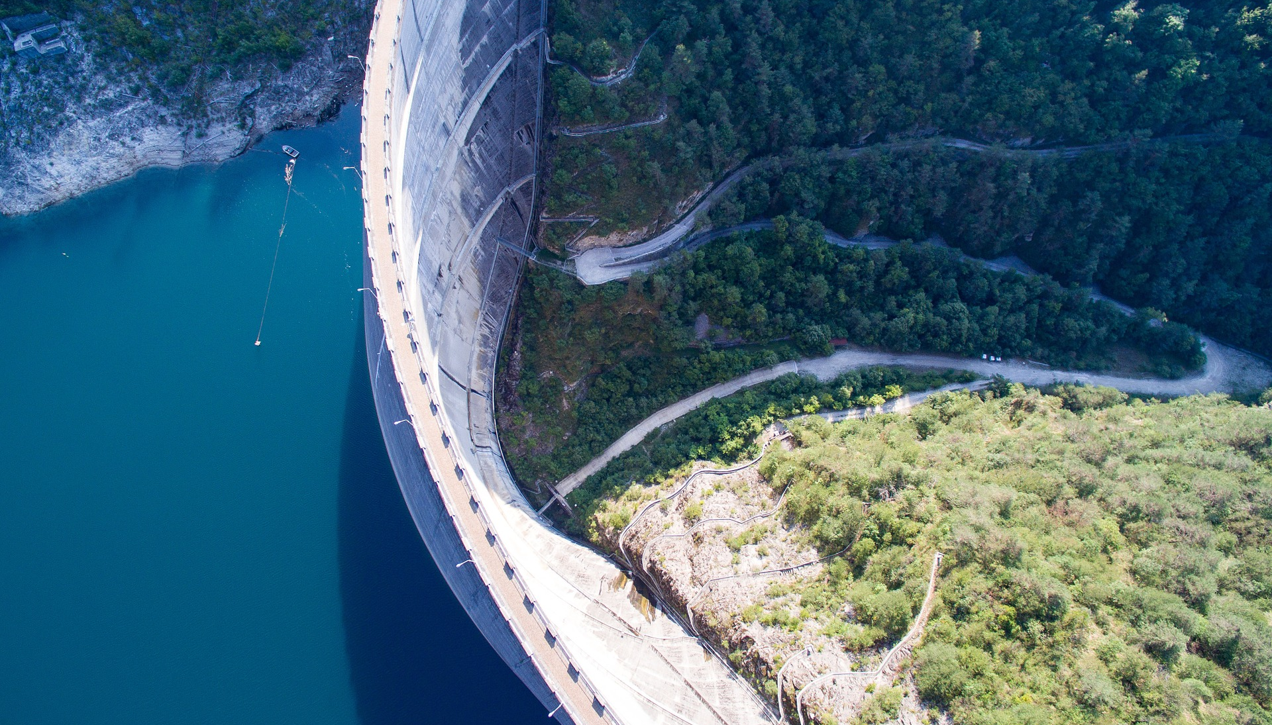
Implementing reservoirs in CLM5: Accounting for reservoir construction in the 20th century
Inne Vanderkelen
Wim Thiery, Dave Lawrence, Bill Sacks, Martyn Clark, Naoki Mizukami, Sean Swenson, Nicole P. M. van Lipzig, Ann van Griensven
Notes:
Humans have altered natural systems in various ways: here you see a dam holding up an immense amount of water.

Slide 2
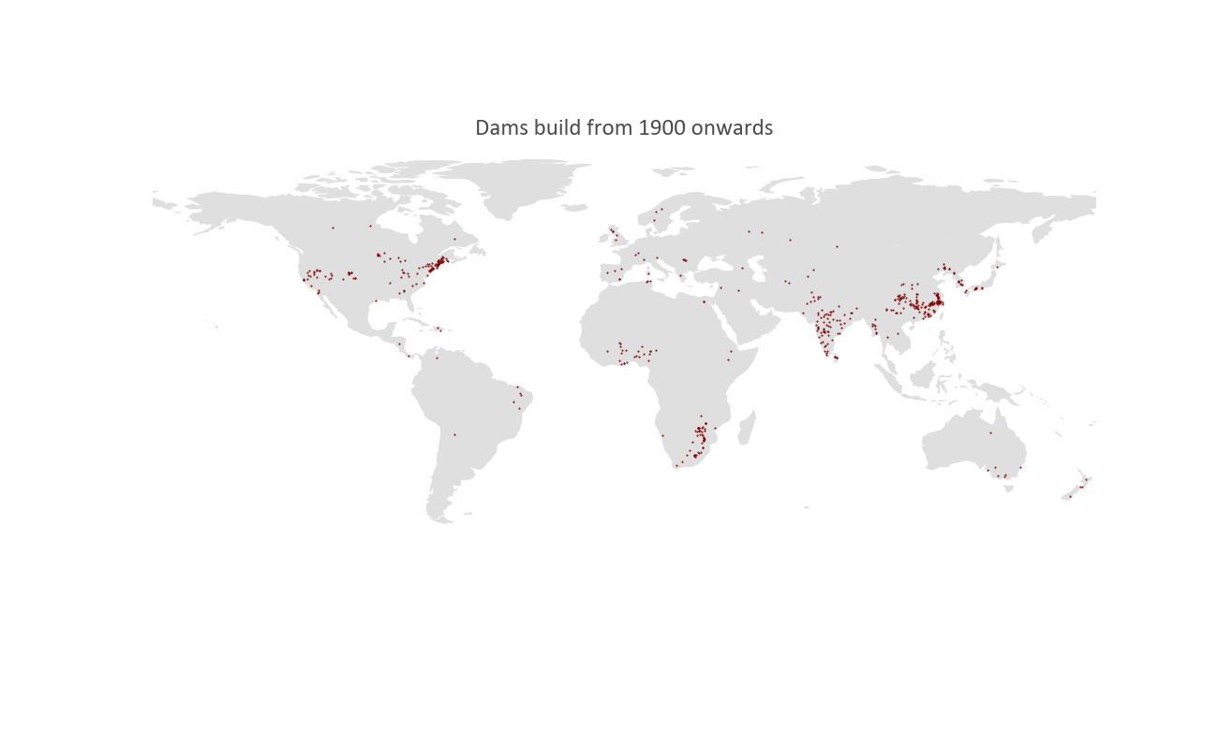
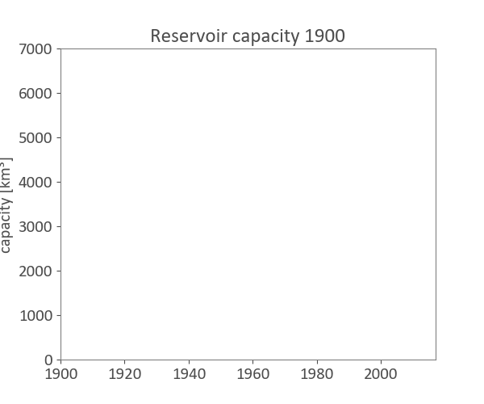
Reservoir construction started to boom in the 1950s
45 000 large dams (> 0.1 km²) build
Based on GRanD data
Notes:
In the past humans have build many of these dam structures (45 000), forming artificial lakes which we know as reservoirs.
Especially during the 20th century,
Large dams: reservoir area > 0.1km²
Increasing capacity: increasing lake area: how is that impacting the climate?
45 000 large dams globally > 0.1km²
Difference between dams and reservoirs!!
Over the 20th century: many dams have been build
This dynamic land use change and the effects on runoff are not yet modelled in present day LSM
Hardly anything is known about the impact of reservoirs on the climate on a global scale.
To quantify this, it is necessary to include reservoirs and their role in an Earth System modeling framework.

Slide 3
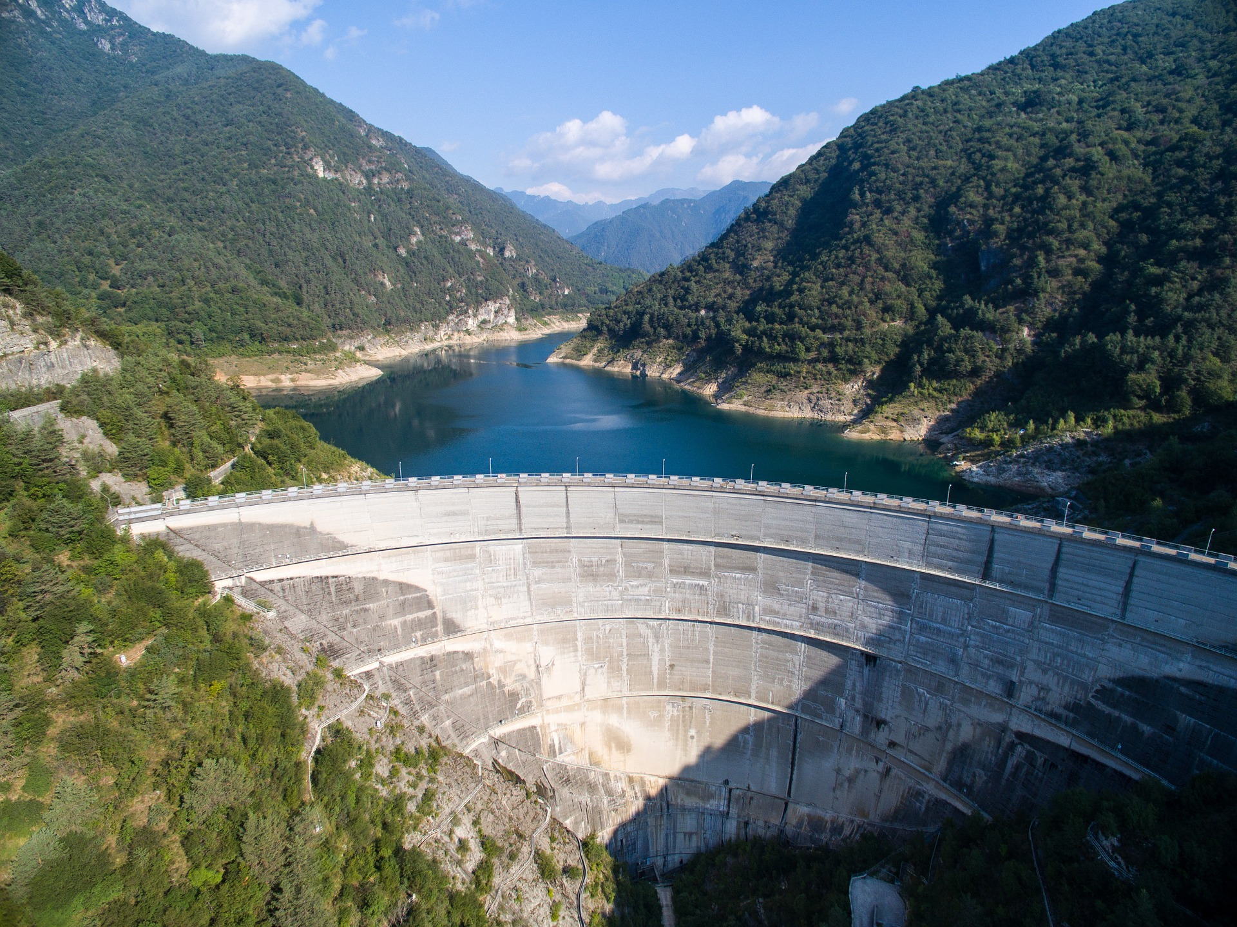
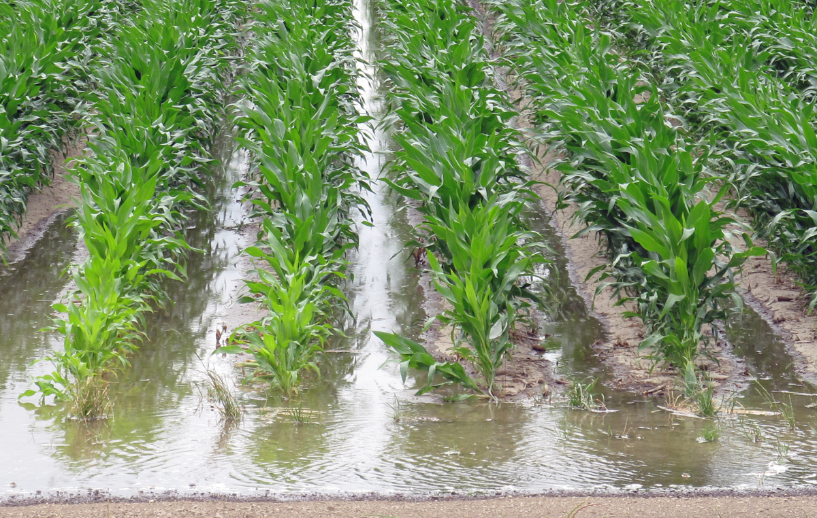
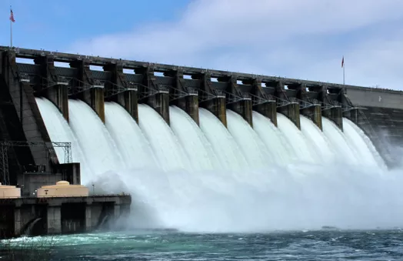
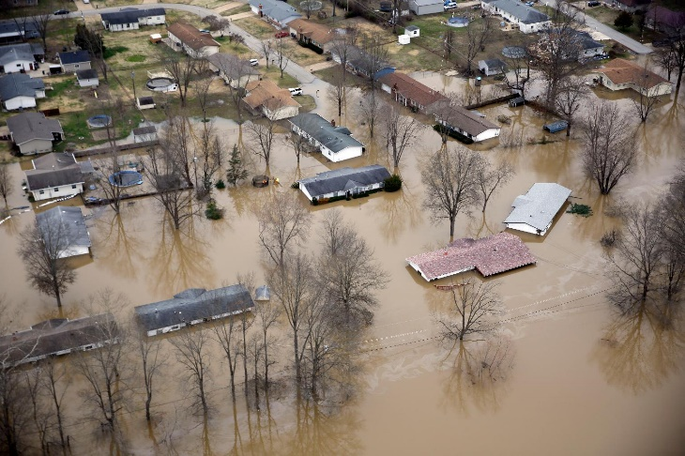
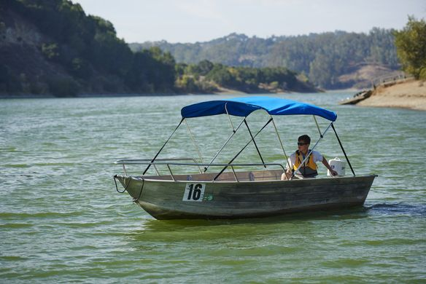
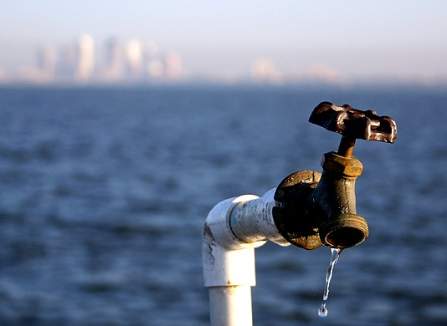
The role of reservoirs
Impound 17% of annual continental discharge
Reduce global sea level with ~30 mm
Cover 9% of global lake area
Irrigation
Hydropower
Flood control
Navigation and recreation
Water supply
How are reservoirs impacting the global climate?
What is the effect of global lake area expansion in the 20th century? How can reservoirs be represented in a LSM (Community Land Model)
Notes:
These reservoirs serve different purposes:
Seen this question, the bigger question on how reservoirs are impacting global climate is yet to be answered.
This is the question which I, (and my name is Inne Vanderkelen) am tackling in my PhD at the Free University of Brussels.
To this extent I am using The Community Land model – CLM
Today I will tackle two subquestions

Slide 4
Represent reservoirs in CLM Choose Input data
Implement dynamical lakes in CLM Conserve water and energy
Look at global effects
Preliminary results
Notes:
Review: go over points

Slide 5
Represent reservoirs in CLM Choose Input data
Implement dynamical lakes in CLM Conserve water and energy
Look at global effects
Preliminary results
Notes:
Here I have a brief overview of the things I will handle today.

Slide 6
Represent reservoirs in CLM Choose Input data
Implement dynamical lakes in CLM Conserve water and energy
Look at global effects
Preliminary results
Notes:
Review: go over points

Slide 7
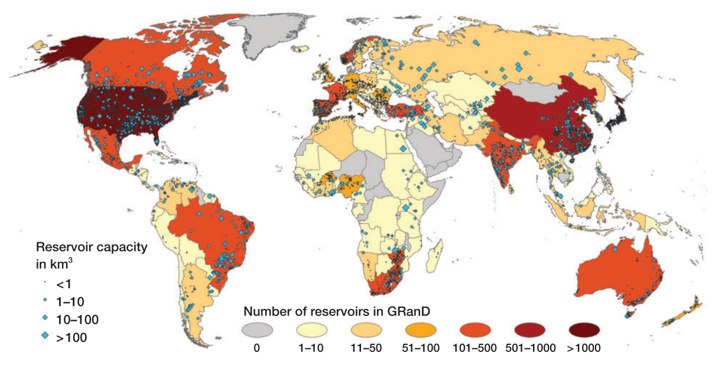
The Global Reservoir and Dam (GRanD) Database includes information of reservoirs > 0.1 km²
Lehner et al, 2011
Notes:
One of the only
>6000 attributes
Metadata: year of construction, purpose of the dam, …

Slide 8
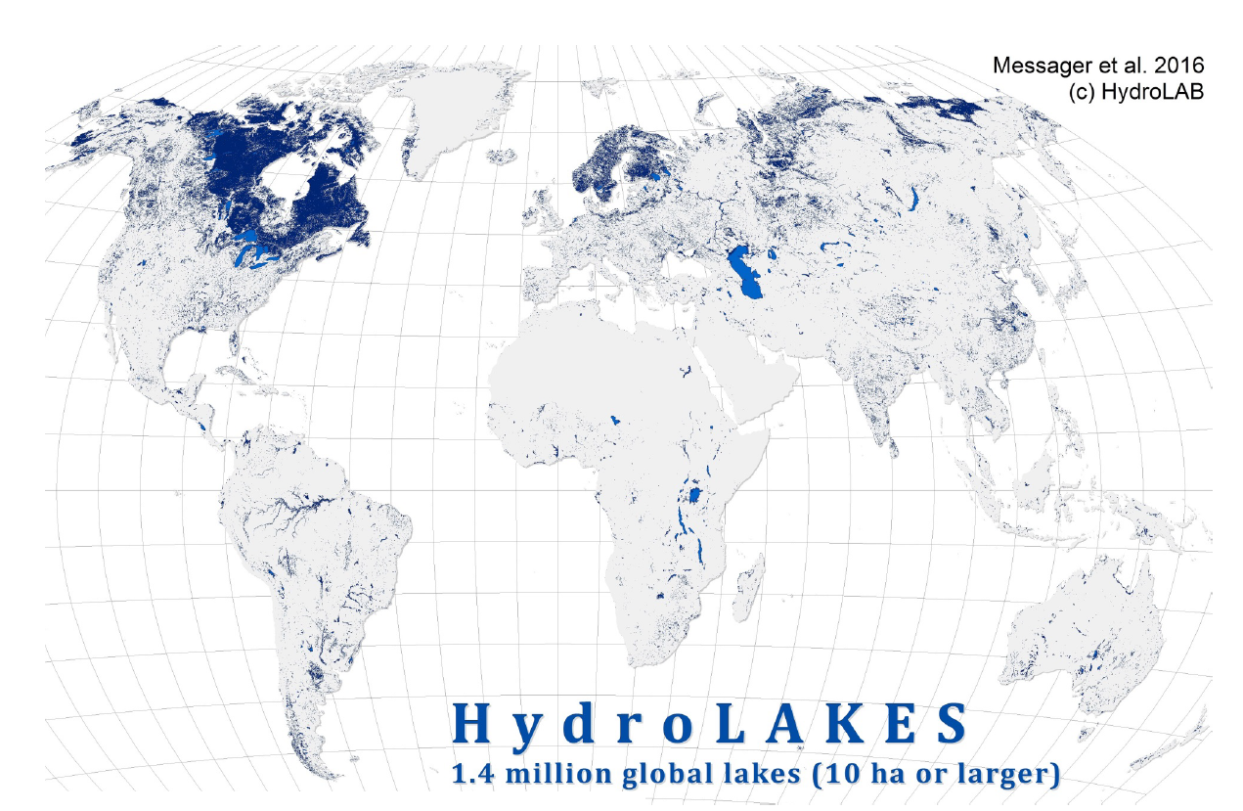
The HydroLAKES database exists of lake polygons with attributes and is linked to GRanD
Messager et al, 2016
Notes:
Lake polygons various sources

Slide 9
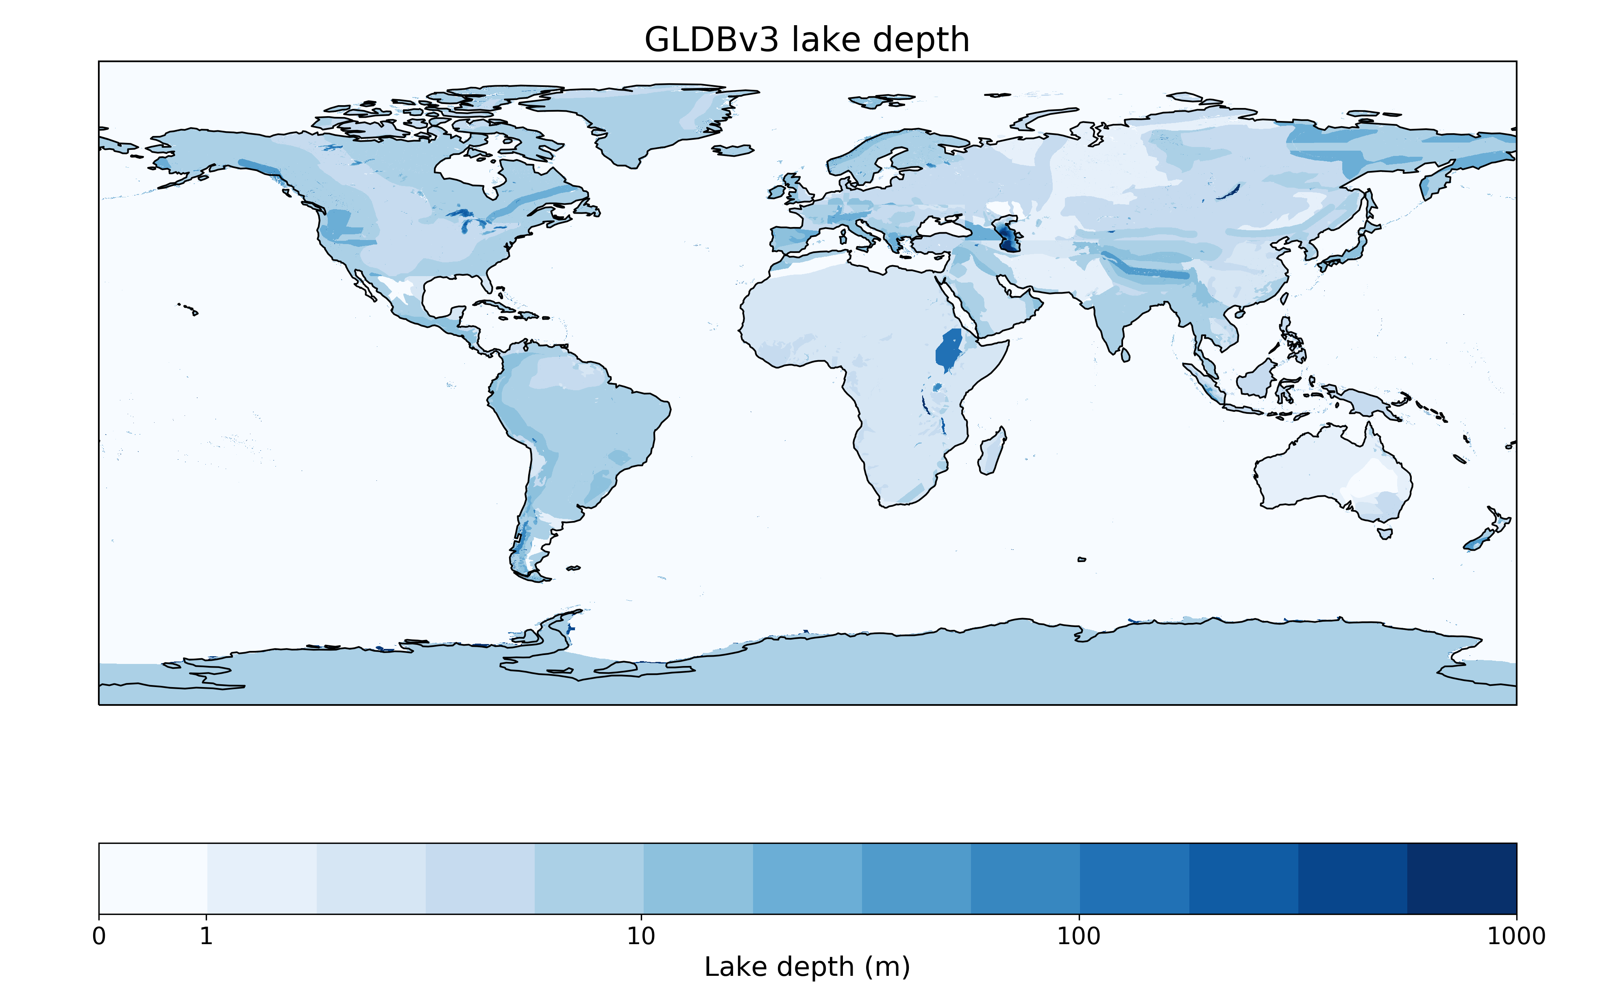
The Global Lake DataBase (GLDB) exists of gridded lake depth and occurrence at 1 km resolution
Choulga et al, 2014
Notes:
Give Margarita and Katharina credit. Insitu data and ECOCLIMAP
Rasterized. Large lakes: bathymetry
Also includes rivers!

Slide 10
Compare HydroLAKES and GLDB
HydroLAKES
Linked to GRanD
Separate lake polygons
Linked with stream network
Lake depth per lake
GLDB
Includes large rivers and depths
Potential lake depths everywhere
Lake bathymetry for large lakes
Land-sea mask
Notes:
They are inherently differen
But GRanD: no good depths for reservoirs (been checked with GRanD)

Slide 11
Compare HydroLAKES and GLDB
HydroLAKES
Linked to GRanD
Separate lake polygons
Linked with stream network
Lake depth per lake
GLDB
Includes large rivers and depths
Potential lake depths everywhere
Lake bathymetry for large lakes
Land-sea mask
Notes:
They are inherently differen
But GRanD: no good depths for reservoirs (been checked with GRanD)

Slide 12
Compare HydroLAKES and GLDB
HydroLAKES
Linked to GRanD
Separate lake polygons
Linked with stream network
Lake depth per lake
GLDB
Includes large rivers and depths
Potential lake depths everywhere
Lake bathymetry for large lakes
Land-sea mask
Notes:
They are inherently differen
But GRanD: no good depths for reservoirs (been checked with GRanD)

Slide 13
Compare HydroLAKES and GLDB
HydroLAKES
Linked to GRanD
Separate lake polygons
Linked with stream network
Lake depth per lake
GLDB
Includes large rivers and depths
Potential lake depths everywhere
Lake bathymetry for large lakes
Land-sea mask
Choose HydroLAKES based on consistency with GRanD and polygons for routing
Notes:
They are inherently different
But GRanD: no good depths for reservoirs (been checked with GRanD)
For now, stay consistent with depth. But sensitivity experiments? Or new version of GLDB with reservoirs depth included?

Slide 14
CLM input data: lake cover based on HydroLAKES and GRanD per year
Distinction between dammed natural lakes and artificial reservoirs
Notes:
To use as CLM input data, the polygons needed to be rasterized: to 0.05 grid.
As we want the change in lake area: annual input files are fed into CLM: distinction between natural lakes and reservoirs.

Slide 15
Represent reservoirs in CLM Choose Input data
Implement dynamical lakes in CLM Conserve water and energy
Look at global effects
Preliminary results
Notes:
Review: go over points

Slide 16
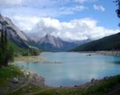
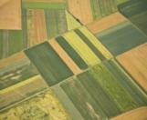
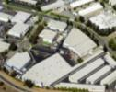
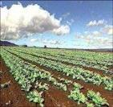
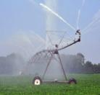
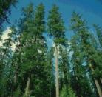
CLM includes subgrid heterogeneity
Gridcell
Landunit
TBD
HD
Vegetated
Lake
MD
Glacier
Crop
Urban
Column
Roof
Shade
Wall
Impervious
Soil
Sun Wall
Pervious
Elevation classes
Unirrig
Irrig
Unirrig
Irrig
Patch
PFT1
PFT2
PFT3
PFT4 …
Crop1
Crop1
Crop2
Crop2 …
Courtesy: Dave Lawrence
Notes:
Example how complex everything is in CLM.
Phisics, processes happen at certain levels, aggregated into grid cell. Tiling.
Conservation of mass at every level.
Capture subgrid heterogeneities. First level: Land unit (vegetation, lakes, urban, … : capture broadest patterns of subgrid heterogeneity. Column: possible variability between soil and snow state variables within single land unit. Independent evolving vertical profiles of soil water and temperature. One soil column divided in different layers. -> where state variables for soil and snow are defined.
Lake and vegetation: only 1 column.
Patch level: different PFTs (CFTs): capture biogeophysical and chemical differences between broad categories of plants.

Slide 17
CLM includes subgrid heterogeneity
Gridcell
Landunit
TBD
HD
Vegetated
Lake
MD
Glacier
Crop
Urban
Notes:
Last time I was here, I got the question on how effects of reservoirs will be visible: well, here is (part of) the answer;
Gridcell, classically, +-2°?
Phisics, processes happen at certain levels, aggregated into grid cell.
Conservation of mass at every level.
Capture subgrid heterogeneities. First level: Land unit (vegetation, lakes, urban, … : capture broadest patterns of subgrid heterogeneity. Column: possible variability between soil and snow state variables within single land unit. Independent evolving vertical profiles of soil water and temperature. One soil column divided in different layers. -> where state variables for soil and snow are defined.
Lake and vegetation: only 1 column.
Patch level: different PFTs (CFTs): capture biogeophysical and chemical differences between broad categories of plants.

Slide 18
CLM includes lakes
Gridcell
Landunit
TBD
HD
Vegetated
Lake
MD
Glacier
Crop
Urban
Notes:
Where we only interested in are lakes

Slide 19
CLM includes lakes
Gridcell
Landunit
TBD
HD
Vegetated
Lake
MD
Glacier
Crop
Urban
Lake column
snow
Lake water
Saturated soil
Bedrock
Notes:
Just one lake modelled Hostetler model by LISS and modified by Zack Subin.

Slide 20
CLM includes lakes
Gridcell
Landunit
TBD
HD
Vegetated
Lake
MD
Glacier
Crop
Urban
Lake column
Precip
Evap
Runoff
Lake water
Constant depth
Saturated soil
snow
soil
Bedrock
Notes:
Last time I was here, I got the question on how effects of reservoirs will be visible: well, here is (part of) the answer;
Gridcell, classically, +-2°?
Phisics, processes happen at certain levels, aggregated into grid cell.
Conservation of mass at every level.
Capture subgrid heterogeneities. First level: Land unit (vegetation, lakes, urban, … : capture broadest patterns of subgrid heterogeneity. Column: possible variability between soil and snow state variables within single land unit. Independent evolving vertical profiles of soil water and temperature. One soil column divided in different layers. -> where state variables for soil and snow are defined.
Lake and vegetation: only 1 column.
Patch level: different PFTs (CFTs): capture biogeophysical and chemical differences between broad categories of plants.

Slide 21
Land units are dynamic
Vegetation
Lake
Vegetation
Lake
Glacier
Crop
Glacier
Crop
Urban
Urban
Notes:
Every year: first day of year: land use change prescribed.
Describe that every year land use change in prescribed and gets into effect the first day of the year.

Slide 22
Land units are dynamic but not all of them
Vegetation
Lake
Vegetation
Lake
Glacier
Crop
Glacier
Crop
Urban
Urban
To account for reservoir construction Make lake land unit dynamic
Lake
Vegetation
Lake
Vegetation
Glacier
Glacier
Crop
Crop
Urban
Urban

Slide 23
Correction fluxes are used to maintain conservation after land use change by balancing out the heat and water deficit
Water Energy
correction fluxes
Vegetation
Lake
Vegetation
Lake
Glacier
Crop
Glacier
Crop
Urban
Urban
Water Content 1
≠
Water Content 2
Heat Content 1
≠
Heat Content 2
Notes:
Correction fluxes: dribbled over the whole year.
Artificial fluxes into or out the atmosphere
Energy as sensible heat and water as runoff, both ice and water.

Slide 24
Correction fluxes needed to account for lake water and heat Especially as lake both warms and expands
Baseline state
Lake expanded
Lake warmed
Lake shrunk
Lake cooled
90% Veg
10°C
80% Veg
10°C
80% Veg
10°C
90% Veg
10°C
90% Veg
10°C
20% Lake
20°C
from atm: + 0.2*5° C
20% Lake
25°C
to atm: - 0.1*5° C
10% Lake
20°C
10% Lake
25°C
10% Lake
20°C
+0.2*5 °C– 0.1*5 °C= 0.5 We have created 0.5 units of heat
Notes:
And this is also the case for lakes, as I am going to demonstrate with the following example.
Example fictive problem
Growing lake area -> energy & water added. But if it doesn’t interact (change in volume or temperature) -> nothing to worry about.

Slide 25
Correction fluxes needed to account for lake water and heat Especially as lake both warms and expands
Baseline state
Lake expanded
Lake warmed
Lake shrunk
Lake cooled
90% Veg
10°C
80% Veg
10°C
80% Veg
10°C
90% Veg
10°C
90% Veg
10°C
E flux + 0.1*20°C
20% Lake
20°C
from atm: + 0.2*5°C
20% Lake
25°C
E flux: -0.1*25°C
to atm: - 0.1*5°C
10% Lake
20°C
10% Lake
25°C
10% Lake
20°C
+0.1*20°C+0.2*5°C – 0.1*25°C– 0.1*5°C = 0 Energy is conserved
Notes:
Statement of the problem
Growing lake area -> energy & water added. But if it doesn’t interact (change in volume or temperature) -> nothing to worry about.

Slide 26
Subtracting baselines minimize the correction fluxes needed Baselines are the beginning state variables
Reference state
90% Veg
10°C
10% Lake
20°C
Baseline state
Lake expanded
Lake warmed
Lake shrunk
Lake cooled
90% Veg
0°C
80% Veg
0°C
80% Veg
0°C
90% Veg
0°C
90% Veg
0°C
E flux + 0
20% Lake
0°C
from atm: + 0.2*5°C
20% Lake
5°C
E flux: -0.1*5°C
to atm: - 0.1*5°C
10% Lake
0°C
10% Lake
5°C
10% Lake
0°C
+0.2*5°C – 0.1*5°C– 0.1*5°C = 0 Energy is conserved Correction fluxes are much smaller
Same principle for water and ice
Notes:
Calculate anomalies compared to the baseline.
Growing lake area -> energy & water added. But if it doesn’t interact (change in volume or temperature) -> nothing to worry about.

Slide 27
Represent reservoirs in CLM Choose Input data
Implement dynamical lakes in CLM Conserve water and energy
Look at global effects
Preliminary results
Notes:
Review: go over points

Slide 28
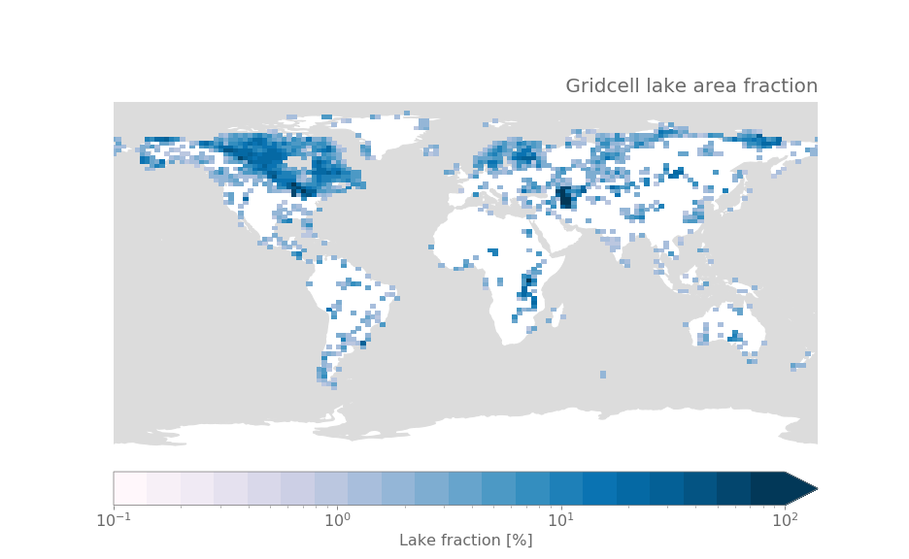
Preliminary results Lake area fraction
CLM Land-only
1.9 x 2.5 °
1900 – 2000
RES: dynamic lake area changes
CTL: lake area constant at 1900
Notes:
Still in test phase, so reduce computation cost.

Slide 29
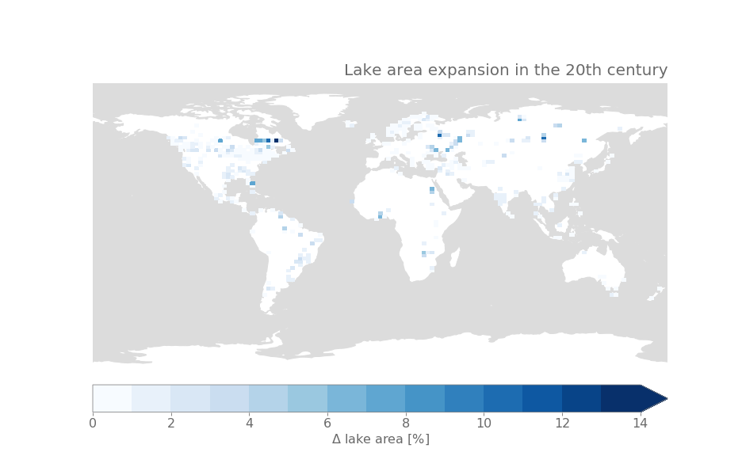
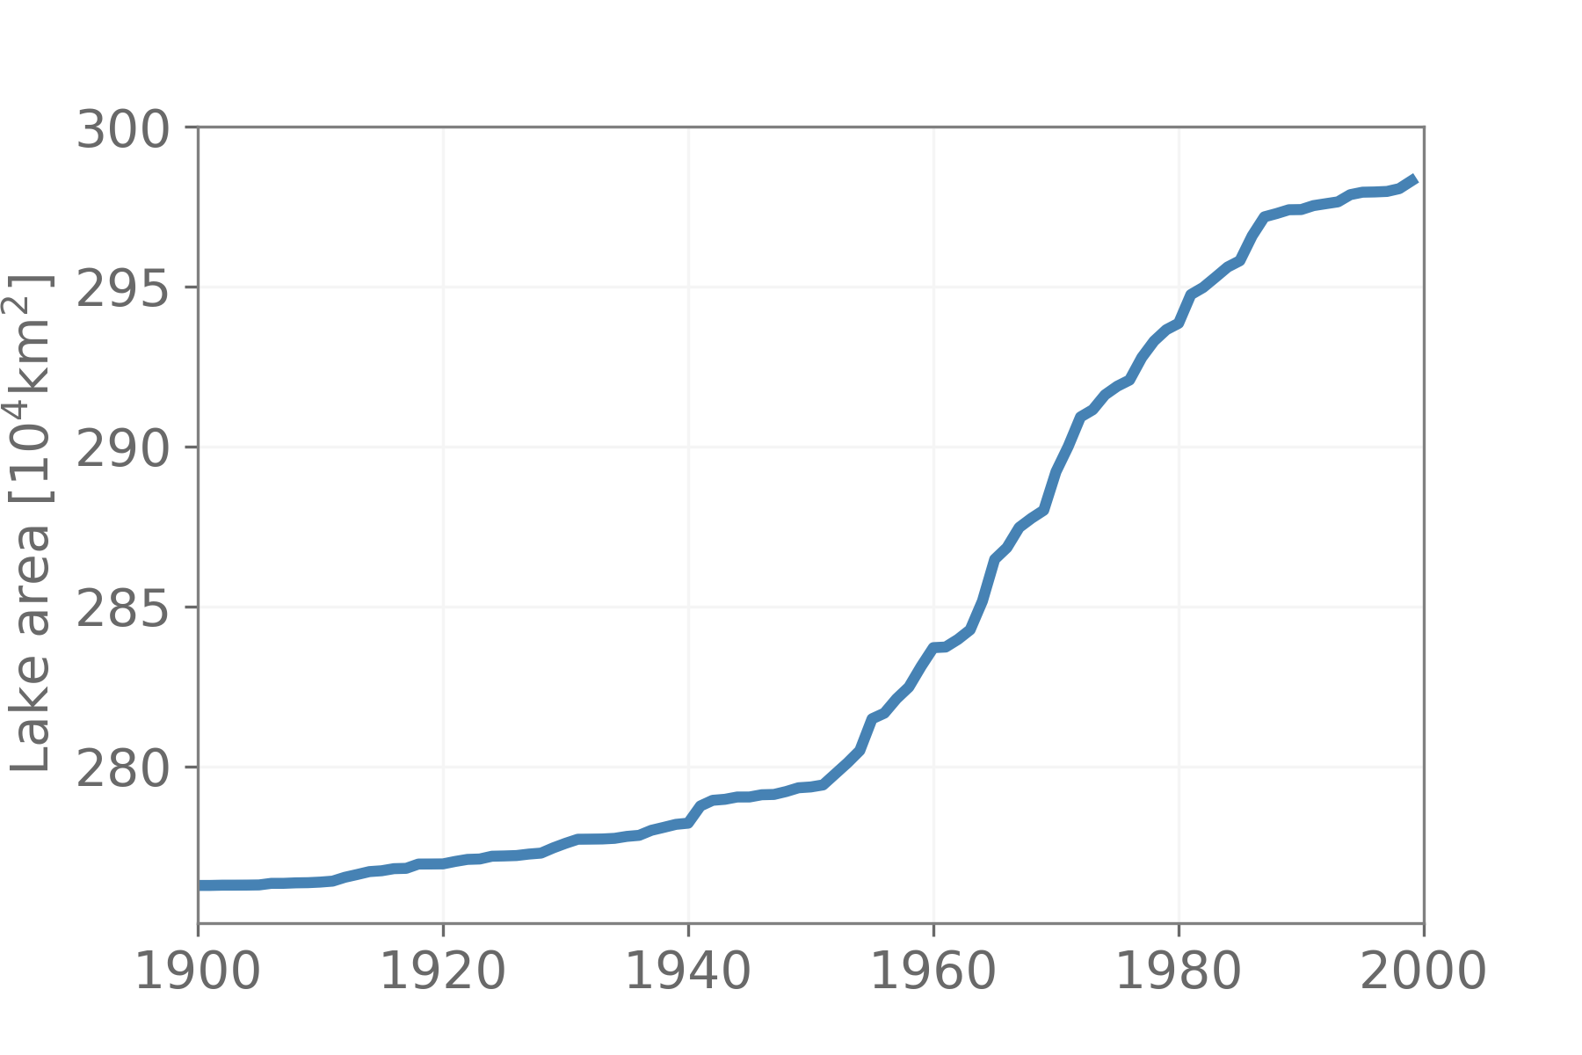
Lake area increases with 8% over the 20th century
CLM Land-only
1.9 x 2.5 °
1900 – 2000
RES: dynamic lake area changes
CTL: lake area constant at 1900

Slide 30
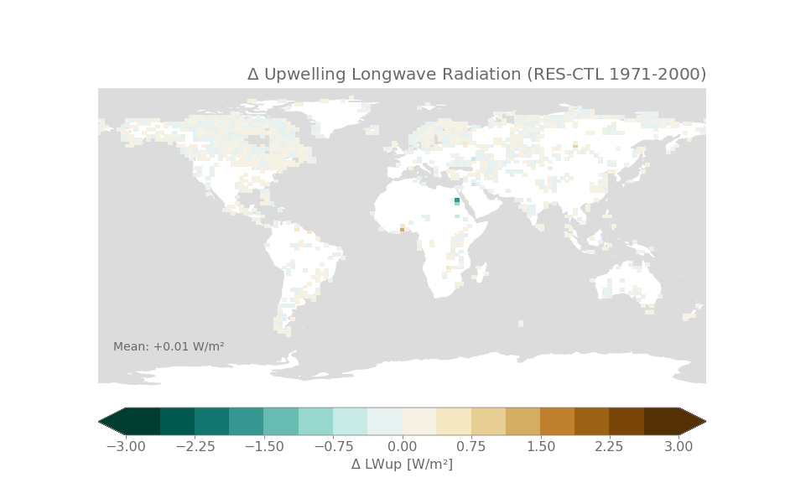
Effects on radiation
CLM Land-only
1.9 x 2.5 °
1900 – 2000
RES: dynamic lake area changes
CTL: lake area constant at 1900
Notes:
Offline: so no cloud feedbacks: incoming longwave and shortwave are the same.
Upwelling longwave; reflecting a change in surface temperature:
Shortwave: showing changes in reflection -> changes in albedo. As expected: increasing lake area: decrease in SW up (decrease in albedo).
Netto the effect of increasing net Radiation available.
Very localized: normal as land only run!

Slide 31
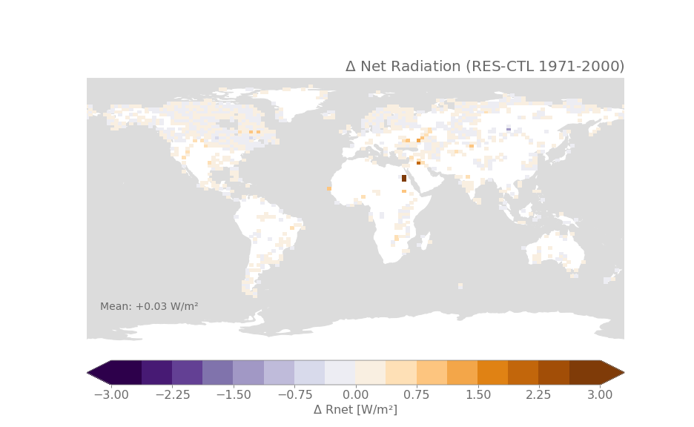
Effects on radiation show local increases in Net Radiation
CLM Land-only
1.9 x 2.5 °
1900 – 2000
RES: dynamic lake area changes
CTL: lake area constant at 1900

Slide 32
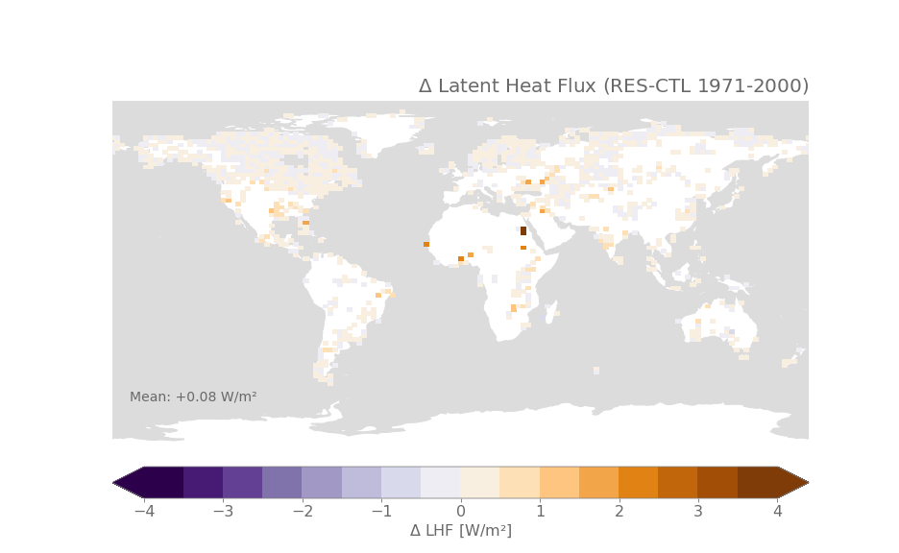
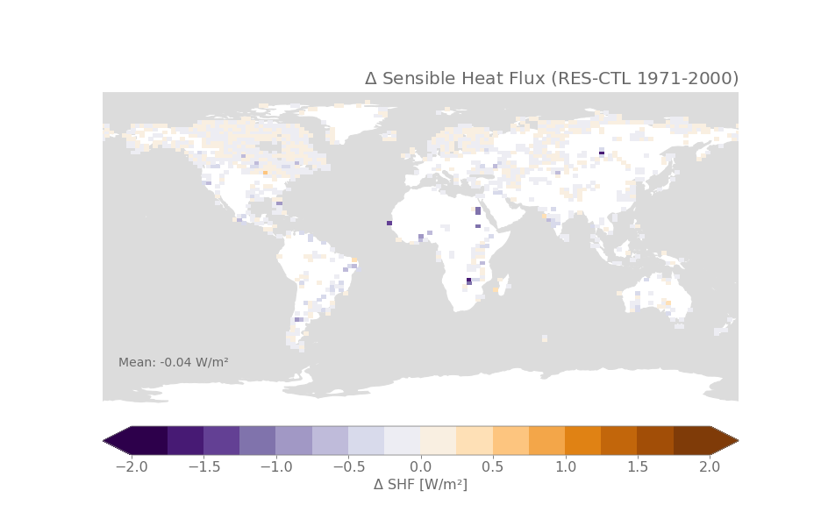
Effects on surface energy fluxes show increase in LHF and decrease in SHF
Notes:
Net radiation is available to feed the surface energy fluxes
Localised increase in reservoir grid cells of latent heat flux: like expected: increasing lake area: more water available for evaporation.
Increase of latent heat seems to be at the cost of sensible heat: overall decrease.
Consolidate theories here: do Energy balance decomposition.

Slide 33
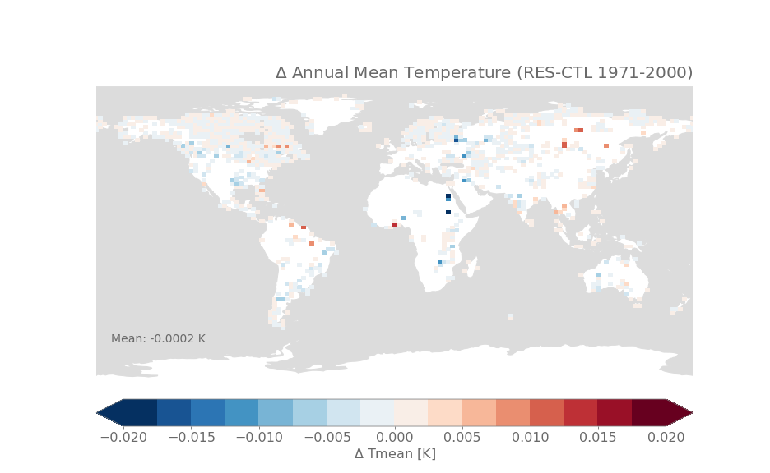
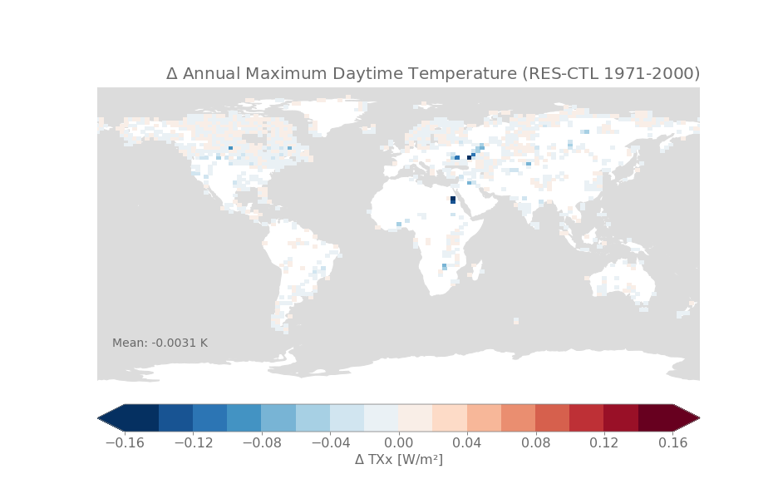
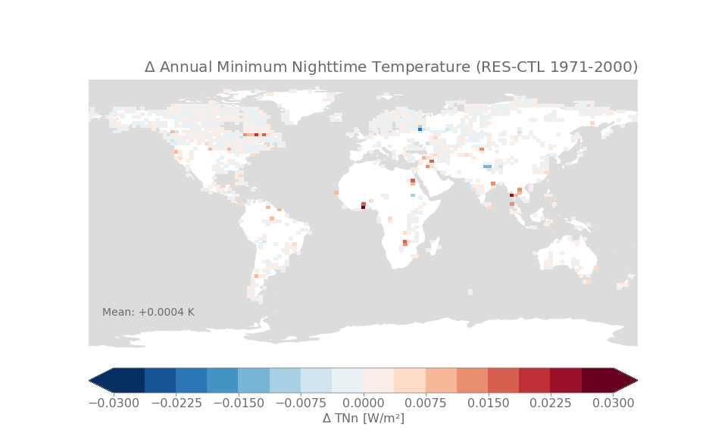
Effects on temperature dampen extremes, largest for hot extreme
Notes:
Finally first look at temperatures:
Annual mean: changes are very small. Both positive and strongly negative.
Effects larger for annual maximum daytime temperature: decrease -> reservoirs tend to cool hot extremes.
Warming effect on minimum temperature (larger heat capacity).
Local dampening of extreme temperatures. µ
A more detailed look is required!

Slide 34
Represent reservoirs in CLM Choose Input data
Implement dynamical lakes in CLM Conserve water and energy
Look at global effects
Preliminary results
Notes:
Review: go over points

Slide 35
Represent reservoirs in CLM Choose Input data
Implement dynamical lakes in CLM Conserve water and energy
Look at global effects
Preliminary results
Reservoirs, lake area and depths from GRanD and HydroLAKES
Notes:
Review: go over points

Slide 36
Represent reservoirs in CLM Choose Input data
Implement dynamical lakes in CLM Conserve water and energy
Look at global effects
Preliminary results
Reservoirs, lake area and depths from GRanD and HydroLAKES
Water and Energy conserved with baselines and dynbal fluxes
Notes:
Review: go over points

Slide 37
Represent reservoirs in CLM Choose Input data
Implement dynamical lakes in CLM Conserve water and energy
Look at global effects
Preliminary results
Reservoirs, lake area and depths from GRanD and HydroLAKES
Water and Energy conserved with baselines and dynbal fluxes
Reservoir effects localized & small
higher LHF, dampen T extremes
Notes:
Review: go over points

Slide 38
Next steps
Deploy coupled atmosphere – land simulations at 0.9°x1.25° resolution
To fully account for all the feedbacks
Perform model evaluation To see whether transient lake area improves the skill of CLM
Implement reservoir management rules in routing model
To simulate effect on river discharge and improve river runoff
Notes:
To consolidate: these first findings: looking in more detail: seasonal and diurnal cycle, higher resolution and coupled simulations

Slide 39
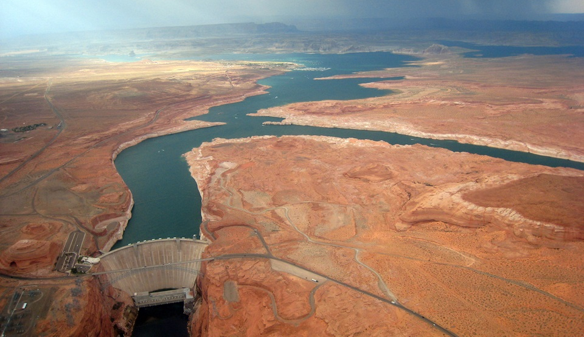
THANK YOU
Inne.Vanderkelen@vub.be
Picture: Glen Canyon Dam Adaptive Management Program

Slide 40
Extra slides

Slide 41
Subtracting baselines minimize the needed correction fluxes Illustrated with heat correction fluxes for two lakes
 | Nasser Reservoir (Egypt & Sudan) |  | Khantayskoye Reservoir (Russia)
Δ lake % | + 5 % |  | + 6 %
 | No Baselines | Baselines | No Baselines | Baselines
Heat correction flux (W/m²) | -0.93 | 0.48 | 0.78 | 0.53
% of Sensible Heat Flux | 3 % | 1% | 5% | 3%
Water correction flux (m/year) | 0.67 | 0.14 | 0.66 | 0.07
% of runoff | 670 % | 140 % | 244 % | 26 %
Notes:
Year in which the maximum lake extent changes.
- Heat correction flux small (
Baslines: possible underestimation -> only 2 year simulation: no time to deviate already a lot.
More fair: look at global dynbal fluxes of 100 year simulation.

Slide 42
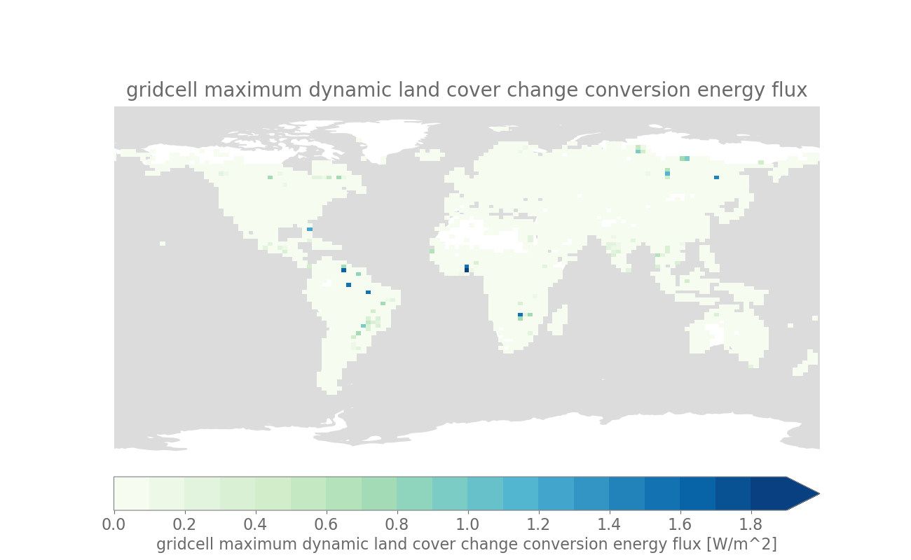
Global maximal correction fluxes After a 100-year 2° simulation
Energy
Correction flux | Global maximum
Energy | 2.6 W/m²
Liquid water | 0.32 m/year
Ice | 0.03 m/year
Liquid
Ice
Notes:
Only applied one year, so considered ok. Not violating too much.
(but important to keep in mind?)

Slide 43
 | HydroLAKES | GLDB v3 (+) (v1 originally used in CLM)
Format | Lake polygons (1 427 688 lakes > 0.1 km²) | Raster (lake percent; 1 km)
Data source | CanVec, SRTM SWBD, GLWD, NHD, ECRINS, manual mapping | in situ info 14 960 lakes (depth), lake coverage from ECOCLIMAP2; in v3 updated with JRC Global Surface Water Explorer (GSWE)
Rivers | No rivers | Yes (distinguish between lake/river type by ECOCLIMAP2)
Scale/resolution | general 1:250000 | 1 km
Lake depths | estimated by prediction model with topography; Lakes > 500km² from literature 1 value per lake | in situ info about 14 960 lakes, indirect estimates based on geology for every grid cell bathymetry (for large lakes?)
Reference | Messager et al., 2016 | Choulga et al., 2014 (v2)
Other | Coupled with GRanD | Used in many climate models (ECMWF, HIRLAM)

Slide 45
Sea of Azov (not in HydroLAKES, could be due to land-sea masking)
Aral Sea (not in GLDBv3)
Lena river (not in HydroLAKES)
Lake Chad (not in GLDB v3)
Congo river (not in HydroLAKES)
Amazone (not in HydroLAKES)

Slide 46
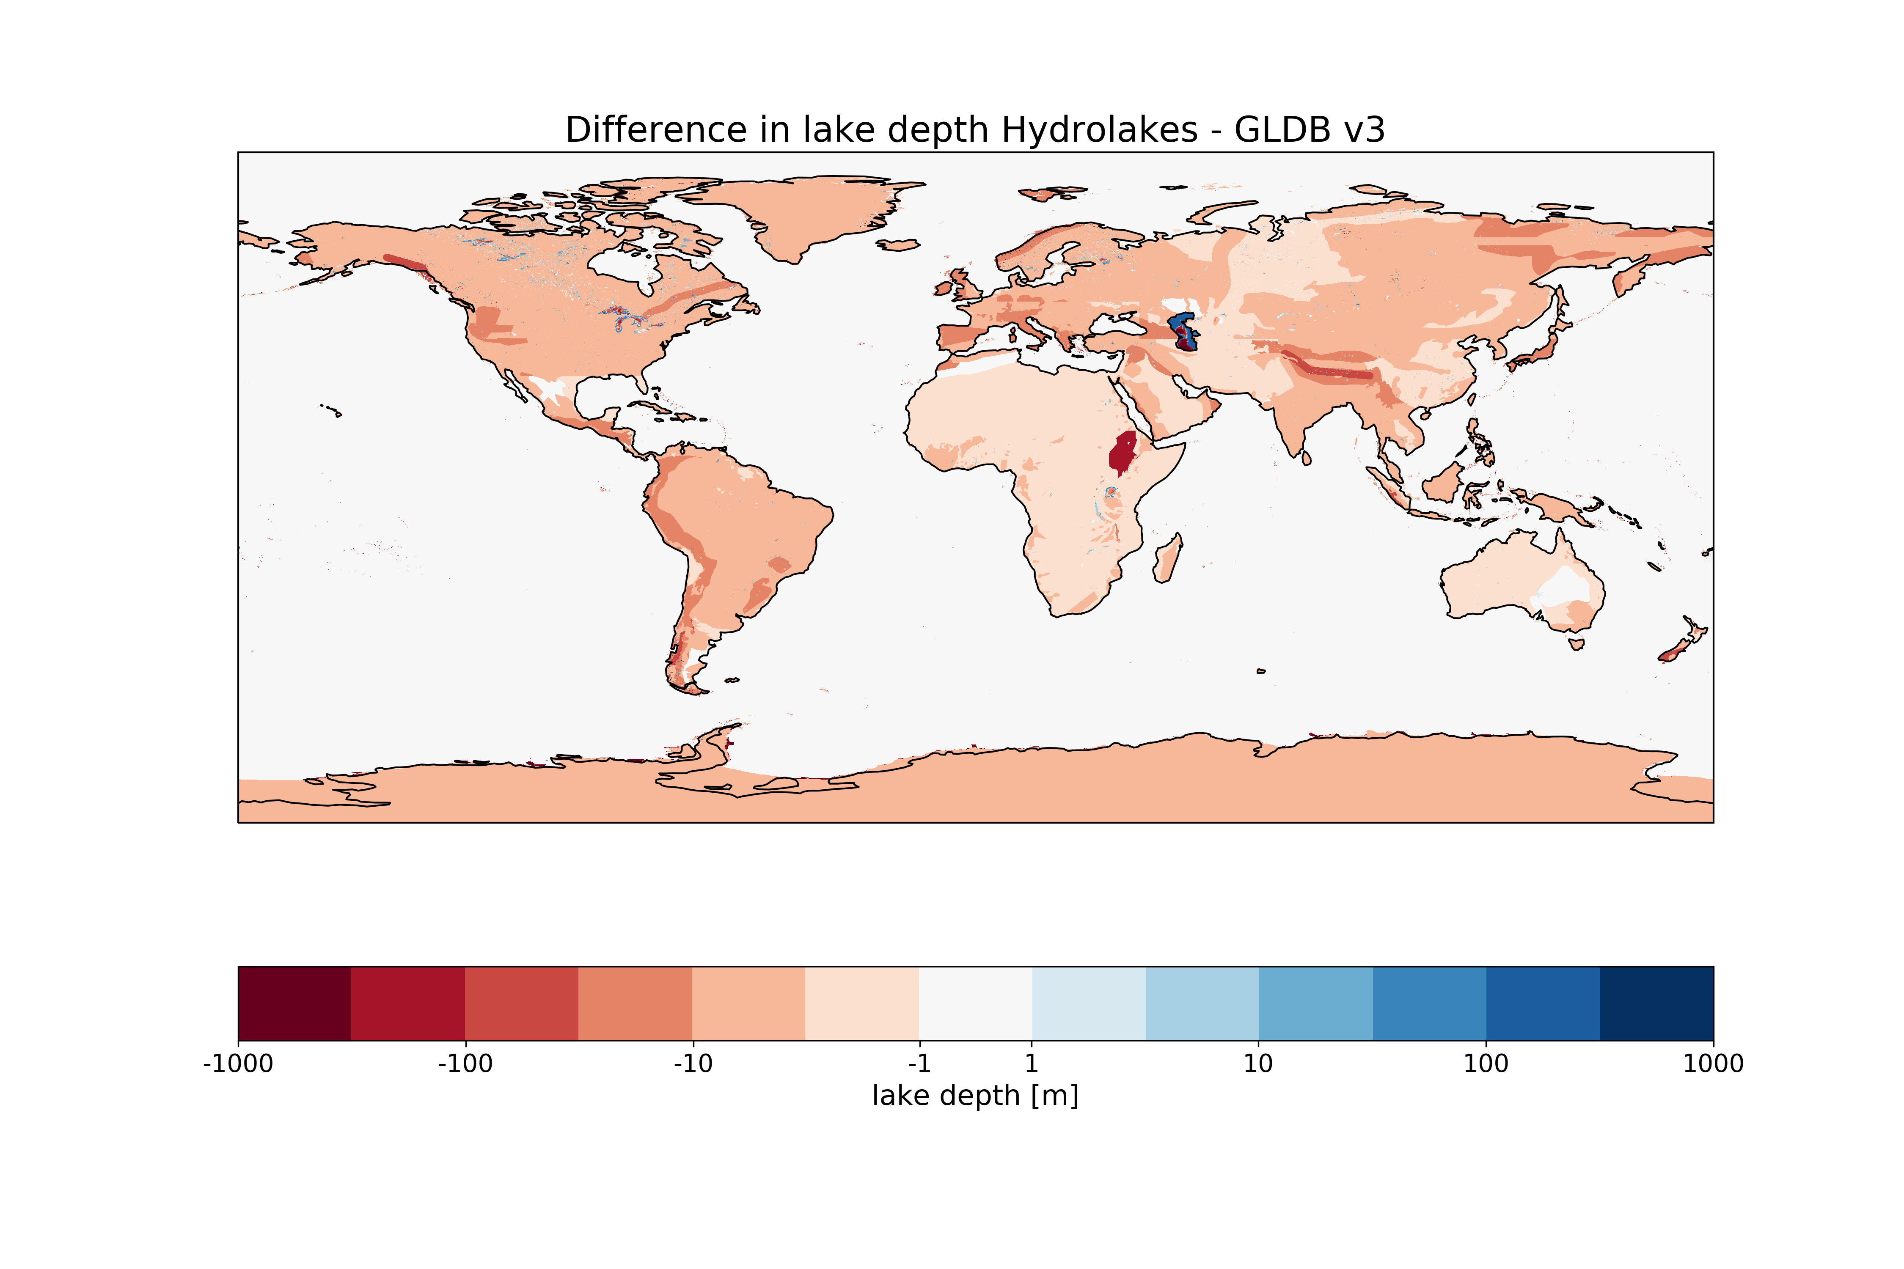

Slide 47
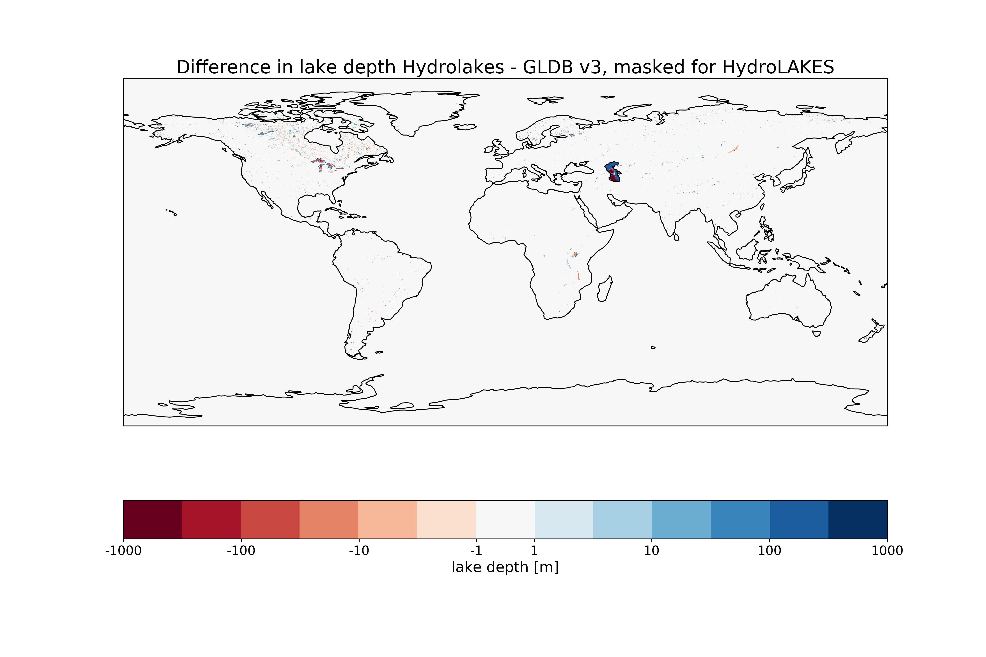

Slide 48
Gridcell dynamical land use: energy conservation* Mass conservation for lake water is not an issue, as lake water is virtual and doesn’t interact with the atmosphere (fixed depth)
CASE 1
Baseline state
Lake expanded
→ no dynbal fluxes needed (no interaction with atmosphere, lake nor vegetation have gained energy from/to atmosphere)
BUT: lake itself has gained energy (0.1*20°C)
But virtual state, so doesn’t matter!
90% Veg
10°C
80% Veg
10°C
10% Lake
20°C
20% Lake
20°C
CASE 2
Baseline state
Lake expanded
Lake warmed
Lake shrunk
Lake cooled
90% Veg
10°C
80% Veg
10°C
80% Veg
10°C
90% Veg
10°C
90% Veg
10°C
20% Lake
20°C
from atm: + 0,2*5°C
20% Lake
25°C
to atm: - 0,1*5°C
10% Lake
20°C
10% Lake
25°C
10% Lake
20°C
+0.2*5 - 0.1 *5 = 0.5 → We have created 0.5 units of heat
→ dynbal fluxes are needed: if lake warms/cools AND expands/shrinks
Courtesy example: Bill Sacks

Slide 49
Solution with dynbal fluxes only
Baseline state
Lake expanded
Lake warmed
Lake shrunk
Lake cooled
90% Veg
10°C
80% Veg
10°C
80% Veg
10°C
90% Veg
10°C
90% Veg
10°C
Eflx dynbal: + 1
from atm: 0,2*5°C = + 1
Eflx dynbal: -1.5
to atm: 0,1*5°C = - 0.5
10% Lake
20°C
20% Lake
20°C
20% Lake
25°C
10% Lake
25°C
10% Lake
20°C
Difference in grid cell total heat content: (0.8*10°C + 0.2*20°C) - (0.8*10°C + 0.2*20°C) = +1
Difference in grid cell total heat content: (0.9*10°C + 0.1*25°C) - (0.8*10°C + 0.2*25°C) = -1.5
+1 +1 -1.5 -0.5 = 0 → energy is conserved!
Solution with baselines and dynbal fluxes
Baseline state
Lake expanded
Lake warmed
Lake shrunk
Lake cooled
90% Veg
0°C*
80% Veg
0°C
80% Veg
0°C
90% Veg
0°C
90% Veg
0°C
Eflx dynbal: 0
from atm: 0,2*5°C = + 1
Eflx dynbal: -0.5
to atm: 0,1*5°C = - 0.5
10% Lake
0°C*
20% Lake
0°C
20% Lake
5°C
10% Lake
5°C
10% Lake
0°C
Difference in grid cell total heat content: 0.1*5°C - 0.2*5°C = -0.5
* Compared to baseline
0 +1 -0.5 -0.5 = 0 → energy is conserved + dynbal fluxes are smaller!
90% Veg
10°C
Baseline substracted
Courtesy example: Bill Sacks
10% Lake
20°C

Slide 50
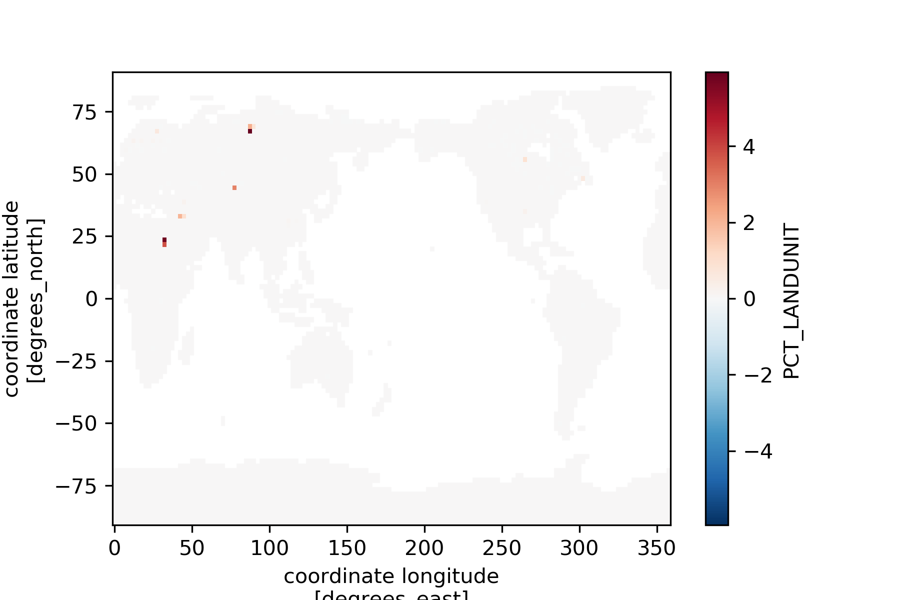
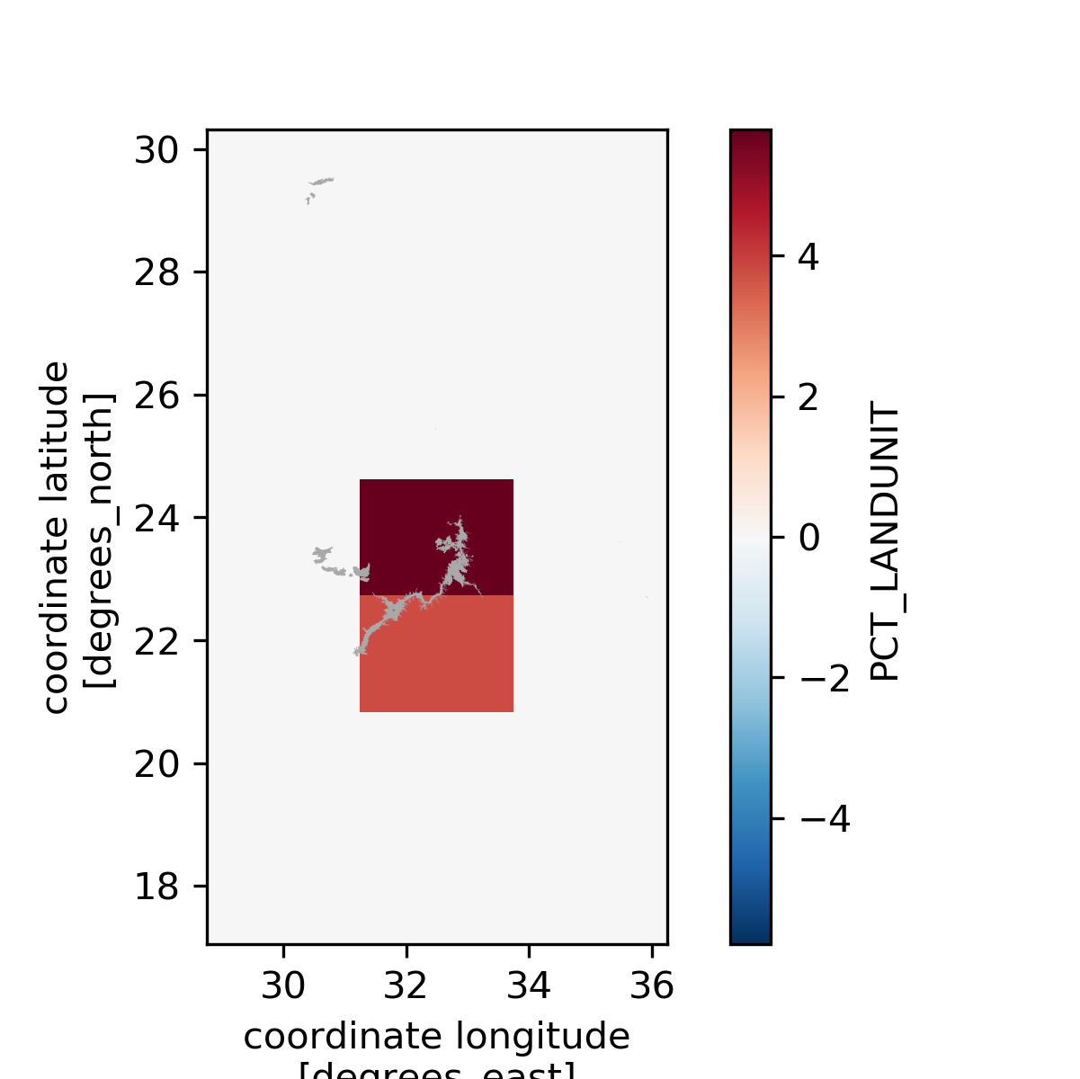
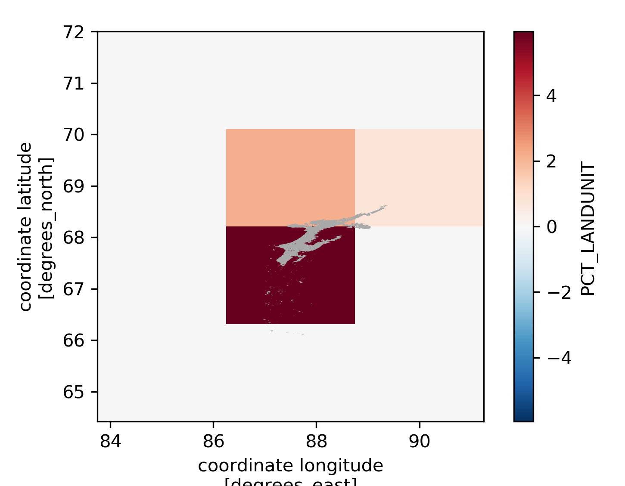
Reservoirs constructed in 1970 (added lake fraction)
Khantayskoye Reservoir (Russia)
Lake Nasser (Aswan Dam)
%
 | Lake Nasser (Egypt) | Khantayskoye Reservoir (Russia) | Mean of all grid cells with reservoir expansion (1 % of land grid cells)
Δ lake % | + 4,78 | + 5,94 | + 0,44

Slide 51
Test run
2 year simulations 1969-1970 (max lake extent added in 1970)
f19_g17 (1.9° x 2.5°) resolution
Three types of simulations:
ORIGINAL (no lake water in total WH content, no baselines)
LAKEWATER (lake water in total WH content)
BASELINES (lake water heat in total WH, but baselines subtracted)

Slide 52
Liquid water
 | Lake Nasser | Khantayskoye Reservoir
Δ lake % | + 4,78 | + 5,94
 | ORIGINAL |  | LAKEWATER |  | BASELINES
 | Lake Nasser | Lake Russia | Lake Nasser | Lake Russia | Lake Nasser | Lake Russia
qflx_liq_dynbal [m/year] | 0,13 | 0,09 | 0,67 | 0,66 | 0,14 | 0,07
qrunoff [m/year] | -0,10 | 0,27 | -0,1 | 0,27 | -0,1 | 0,27
qrunoff_to_coupler [m/year] | -0,22 | 0,18 | -0,76 | -0,39 | -0,22 | 0,21
liquid_content1 [m] | 1,08 | 2,42 | 1,08 | 2,54 | 1,08 | 2,42
liquid_content2 [m] | 1,22 | 2,52 | 1,81 | 3,26 | 1,22 | 2,49
delta liquid_content2 [m] | 0,14 | 0,10 | 0,73 | 0,72 | 0,14 | 0,07
Manual delta lake liq |  |  | 0,60 | 0,59
Manual calculation of lake water added (delta_pct*lakedepth) -> only lake water (no water from soil under lake)
Notes:
Liquidcontent1 doesn’t differ a lot for lakewater vs original: because lake Nasser has no lake initially and Lake Russia very small! Changes are important!
?? Difference between qflx and delta liquid

Slide 53
Ice
 | Lake Nasser | Khantayskoye Reservoir
Δ lake % | + 4,78 | + 5,94
 | ORIGINAL | LAKEWATER | BASELINES
 | Lake Russia | Lake Russia | Lake Russia
qflx_ice_dynbal [m/year] | -0,03 | -0,01 | -0,01
qrunoff_ice [m/year] | 0 | 0 | 0
qrunoff_ice_to_coupler [m/year] | 0,03 | 0,01 | 0,01
ice_content1 [mm] | 0,66 | 0,66 | 0,66
ice_content2 [mm] | 0,62 | 0,65 | 0,65
delta ice_content2 [mm] | -0,03 | -0,01 | -0,01
lakeice_fraction_surface | 0,61 | 0,61 | 0,61
When lake grows -> less ice (soil w ice becomes saturated soil).
Delta ice is less for lakewater, because lake ice is taken into calculation (and replaces soil ice, so that the difference becomes less).
Notes:
Only lake in Russia (Nasser no ice)
? Why baselines so small ice content?

Slide 54
Heat
 | Lake Nasser | Khantayskoye Reservoir
Δ lake % | + 4,78 | + 5,94
lake_heat [J/m²] | 4,8E+9 | 3,4E+9
 | ORIGINAL |  | LAKEWATER |  | BASELINES
 | Lake Nasser | Lake Russia | Lake Nasser | Lake Russia | Lake Nasser | Lake Russia
eflx_dynbal [W/m²] | -0,47* | 0,65 | -0,93* | 0,76 | 0,48 | 0,53
fsh [W/m²] | 36,15 | 15,46 | 36,15 | 15,46 | 36,15 | 15,46
fsh_to_coupler [W/m²] | 36,61 | 14,81 | 37,08 | 14,7 | 35,66 | 14,93
heat_content1 [J/m²] | 2,16E+09 | 8,06E+08 | 2,16E+09 | 8,47E+08 | 2,16E+09 | 8,03E+08
heat_content2 [J/m²] | 2,20E+09 | 8,60E+08 | 2,44E+09 | 1,12E+09 | 2,24E+09 | 8,46E+08
delta heat_content [J/m²] | 4,14E+07 | 5,47E+07 | 2,83E+08 | 2,69E+08 | 7,77E+07 | 4,24E+07
Manual delta lake heat [J/m²] |  |  | 2,29E+08 | 2,04E+08
Manual calculation of lake heat added (delta_pct*lakeheat) -> only lake water (no water from soil under lake)
Negative sign (grid cell looses heat) while delta heat is positive because AdjustHeatDeltaLiq -> liquid is added to grid cell and energy contained within this added liquid is subtracted from total delta heat. (tested with Adjust subroutine off)
Not for lake in Russia: there temperature of grid cell much lower -> added liquid carries much less energy?

Slide 55
Overview of dynbal fluxes (with baselines)
 | Lake Nasser | Lake Russia | Mean of all grid cells with reservoir expansion in 1970
Δ lake % | + 5 ¨% | + 6 % | + 0,44 %
Liquid
qflx_liq_dynbal [m/year] | 0,14 | 0,07 | 0,01
qflx_liq_dynbal / qrunoff | 140 % | 26 % | 2 %
Ice
qflx_ice_dynbal [m/year] |  | -0,01 | 0
Heat
eflx_dynbal [W/m²] | 0,48 | 0,53 | 0,02
eflx_dynbal/fsh [%] | 1,33% | 3,43% | 0,06%

