Slide 1
Some features of wintertime surface energy balance in a small dimictic lake in Finland: implications to carbon cycle related processes
Ivan Mammarella, Aleksi Arola, Joonatan Ala-Könni
Institute for Atmospheric and Earth System Research/Physics
University of Helsinki, Finland
LAKE2019, 22-24 Oct 2019, Toulouse

Slide 2
Outlines
Introduction and research questions
Flux measurements
(Preliminary) Results
Conclusions and next steps

Slide 3
Lake surface energy balance
$\frac{dQ}{dt}=Q_{s}−Q_{r}+$ $Q_{La}−Q_{LO}+Q_{c}+Q_{e}+ Q_{P}+Q_{SH}+Q_{RI}$

Slide 4
Lake carbon cycle
CO₂,
Adapted from Martinez-Cruz et al, 2015, BG

Slide 5
Linking Carbon cycle and Physical processes

Slide 6
Research Hypothesis: decrease of ice cover duration in northern lakes affects annual cycle of biogeochemical processes and GHG emissions.
Critical aspects to consider:
Surface energy balance and ice-off date.
Timing and duration of the spring mixing period.
Effect on biogeochemical processes in the water column and related GHG emissions.

Slide 7
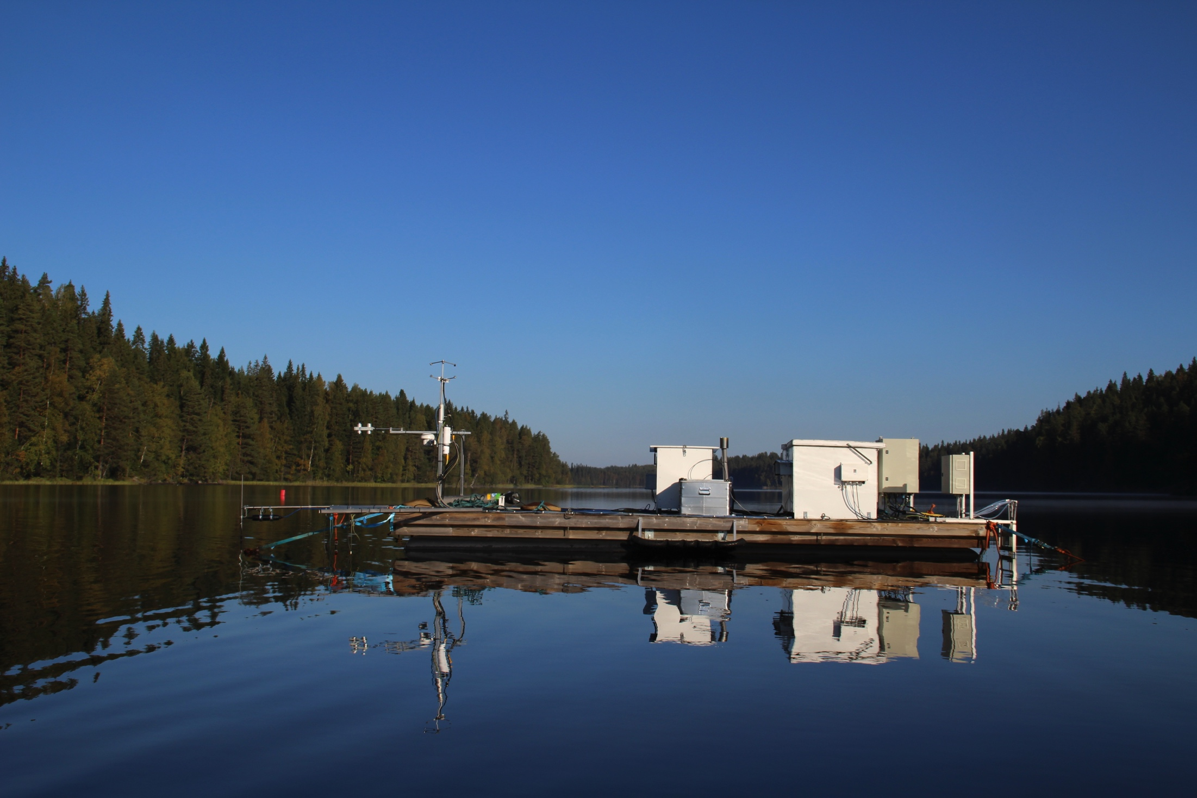
Lake Kuivajärvi
Continuous measurements since 2010
Water T at several depths
Water CO₂ at several depths
Water PAR at several depths
Radiation components (SW and LW)
Air T and RH
EC fluxes of momentum, sensible and latent heat, CO₂ and CH₄
Floating chamber fluxes of CO₂ and CH₄
Water current velocities and turbulence

Slide 8
Wind direction and flux footprint
(Mammarella etal, 2015, JGR-Biogeosc)

Slide 9
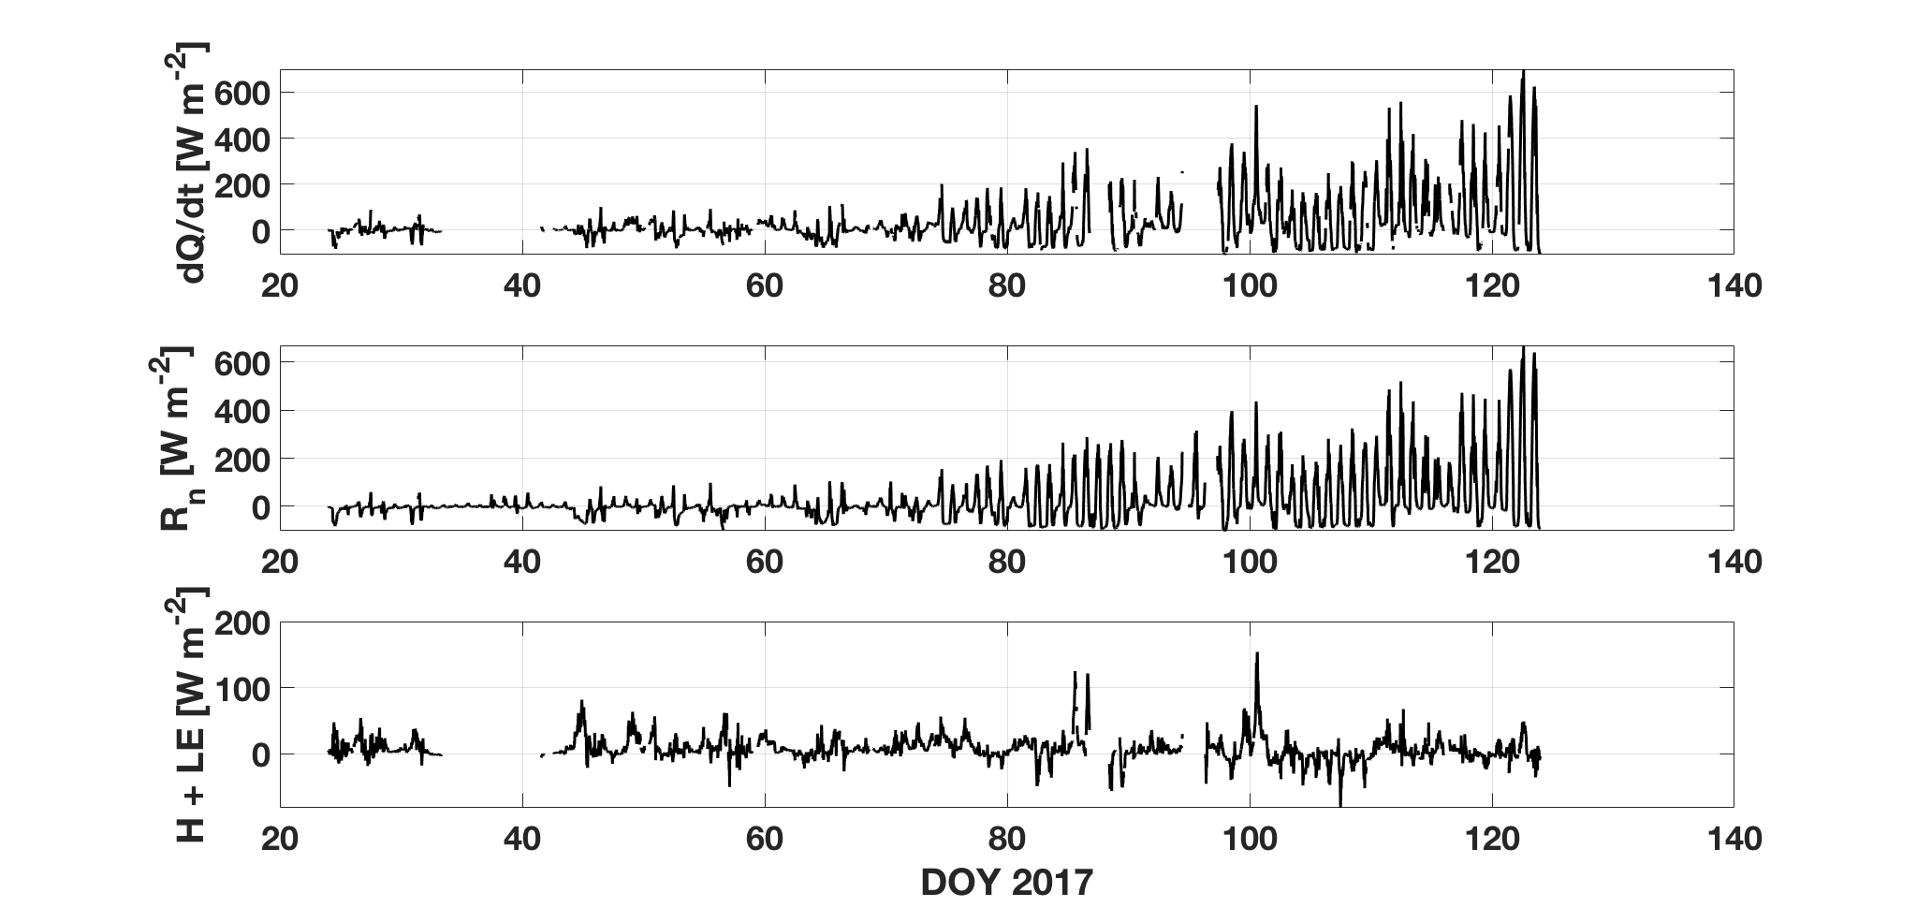
Surface Energy balance in ice-covered lake

Slide 10
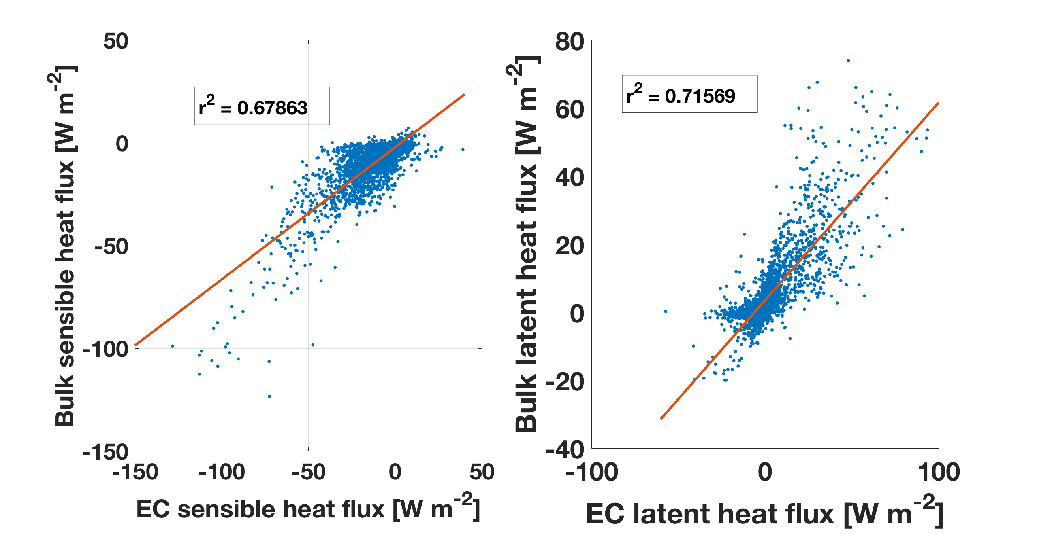
Bulk transfer relationships
$H=ρc_{p}\overline{w^{′}T′}=ρc_{p}C_{H}U(T_{s}−$ $T_{a})$
C_{H} = Stanton number
C_{E} = Dalton number
$LE=ρL_{v}\overline{w^{′}e′}=ρL_{v/s}C_{E}U(e_{sat}−$ $e_{air})$

Slide 11
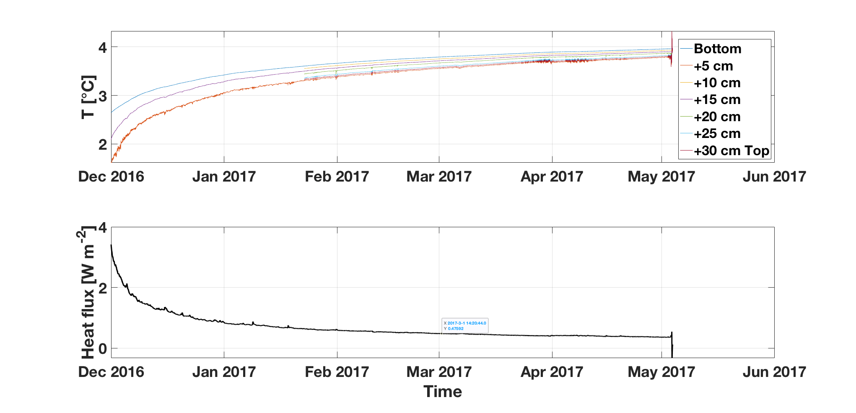
Sediment heat flux

Slide 12
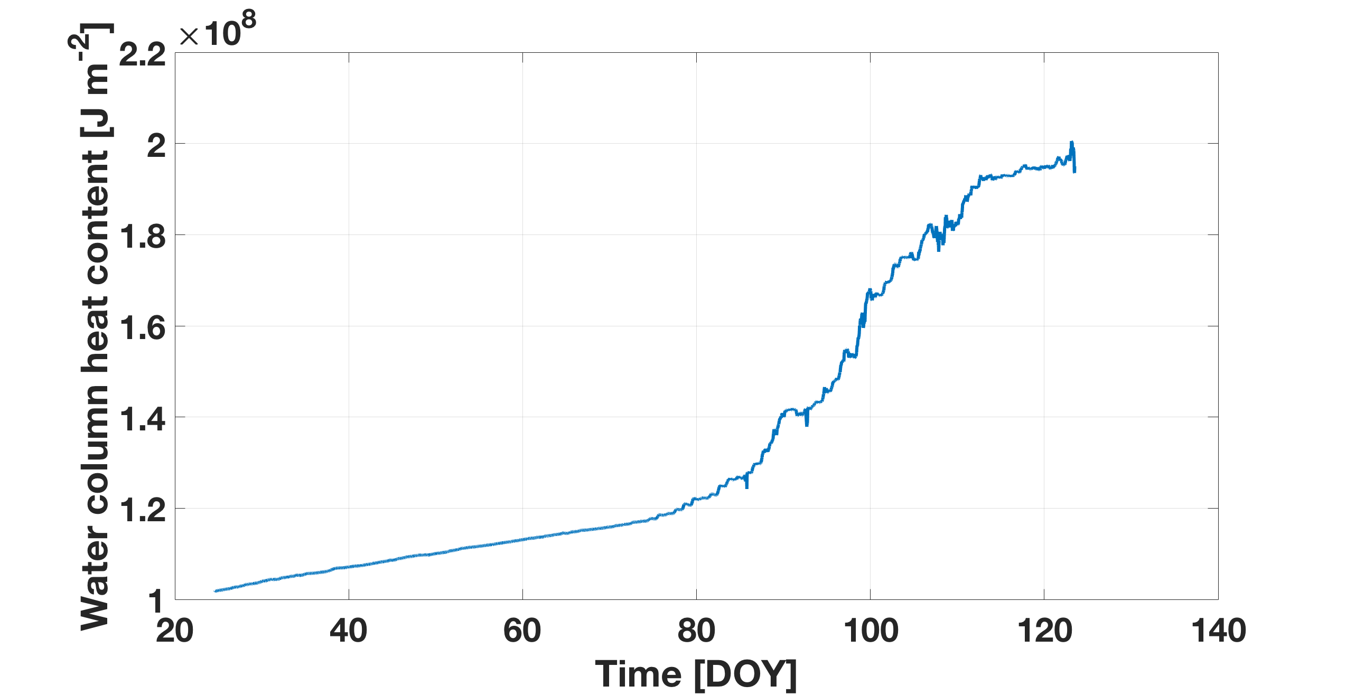
Water column heat content
Heat also from solar radiation
Heat from sediment
Heat content calculated as deviation from the freezing point.

Slide 13
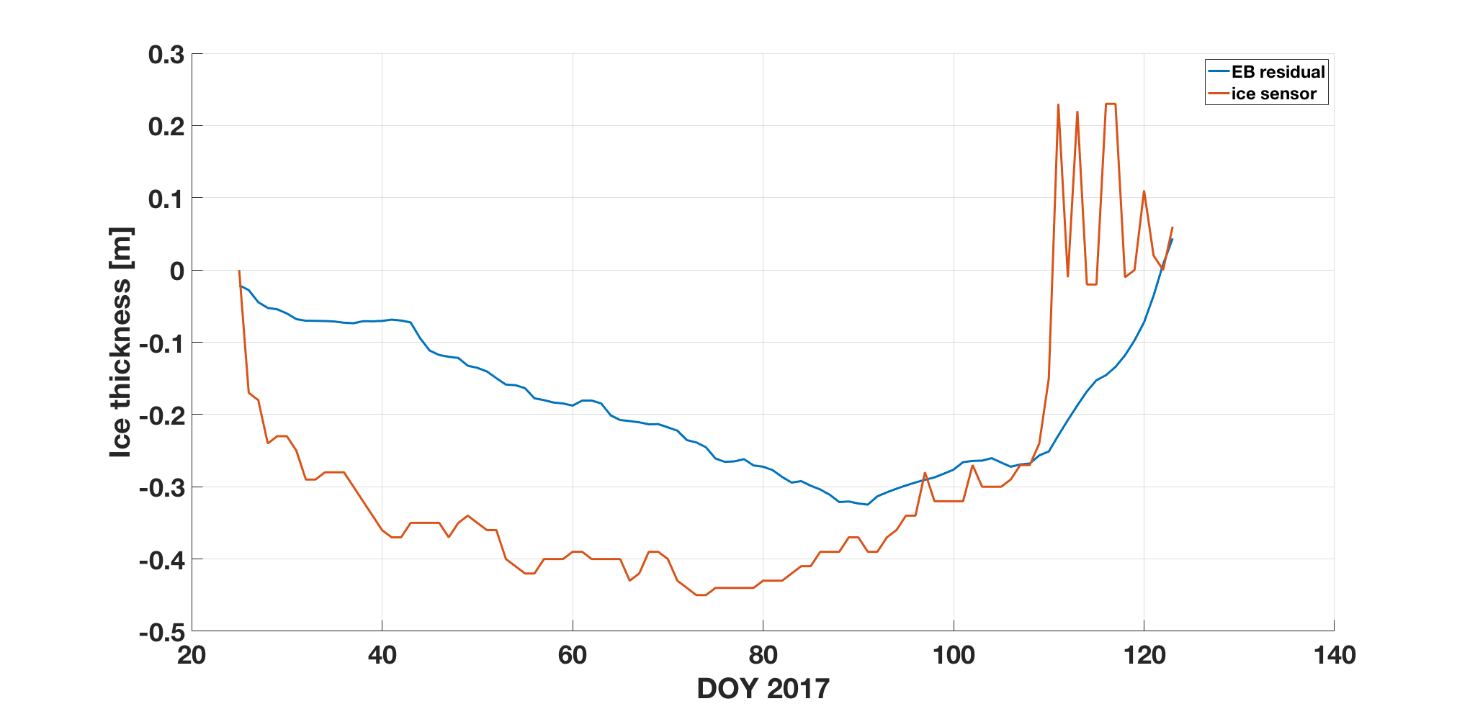
Ice layer development
Depth (m)

Slide 14
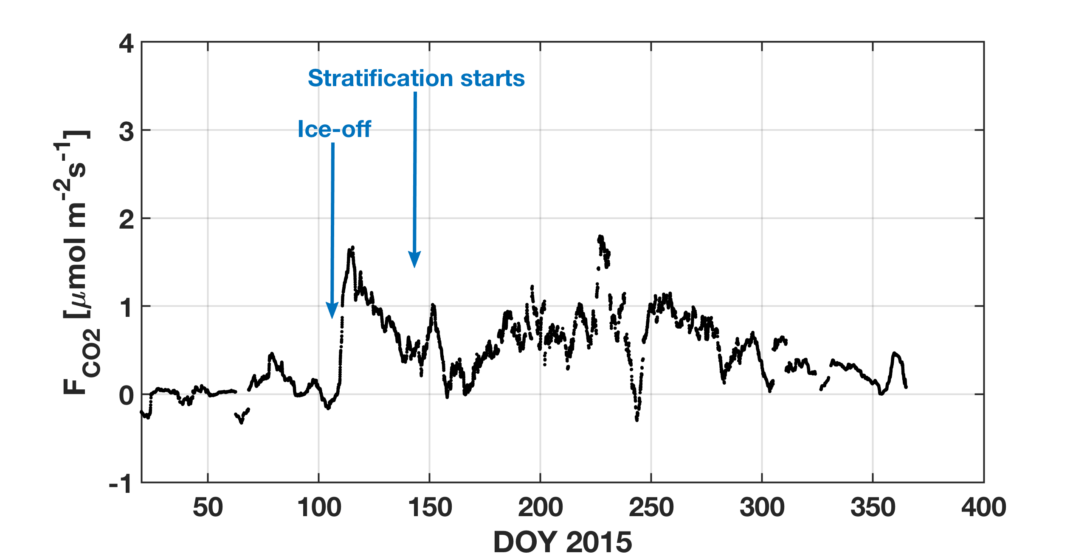
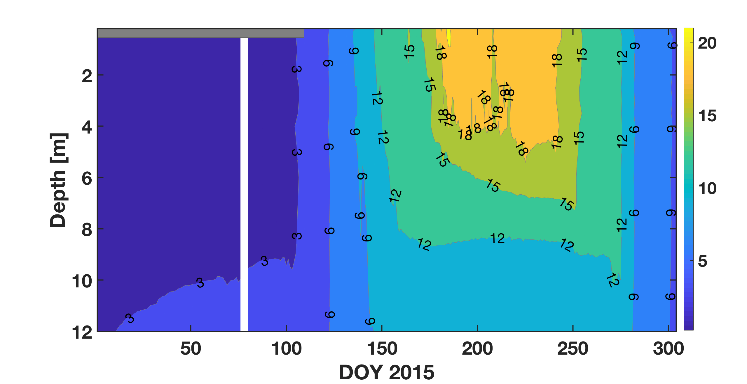
Spring emissions of GHGs
Long mixing period in 2015 affecting emissions of CO₂

Slide 15
Two CO2 emission peaks in Spring (small boreal lake in Sweden)
Denfeld et al, 2015, BER

Slide 16
Surface water pCO2 vs Brunt-Vaisälä frequency N_{s}
Lake Valkea-Kotinen (Finland)
(Huotari etal, 2011, GRL)

Slide 17
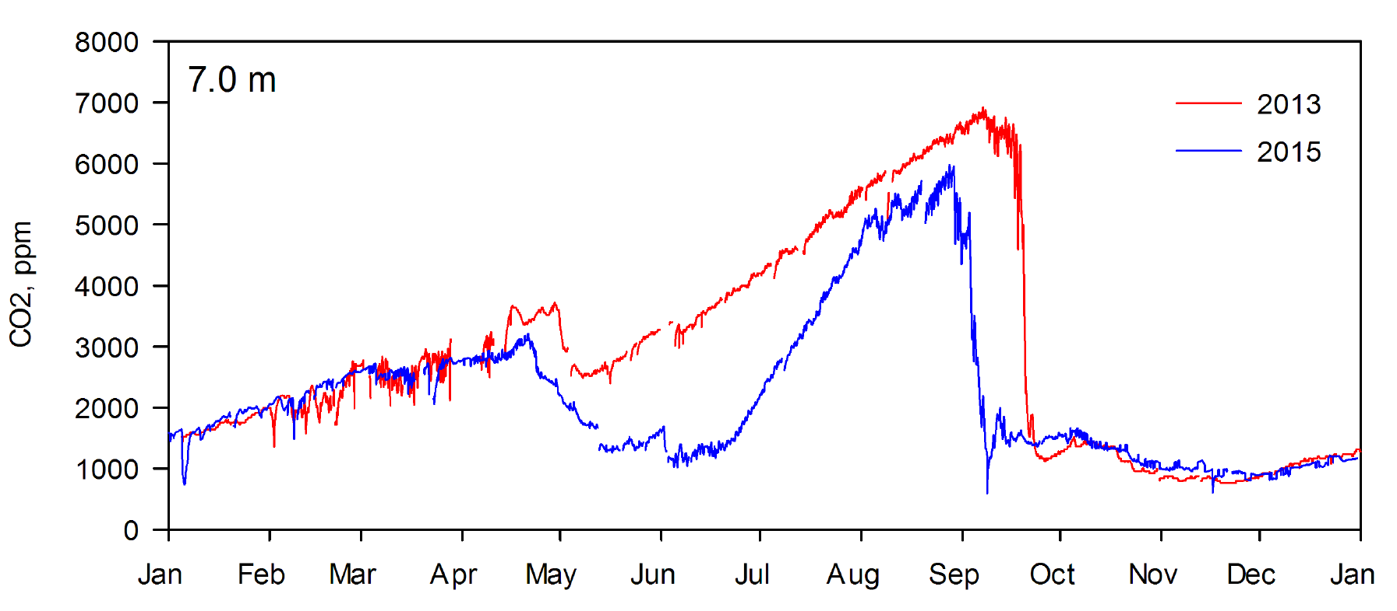
Importance of weather during spring mixing period for bottom water CO2
Lake Kuivajärvi (Finland)
Note in 2015 earlier ice-off, relatively cold spring and longer spring mixing, and higher CO2 increase rate in summer, because of higher T in hypolimnion.
(Mammarella etal, 2018, Boreal Env Res)

Slide 18
Conclusions
Turbulent heat fluxes seems to follow the bulk transfer approach.
The timing and the length of mixing period are relevant drivers for GHGs emission in spring and bottom GHG accumulation during summer.
Ns seems to be a simple and relevant proxy for surface pCO_{2.}
Next steps
Systematic analysis and climatology of winter-spring dynamics and effect on GHG emissions.
Site-level comparison with LAKE model (Stepanenko etal, 2016, GMD).

Slide 19
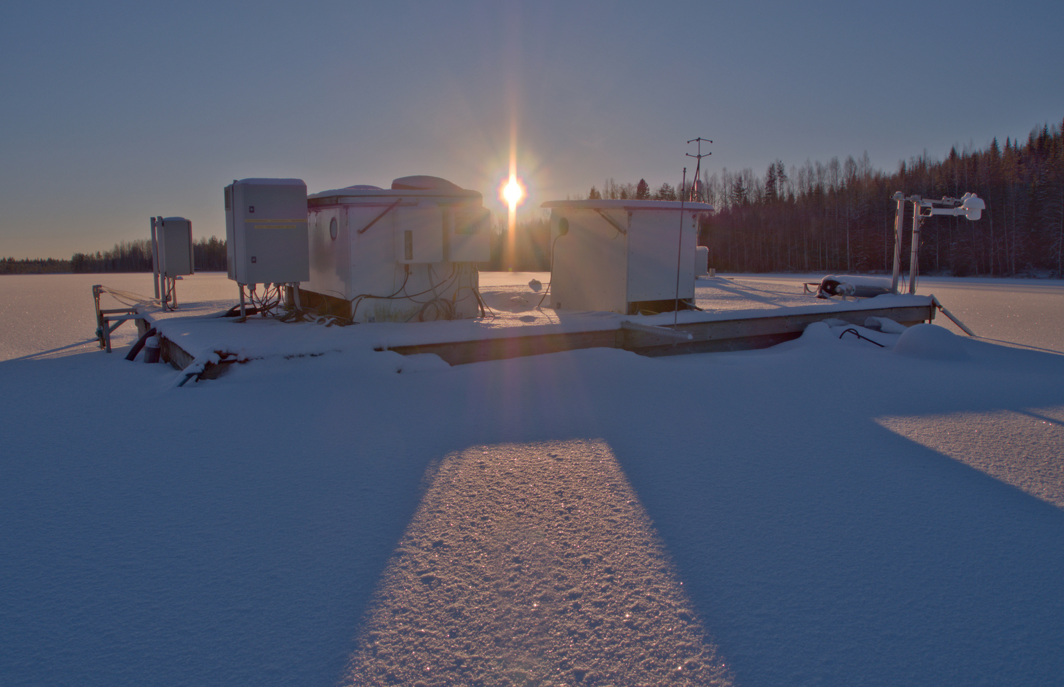
Thanks for your attention!!!
Photo by Juho Aalto

Slide 20
Extra slides

Slide 21
EC flux calculation
- EddyUH software (Mammarella et al, 2016, AMT)
Correction of wind velocity components for the moving platform using inclinometer data.
Coordinate rotation of wind velocity components.
Time lag between w and H₂O.
Spectral correction of fluxes.
Flux quality criteria (flux stationarity, etc.) and flux footprint estimates.

Slide 22
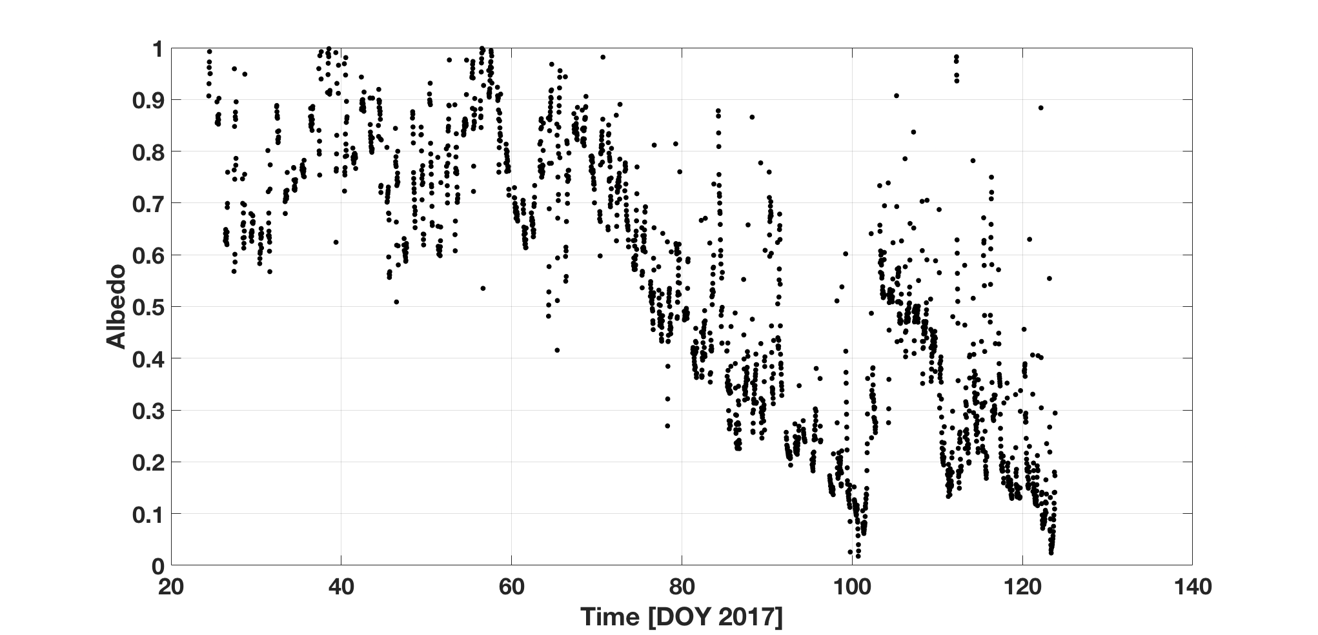
Surface albedo

