Slide 1

EaSy-lakes?
Philosophy and status of the ISIMIP lake sector
Wim Thiery, Gosia Golub, Don Pierson, & Rafa Macre

Slide 2
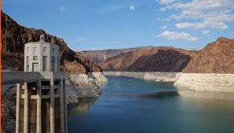
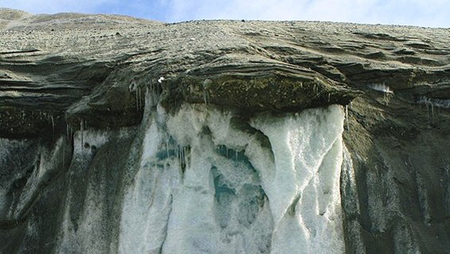


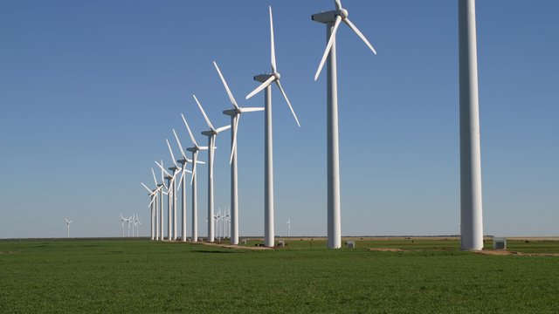
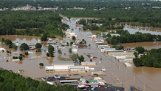

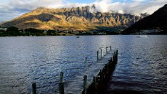

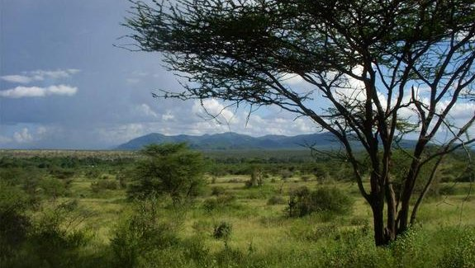

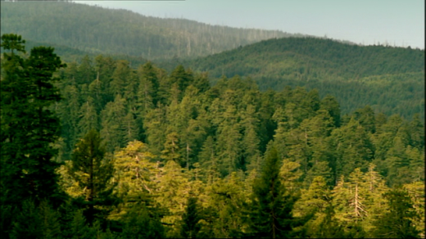

water (regional)
permafrost
biodiversity
coastal infrastructure
energy supply & demand
water (global)
lakes
agriculture
health
global biomes
regional forests
fisheries
Notes:
ISIMIP is about modelling the impacts of climate change in a way which that is consistent across sectors. Hence it becomes possible to compare climate change impacts on e.g. crop yields and river flows.
Currently 12 sectors
ISIMIP is coordinated by PIK near Berlin, which was recently nominated to be the world’s no1 environmental think thank

Slide 3
water (regional)
permafrost
biodiversity
coastal infrastructure
energy supply & demand
water (global)
lakes
agriculture
health
global biomes
regional forests
fisheries
Notes:
Lake sector is the most recent sector, was establishes in 2017. The ISIMIP lake sector is a merge of people coming from the GLEON and the LAKEMIP community.
Emphasize cross-sectoral aspect here

Slide 4

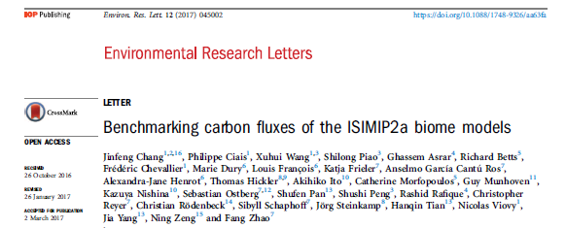
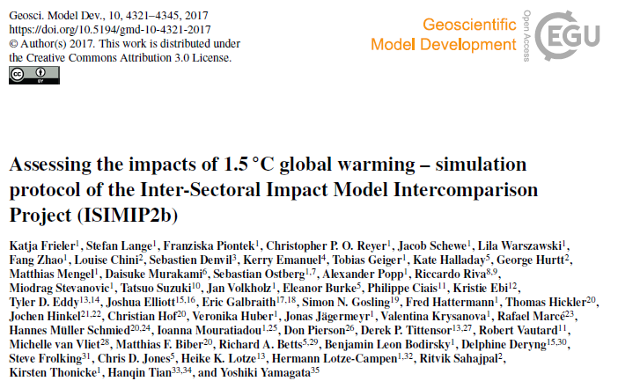
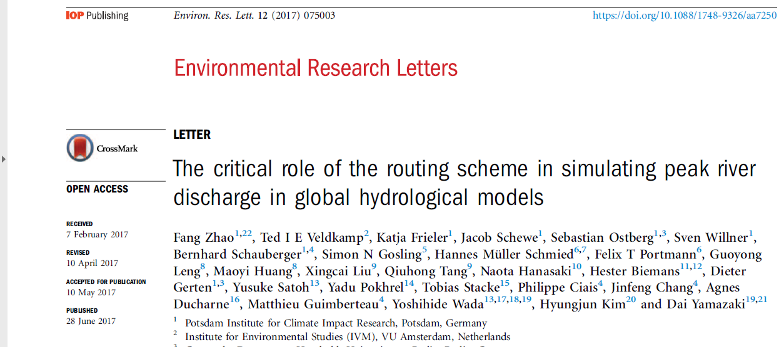
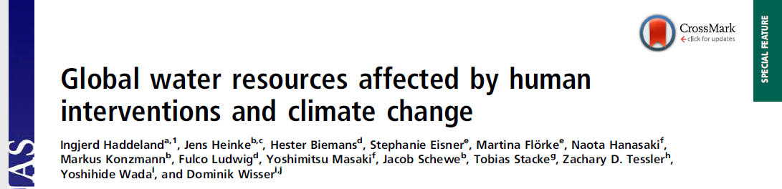
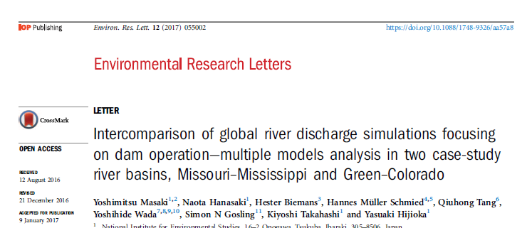
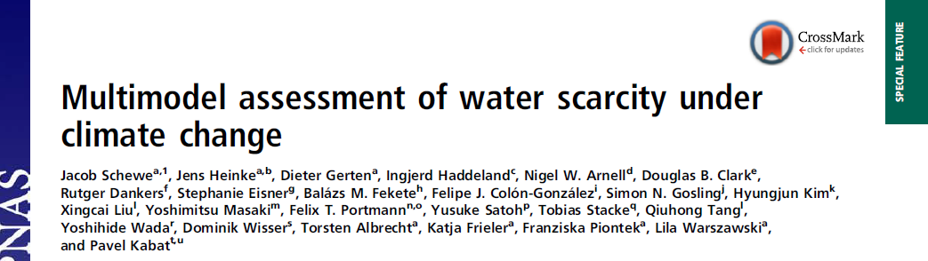
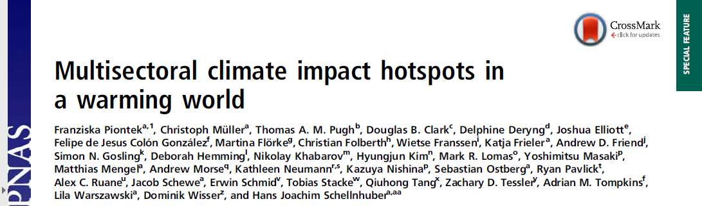
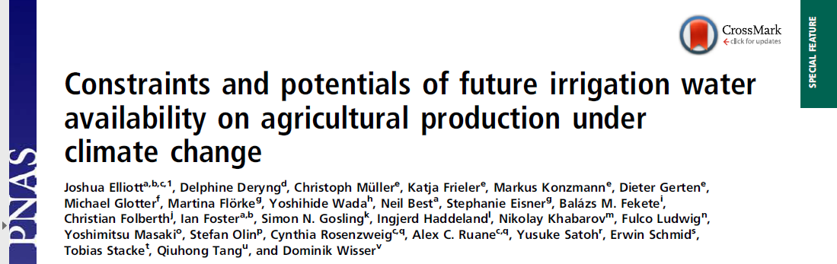
ISIMIP Phases
Aligned with IPCC reports
Fast Track (PNAS)
ISIMIP2a (ERL)
ISIMIP2b (ongoing)
ISIMIP3a/b (2020-…)
Notes:
The first ISIMIP simulation round, the ISIMIP Fast Track, ran from early 2012 until mid 2013, with a focus on providing cross-sectorally consistent projections of the impacts of different levels of global warming in the 21st century. The common set of scenarios made use of climate projections from five Global Climate Models (GCMs) driven by the Recommended Concentration Pathways (RCPs), making ISIMIP a natural extension of the work done within the Coupled Climate Model Intercomparison Project (CMIP).
Fast Track simulations were submitted by 35 impact-modelling teams, covering the agriculture, water, global biomes, coastal infrastructure and vector-borne diseases sectors all at the global scale.
Used in AR5.
The results of the Fast Track were collected in two special issues: of the Proceedings of the National Academy of Sciences (PNAS, link to special issue), and in Earth Systems Dynamics (ESD, link to special issue).
The focus topic for ISIMIP2a is model validation, in particular with respect to the representation of impacts of extreme weather events and climate variability. During this phase we will provide a common global observational climate data set across all impact models and sectors. In addition, appropriate observational data sets of impacts for each sector have been identified, against which the models can be benchmarked. Access to all these data is provided through a central online ISIMIP archive.
ISIMIP2b is designed to provide robust information about the impacts of 1.5°C global warming and related low-emission pathways, as required for the IPCC Special Report on this topic. In addition to those sectors already represented within ISIMIP, impacts on biodiversity, tropical cyclones, heat-related mortality, and energy supply and demand will be considered.

Slide 5
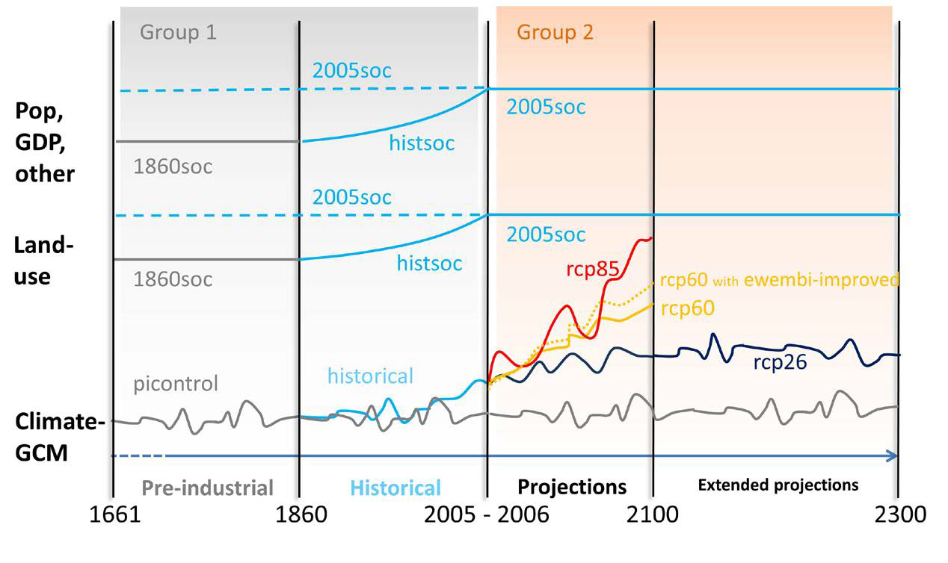
Simulation overview
Group 1 & 2
(Frieler et al., 2017 GMD)

Slide 6
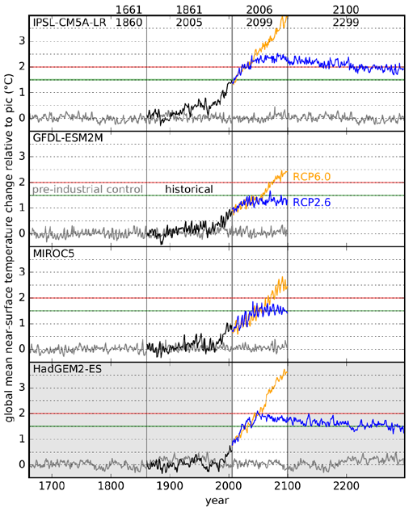
ESM forcing
GCM data:
- are bias corrected
- contain all variables needed to force hydrodynamic models
- Are supplied for specific lake locations
(Frieler et al., 2017 GMD
Lange, 2017 ESD)
Notes:
Bias corrected CMIP5 data from 4 GCMs
You can see the 1.5 and 2° lines. This was also the main focus of this round of ISIMIP simulations

Slide 7
ISIMIP in numbers
An overview
635 scientists
ISIMIP2a: 84 models, ISIMIP2b: 55 models, and growing
Mostly global focus
e.g. 2b sector water_global:
  13 GHMs
  13 TB
https://www.isimip.org/impactmodels/
Notes:
Emphasize cross-sectoral aspect here

Slide 8
Lake sector simulation strategy
Two synergetic approaches
global
  Led by LakeMIP: http://www.unige.ch/climate/lakemip/
  Generic simulations – applied to > 16’000 lakes
  Generalized information e.g. bathymetry, area
  No model calibration
local
  WATExR –work package
  GLEON working group
  Well understood and studied lakes
  Site specific calibration
  Hoping for global coverage
Simulation protocol: https://www.isimip.org/protocol/#isimip2b
Data management plan: https://tinyurl.com/y9q4snw9
Paper ideas: https://tinyurl.com/yd27huo6
Contribution spreadsheet: https://tinyurl.com/yb3g4taq
Notes:
Simulating 16346 lakes, i.e. all land pixels containing a lake according to the global lake and wetland data base

Slide 9
Where do we stand?
Lakes
Committed | # | which | institute | Status
lakes_local | 7 | - FLake - ALBM - GOTM - GLM - SimStrat - MyLake - Air2water | IGB Berlin PNNL DkIT DkIT & UWM EAWAG Laval Uni Uni West. Austr. | running running finished (postprocessing) finished (postprocessing) finished (postprocessing) calibrated calibrated
lakes_global | 7 | - CLM4.5 - ALBM - LAKE - Simstrat - VIC-Lake - FLake - GOTM | ETH & VUB PNNL MSU Uni Geneva Uni Wageningen DkIT Uppsala Uni | finished (uploaded) finished (uploaded) finished (uploaded) finished (uploaded) finished (uploaded) running running
Active analyses | 3 | - Lake sector description - Fate of global lake snow/ice - GOTM calibration Erken | Uppsala Uni VUB Uppsala Uni | in prep. in prep. In review
Lake data | 62 | - T & hypsometry for calibration | multiple | finished (dropbox)
5.6 TB
25 ideas
+ yours?
Notes:
Many people have helped with calibration of GOTM/GLM who aren’t mentioned.

Slide 10
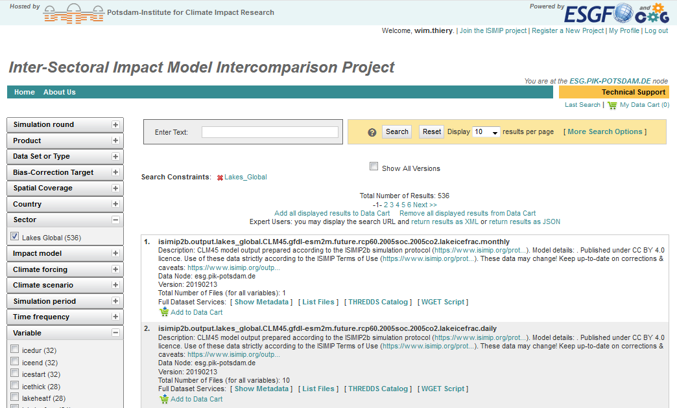
https://esg.pik-potsdam.de/search/isimip/
Notes:
Go to ESGF website!!!
https://esg.pik-potsdam.de/search/isimip/
https://esgf-data.dkrz.de/esgf-idp/openid/wim.thiery

Slide 11
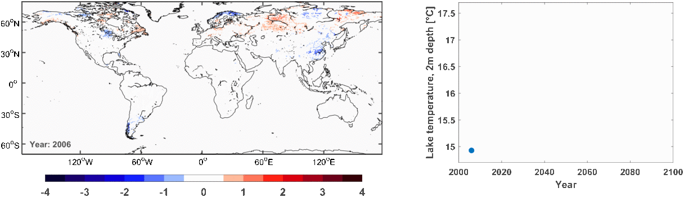
Example of global run
CLM4.5, IPSL-CM5A-LR forcing, RCP60
2m lake temperature anomaly relative to 2006-2010 [°C]

Slide 12
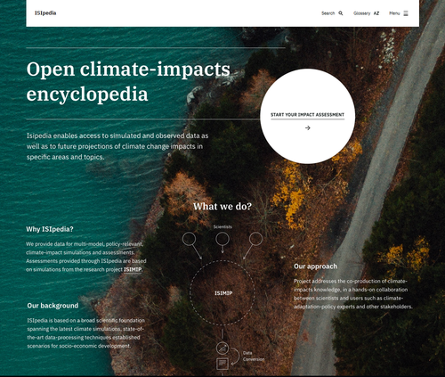

Slide 13
Is lake ice disappearing from the earth system?
First results from the ISIMIP lake sector
Luke Grant, Inne Vanderkelen, Zeli Tan, Victor Stepanenko, Marjorie Perroud, Martin Schmid,
Bram Droppers, Annette Janssen, Fang Zhao, Jakob Schewe, Gosia Golub, Don Pierson,
Rafa Macré, Wim Thiery & more

Slide 14
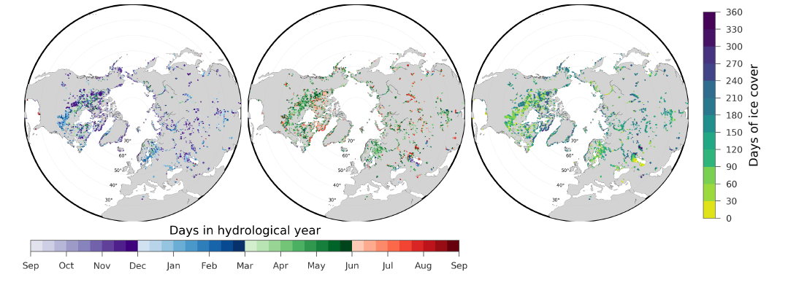
Observational data
AMSR-E/AMSR2
ice start (Oct-Sep)
ice end (Sep-Aug)
ice duration
Notes:
Define hydrological years and perform evaluation across that hydrological year
October to September hydrological year for ice start
September to August hydrological year for ice end
Ice duration: Annual ice covered days

Slide 15
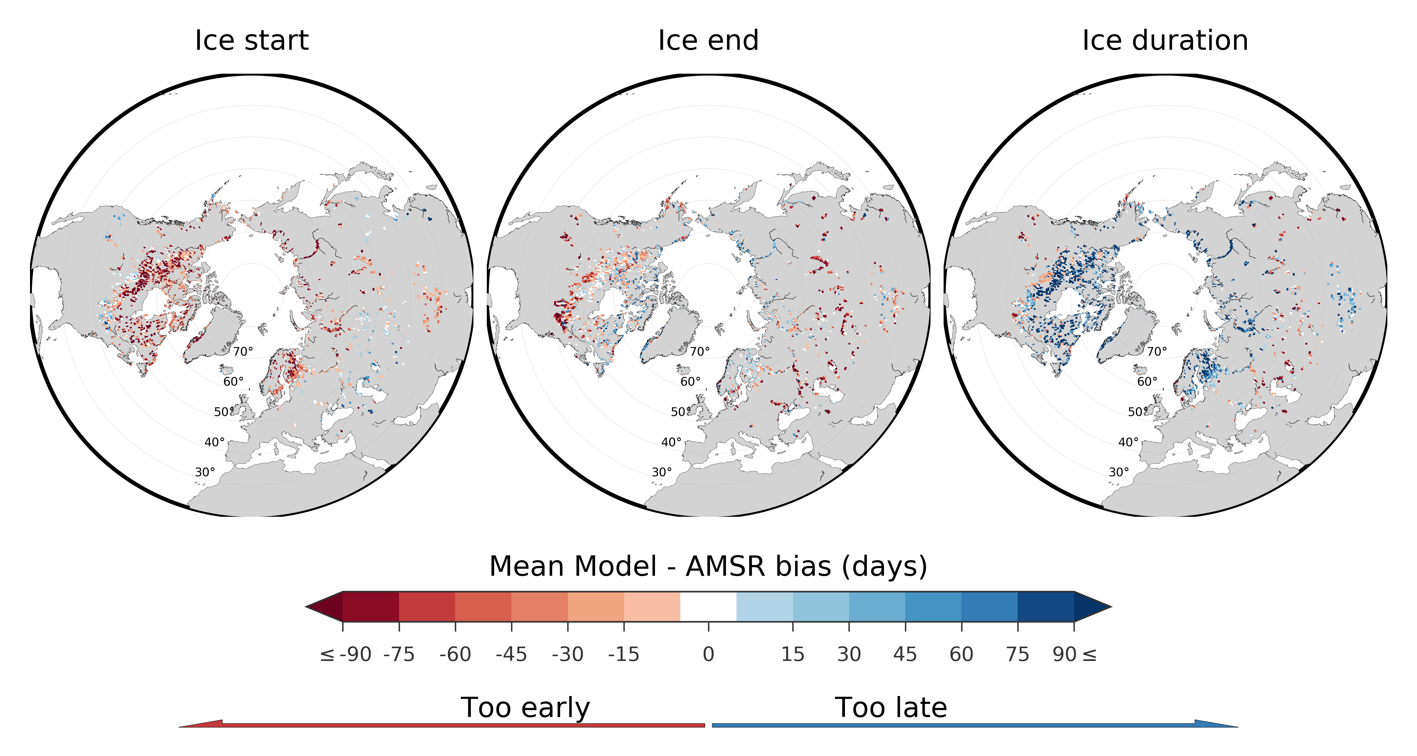
Model evaluation
ice start
ice end
ice duration
Multi-
Model-
Mean
Notes:
First impressions:
Ice start early
Ice end sometimes early
Duration too long
At this stage, striking that two models have very similar biases

Slide 16
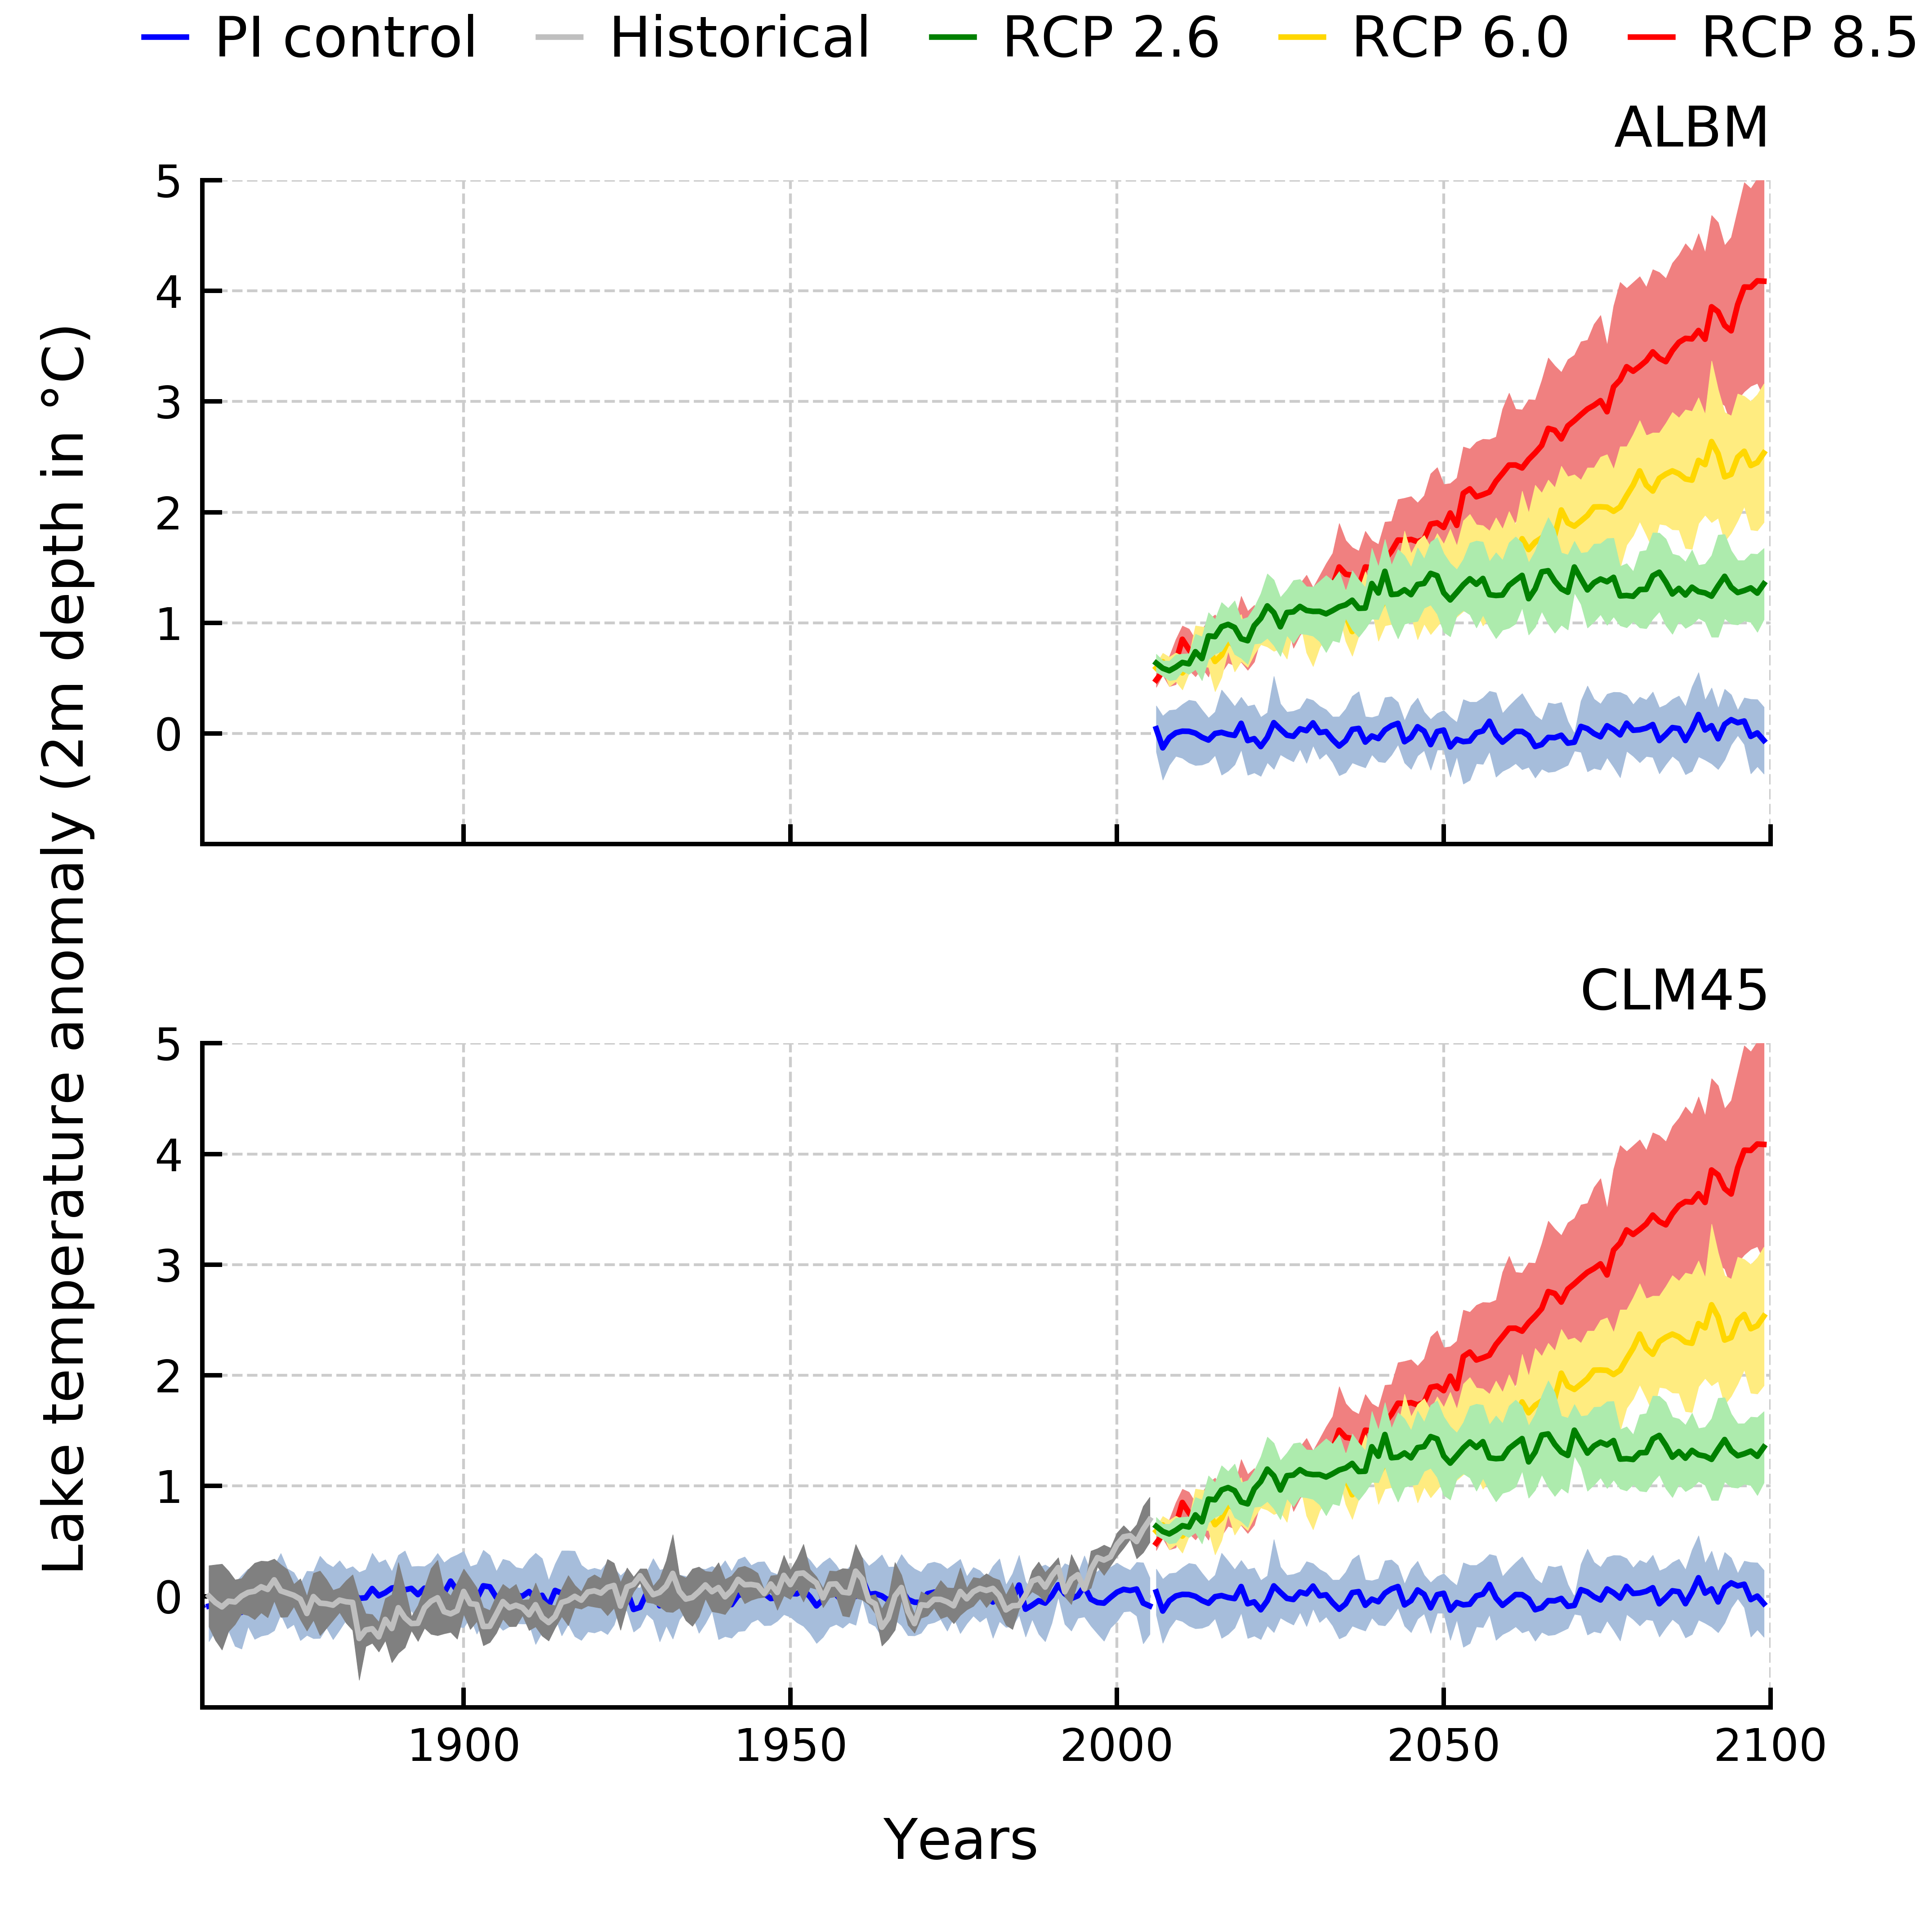
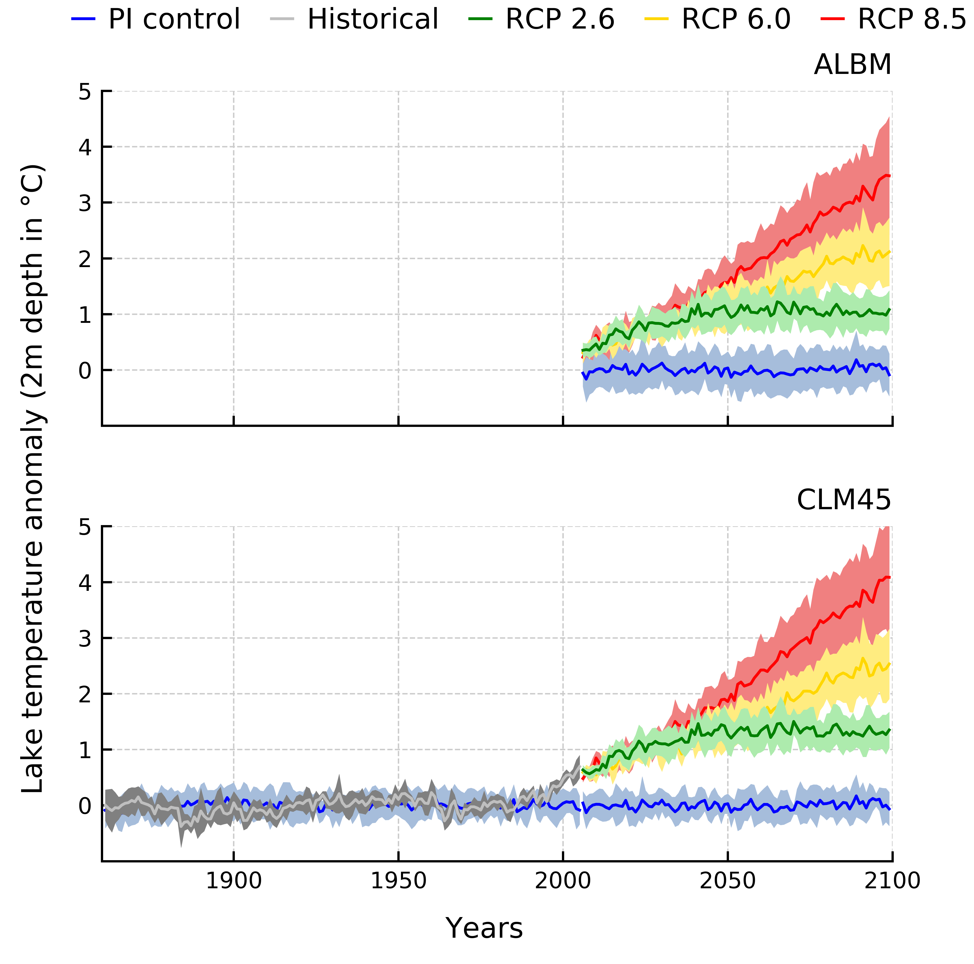
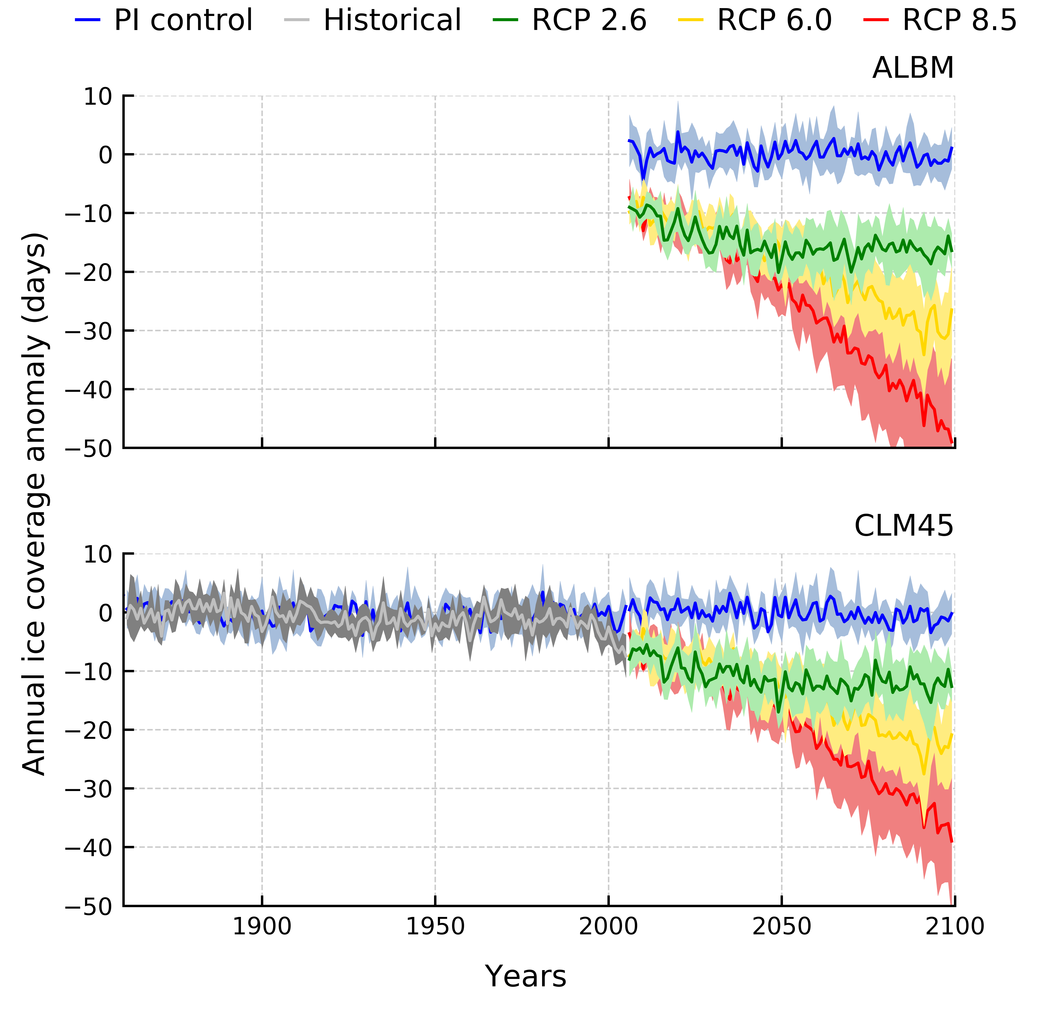
RCP 8.5: +3.5ºC and +4ºC
RCP 8.5: -50 and -40 days
Notes:
Two models, but we expect at least four more.
Key conclusions: consistency among two models in terms of magnitudes of lake temp and ice duration
Four sources of uncertainty in future projections: GCM, lake model, RCP and nat var. Largest uncertainty comes from RCP

Slide 17
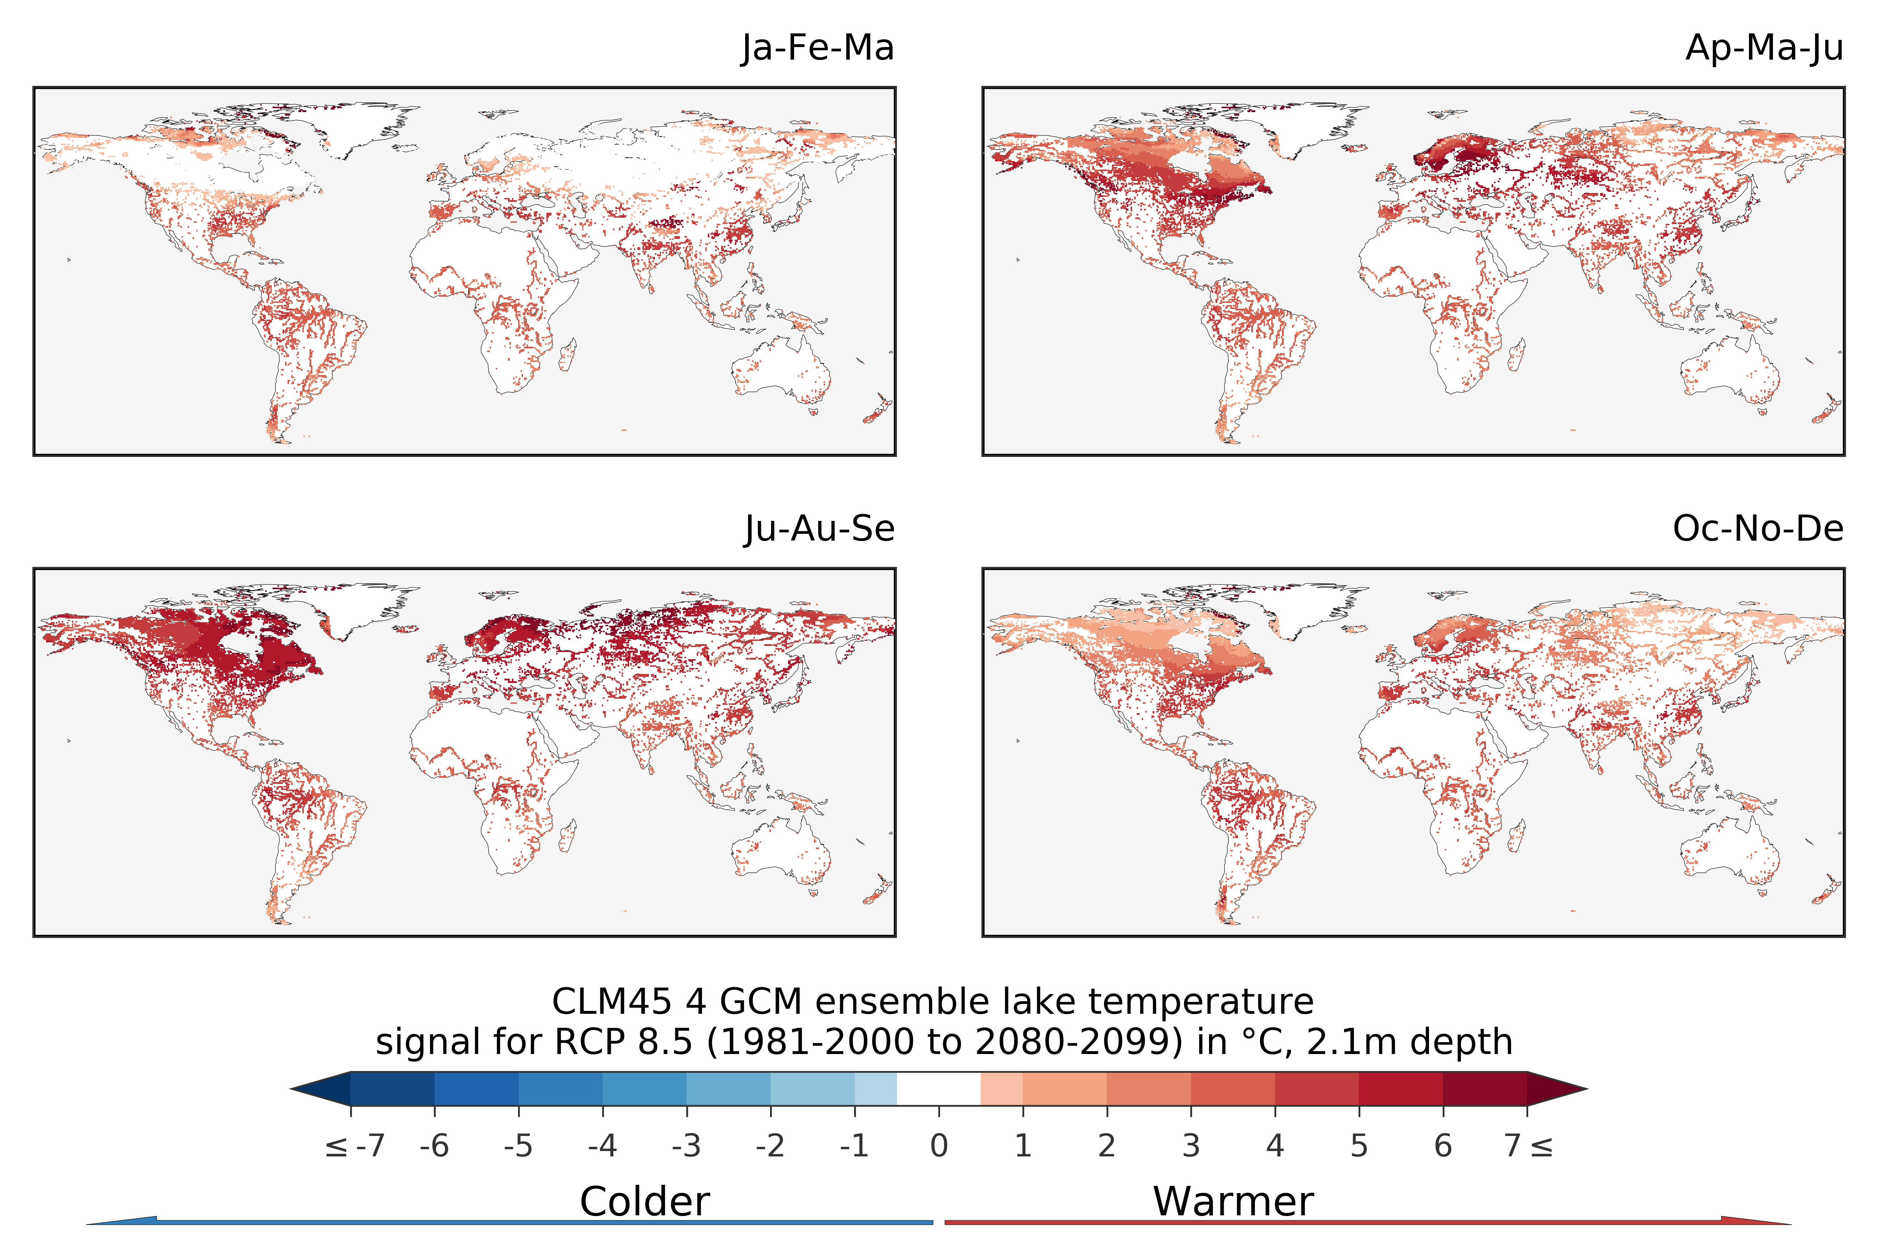
Scandinavia: strong spring warming
Northern latitudes: significant summer warming
Notes:
Look at spatial patterns: strongest warming during spring and summer period,
CLM4.5 only because historical simulations of ALBM missing

Slide 18
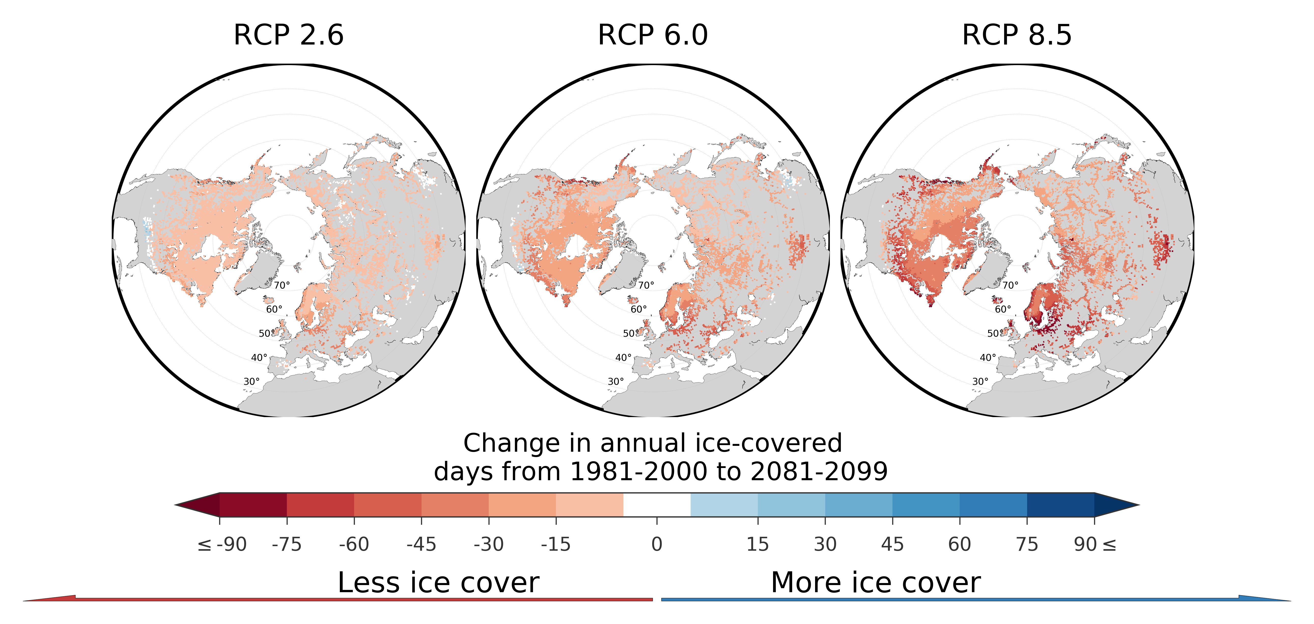
Gradient in distance to oceans in ice day losses
Notes:
Ice duration, CLM4.5 only
Coastal pixels experience greatest loss, at the moment we have no explanation for this

Slide 19
Slightly less than 1:1 warming
RCP 8.5: potentially severe warming before 2100
Notes:
CLM4.5 and ALBM
Scaling: plot global average lake warming against global average temeprature anomaly. Apply to all simulations/RCPs: collapse onto one line! Scaling is scenario independent.
This gives us robust estimate of sensitvity: 0.8°C/°C

Slide 20
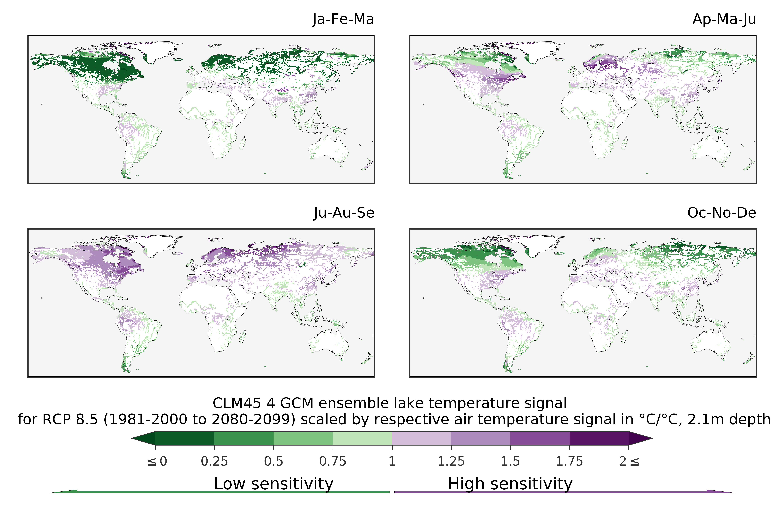
Scandinavia: strong spring climate sensitivity
Northern latitudes: high summer climate sensitivity
Notes:
CLM45 only
Look at this spatially: which regions warm more than global average (purple), which less (green)

Slide 21
~9 day reduction per ºC warming
Greater uncertainty in end of century projections
Notes:
Now do this for ice duration: number of days with ice cover.
Ice duration: -8.6 days/C
Ice thickness: -0.045m/C, (5cm per degree)

Slide 22
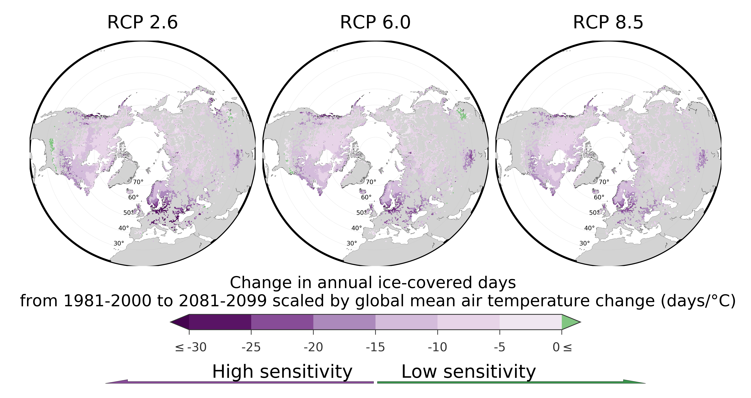
Greater sensitivity in coastal areas
Europe with reduced sensitivity in more severe scenarios
Notes:
CLM4.5 only

Slide 23
Is lake ice disappearing from the earth system?
First results from the ISIMIP lake sector
Luke Grant, Inne Vanderkelen, Zeli Tan, Victor Stepanenko, Marjorie Perroud, Martin Schmid,
Bram Droppers, Annette Janssen, Fang Zhao, Jakob Schewe, Gosia Golub, Don Pierson,
Rafa Macré, Wim Thiery & more

Slide 24
CONCLUSIONS
Ro 1: MODEL PERFORMANCE?
Remote sensing series is short
Biases attributable to models, satellite artefacts and pre-processing
Further validation necessary
Ro 2: How will global mean lake temperature and lake ice change?
Increased temperature and decreased ice coverage
Only RCP 2.6 projections stabilizing
Ro 3: What is the global outlook of changes by 2100?
Latitude/distance to oceans correlate with reductions in temperature/ice cover: polar amplification and land-ocean dynamics?
Ro 4: What are the changes per ºC surface warming?
Linear scaling for global means
Lake temperature climate sensitive in Scandinavia and northern Canada
Ice cover climate sensitive in Coastal regions

Slide 25
