Slide 1
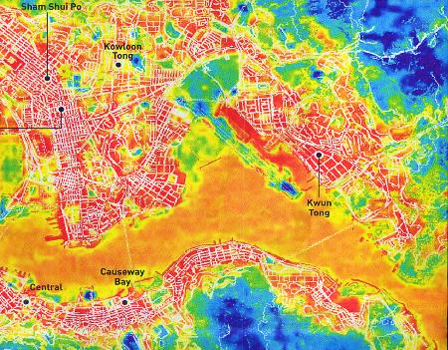



Urban Database in High-density Cities and its Role in Numerical Modelling
Kevin Ka-Lun Lau^{1,2,3}, Margaret Yu-Ting Kwok¹
¹Institute of Future Cities, The Chinese University of Hong Kong, Hong Kong
²CUHK Jockey Club Institute of Ageing, The Chinese University of Hong Kong, Hong Kong
³Institute of Environment, Energy and Sustainability, The Chinese University of Hong Kong, Hong Kong

Slide 2
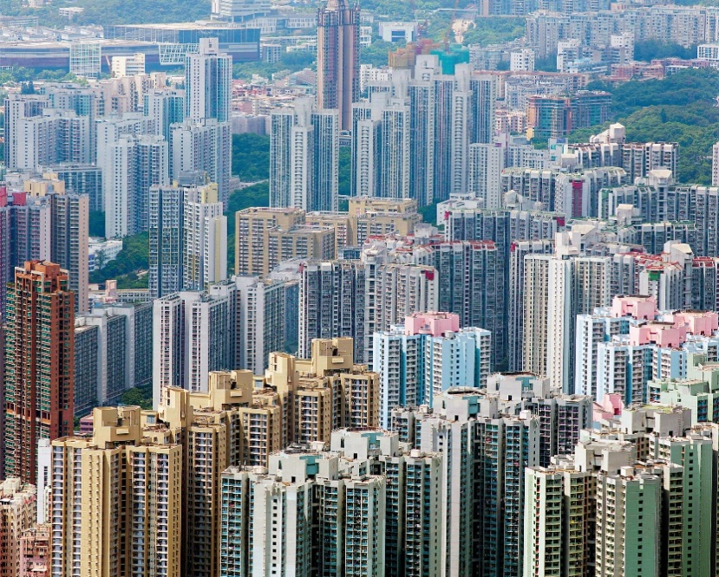
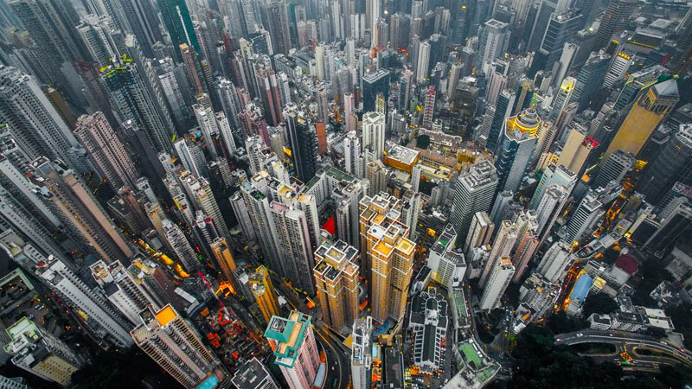
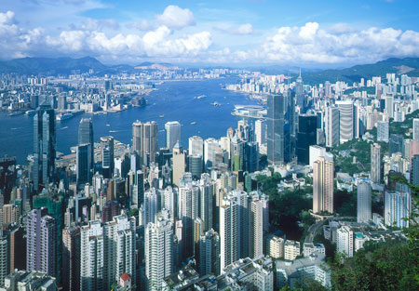
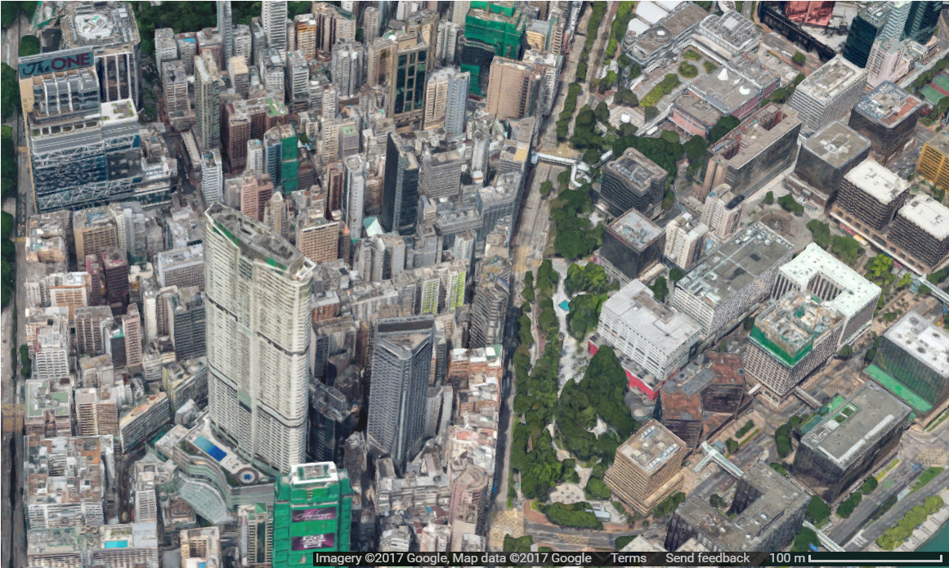

High-density Cities
  High-density
  Compact
  High-rise
  Complex, mixed land use
SURFEX Users’ Workshop, Toulouse, 20170228

Slide 3
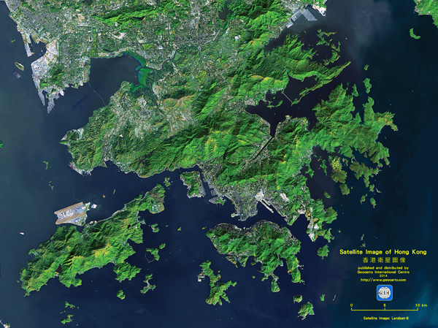
  Limited Land Availability
  Total area: 1,100 km²
  Built-up area: <300 km²
  Hilly Topography
  Distinctive urban form
  High Population
  High-rise and compact urban morphology

Slide 4
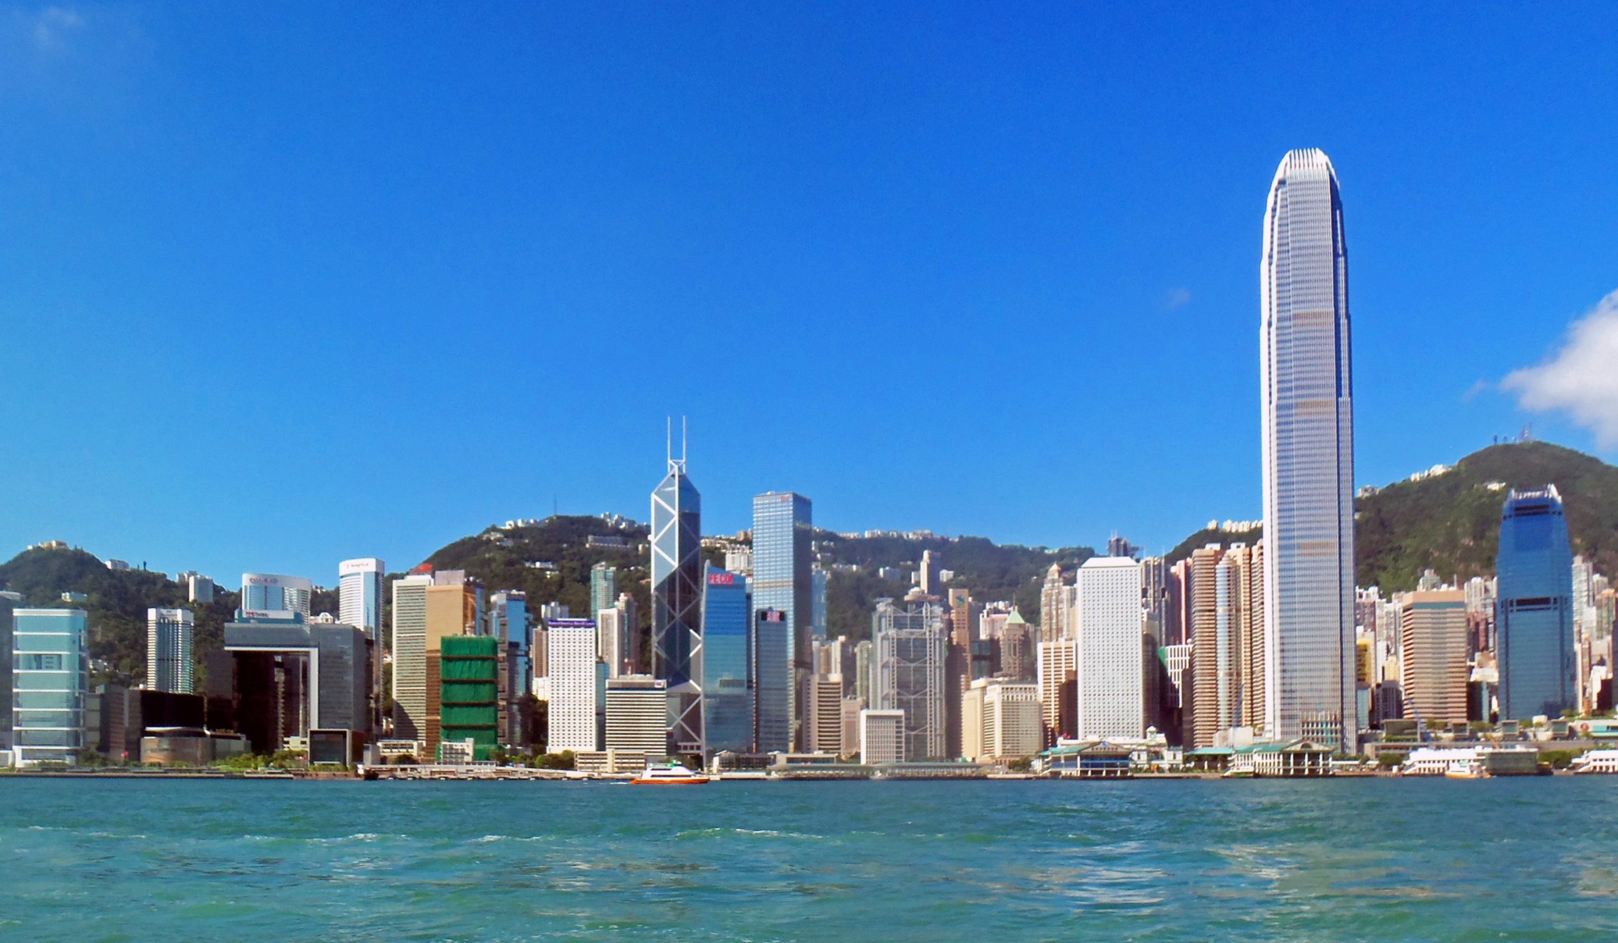
Urban Morphology
  High-rise Buildings
SURFEX Users’ Workshop, Toulouse, 20170228

Slide 5
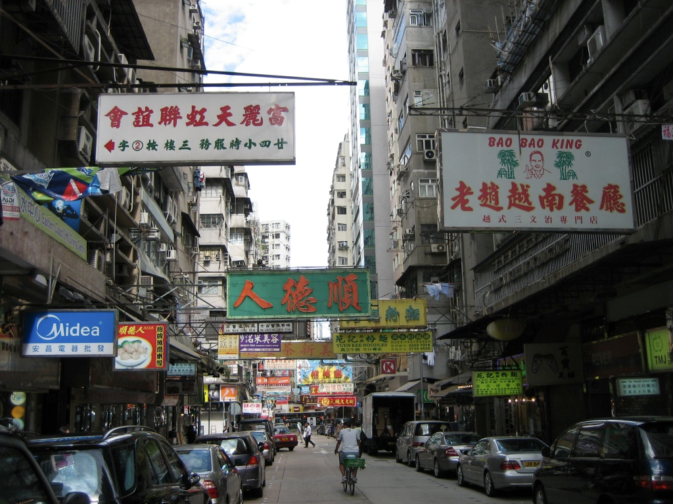
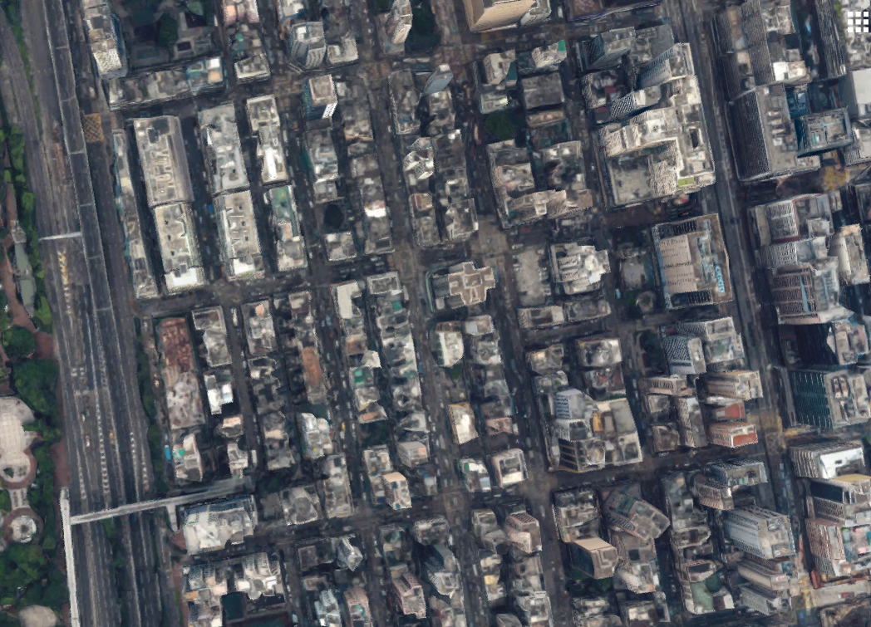
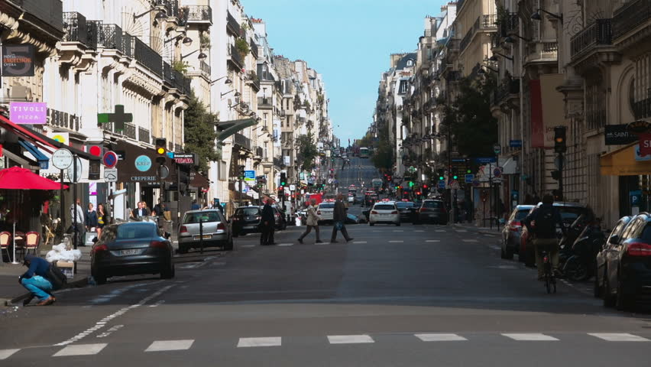
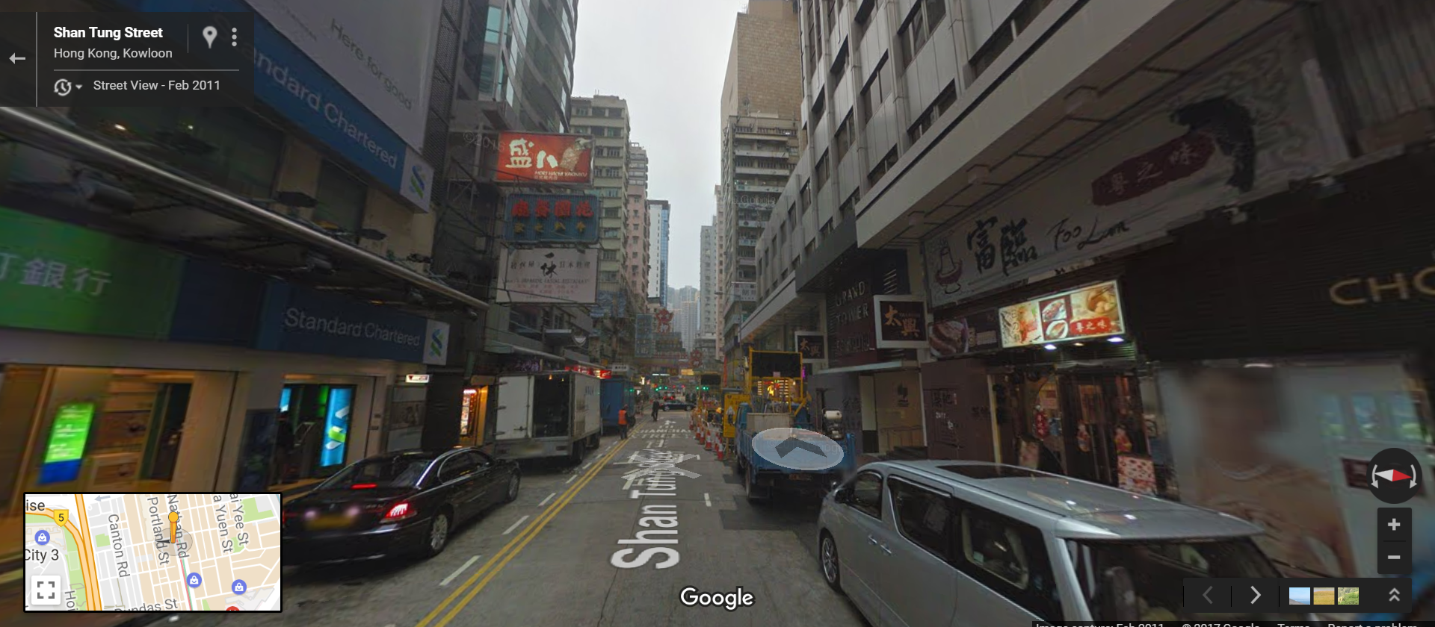
Urban Morphology
  Compact Street Canyons
SURFEX Users’ Workshop, Toulouse, 20170228

Slide 6
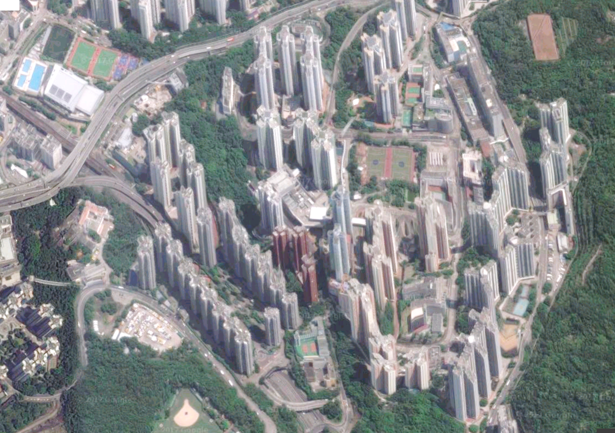
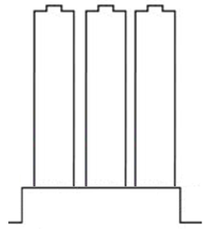
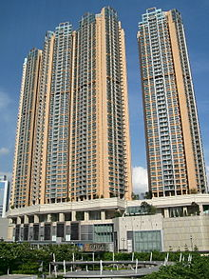
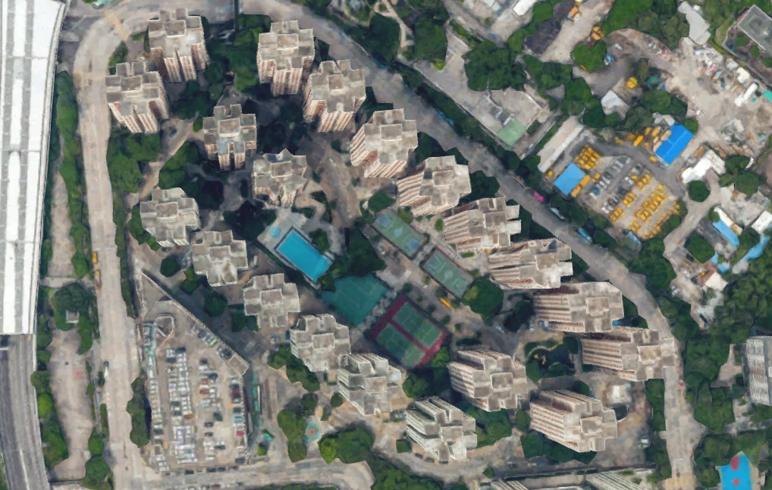
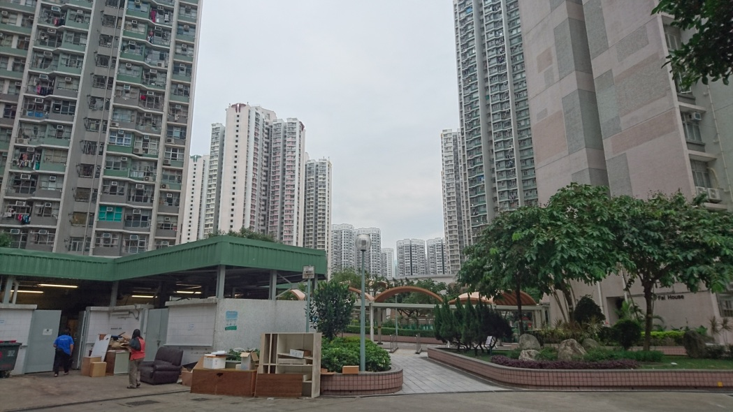
Urban Morphology
  High-rise Building Towers with Podiums
SURFEX Users’ Workshop, Toulouse, 20170228

Slide 7
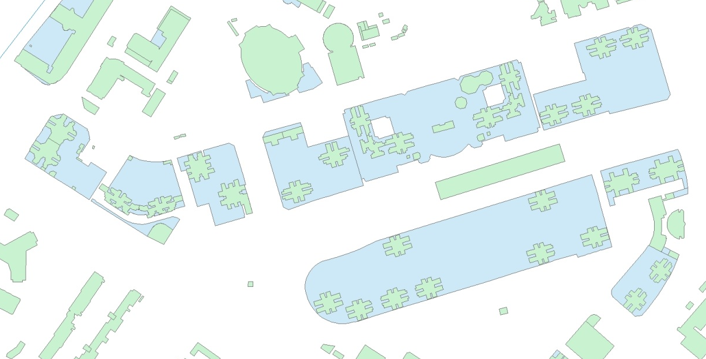

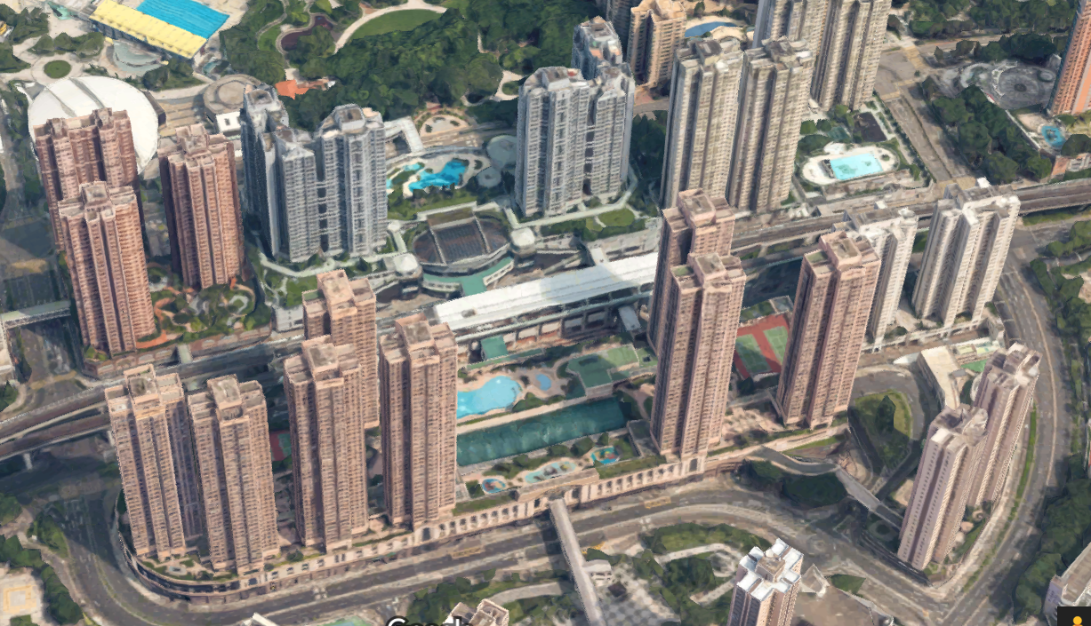
Urban Morphological Data
  Building Height and Footprint
  Consists of two types of building information
    Building towers
    Podiums
  Primary data of urban form and morphology from Hong Kong Planning Department
  TEB parameters
    Fraction of buildings
    Roughness length
    Building height
    Ratio between wall and horizontal surfaces
SURFEX Users’ Workshop, Toulouse, 20170228

Slide 8
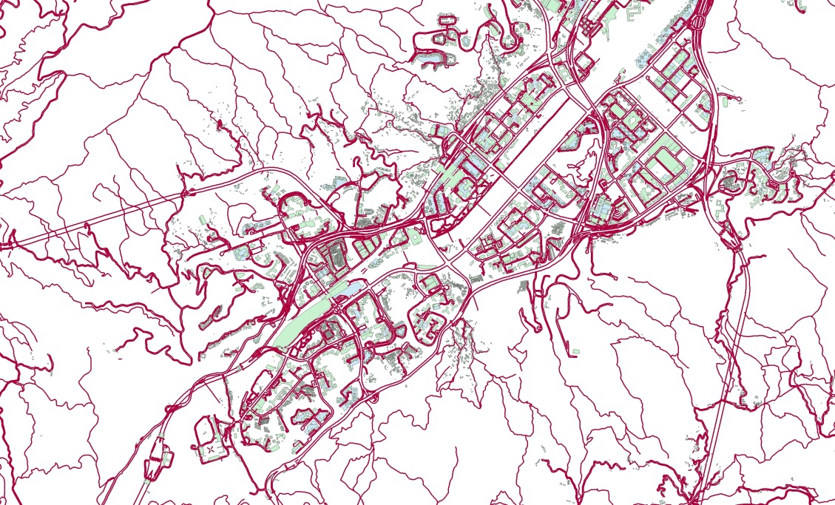
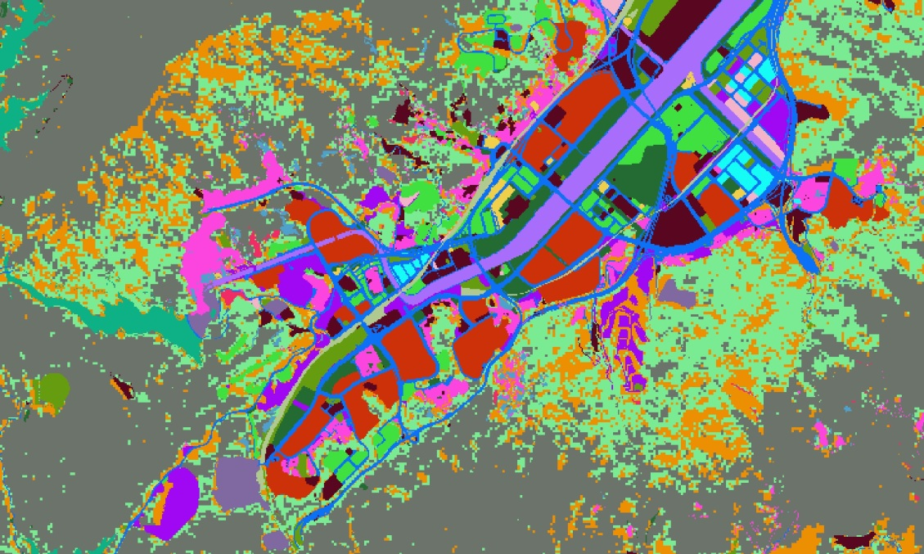
Urban Morphological Data
  Road Network
  Information about primary and secondary roads in Hong Kong from Lands Department
  TEB parameters
    Road orientation
    Also used to determine town fraction
  Land Use Data
  Land utilization in Hong Kong at 10m resolution from Hong Kong Planning Department
  TEB parameters
    Determine the fraction of four surface types
SURFEX Users’ Workshop, Toulouse, 20170228

Slide 9
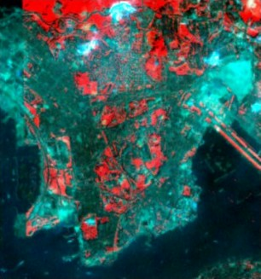
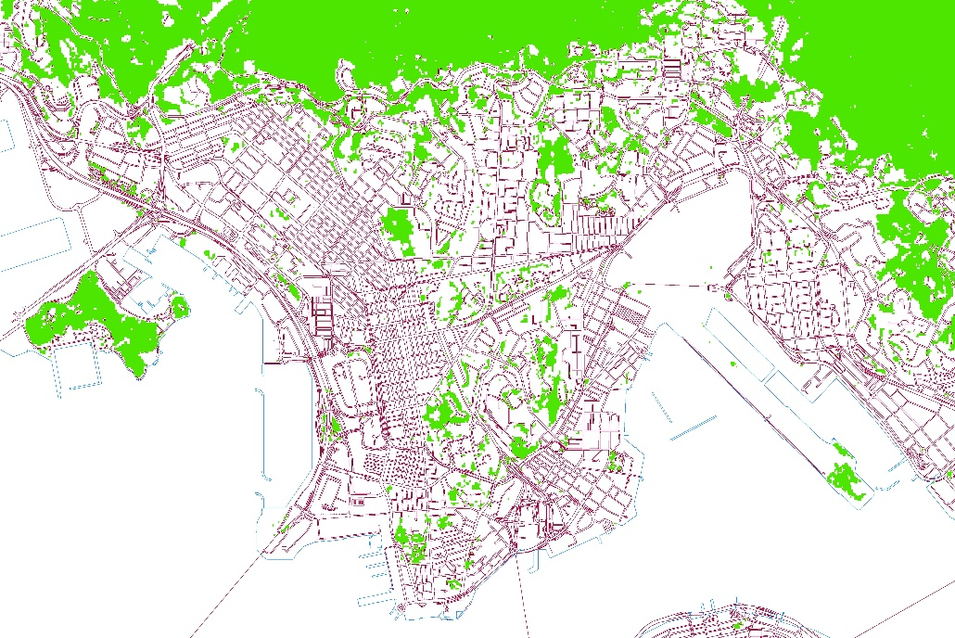
Urban Morphological Data
  Vegetation
  Based on the Normalized Difference Vegetation Index (NDVI)
  Derived from the IKONOS multispectral images with a spatial resolution of 15m (Nichol et al., 2006)
  Determines potential vegetation cover and vegetation types
  TEB parameters
    ISBA and TEB-veg
    Vegetation in urban areas
SURFEX Users’ Workshop, Toulouse, 20170228

Slide 10
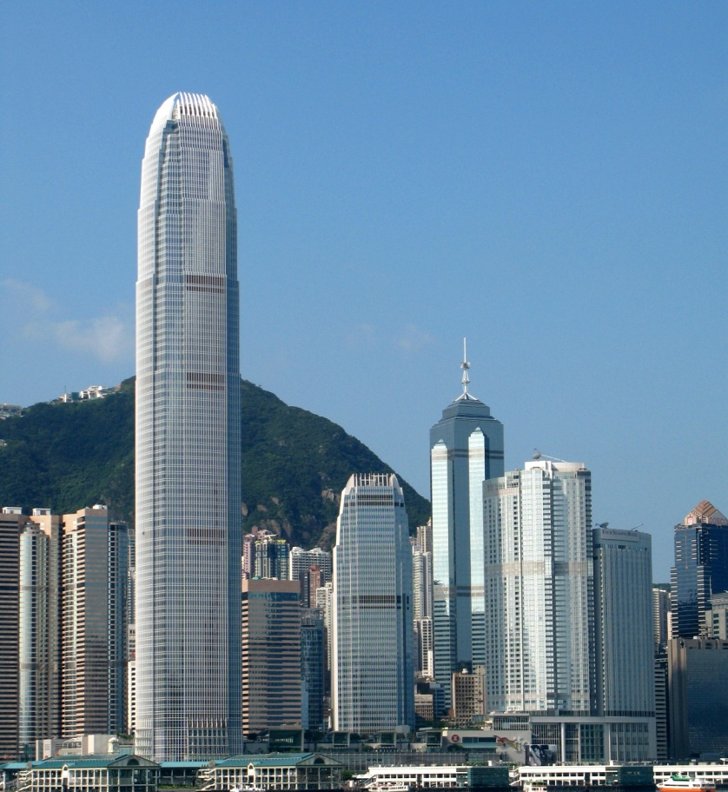
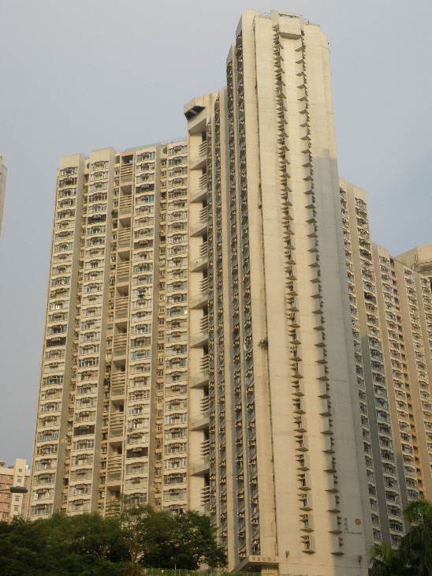
Urban Morphological Data
  High-rise Buildings
  Impacts on the mesoscale modelling
  Height of the surface layer
  Drag function and energy balance
404m
98.4m
60m
Ng E, Yuan C, Chen L, Ren C, Fung JCH, 2011. Improving the wind environment in high-density cities by understanding urban morphology and surface roughness: a study in Hong Kong. Landscape and Urban Planning 101(1): 59–74.
SURFEX Users’ Workshop, Toulouse, 20170228

Slide 11
TEB Assumption
  Buildings oriented along street canyons with length >> width
    Street canyon concept
    High-rise buildings (average building height in HK = 60m)
  Homogeneous urban morphology, i.e. same building height and street width within the grid
    Optimal grid size for high-density cities
  Street canyon orientation
    Non-canyon areas (e.g. residential estates)
  Single layer urban canopy model (one-node walls, ...)
SURFEX Users’ Workshop, Toulouse, 20170228

Slide 12
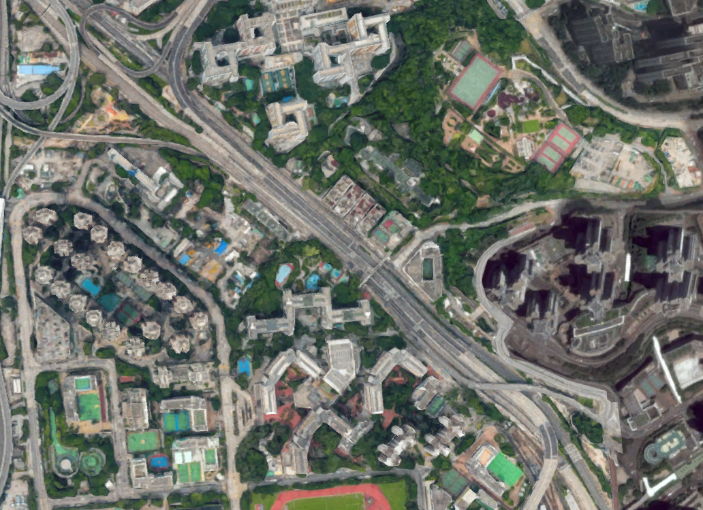
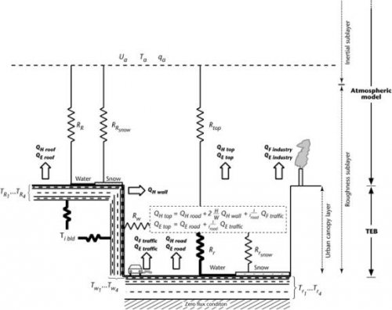
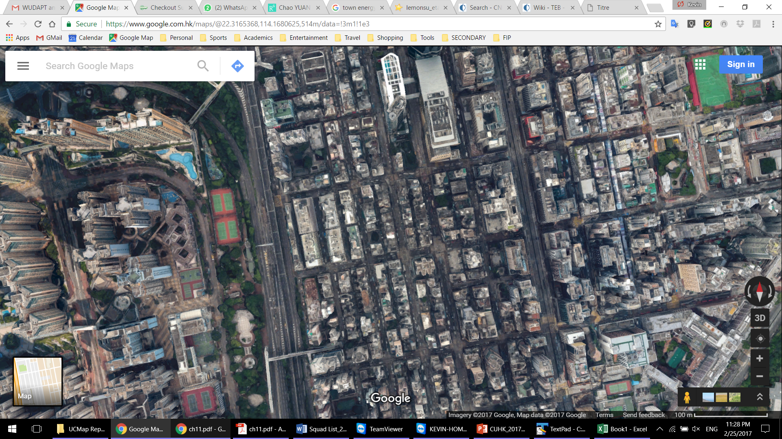
Street Canyon Concept
  Energy fluxes (and balance) are different across urban settings
  Effect of extremely high-rise buildings
  Can TEB produce the correct fluxes?
    Coupled mode: MesoNH
    Offline mode
SURFEX Users’ Workshop, Toulouse, 20170228

Slide 13
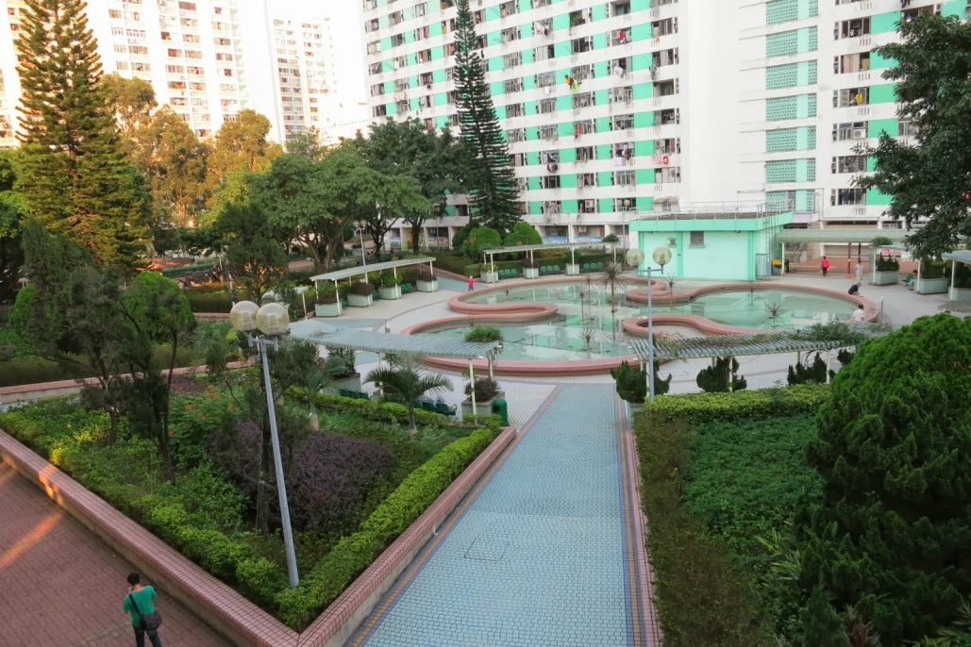
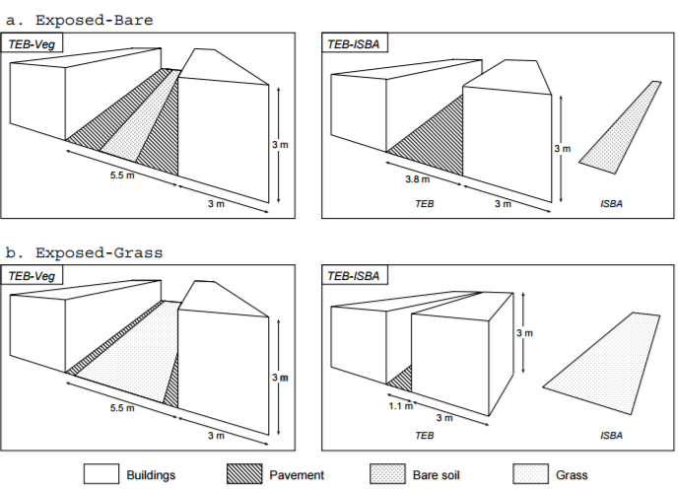
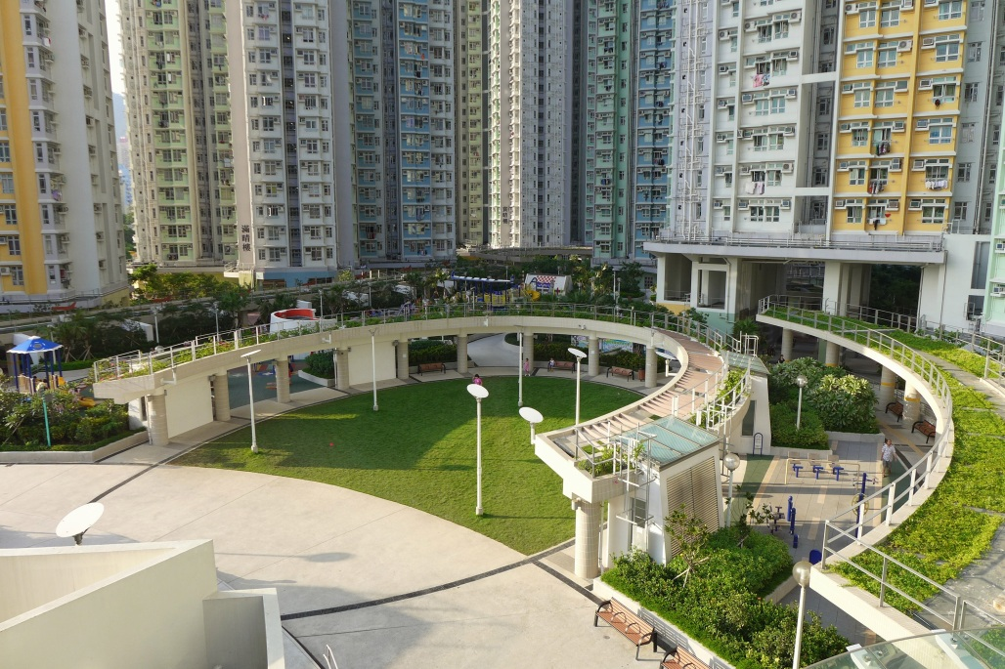
Garden Fraction
  Garden fraction within street canyons
  Vegetation is generally situated in more open settings
    Housing estates
    District parks
Lemonsu A, Masson V, Shashua-Bar L, Erell E, Pearlmutter D, 2012. Inclusion of vegetation in the Town Energy Balance model for modelling urban green areas. Geoscientific Model Development 5: 1377–1393.
SURFEX Users’ Workshop, Toulouse, 20170228

Slide 14
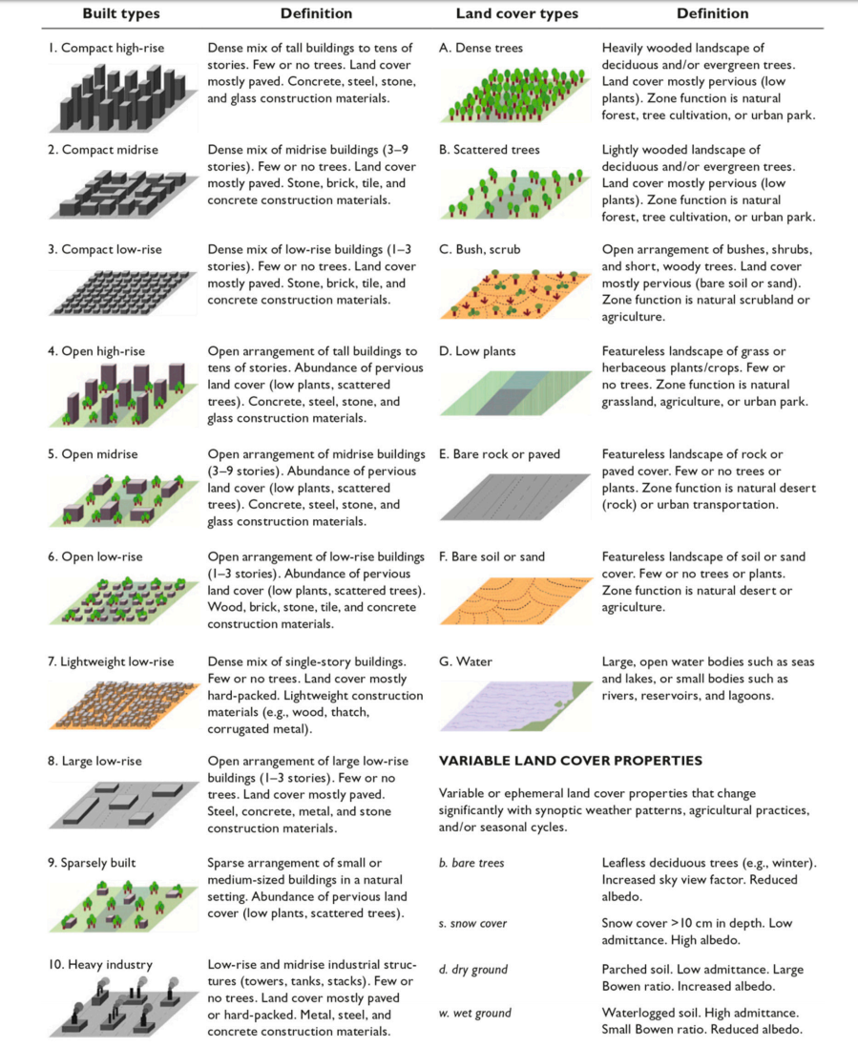
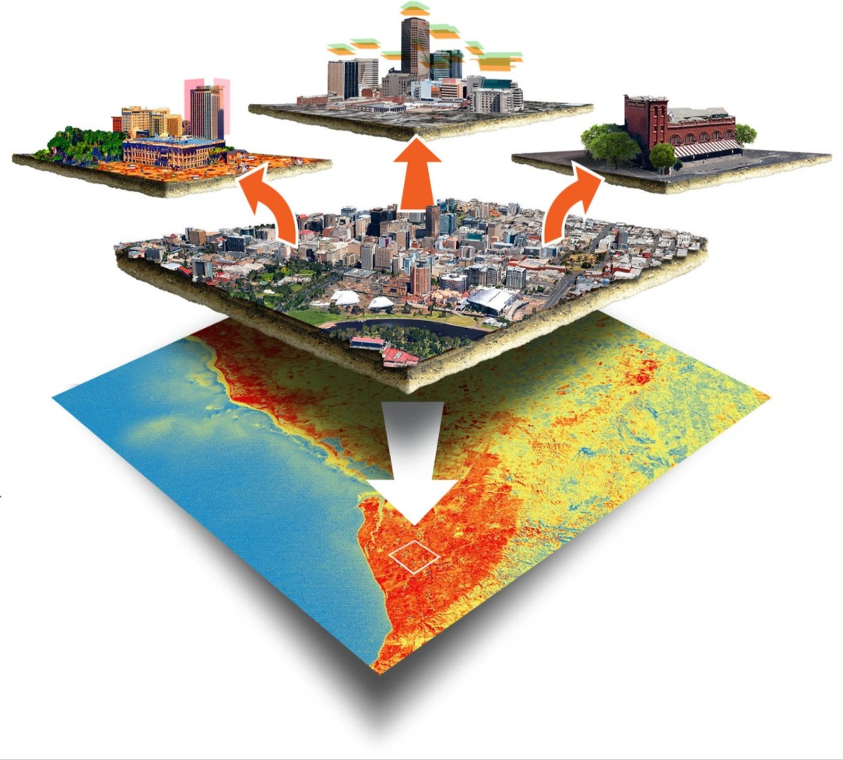
Local Climate Zone
  Local Climate Zone Classification Scheme
  Stewart and Oke, 2012
  Regions of uniform surface cover, structure, material, and human activity
Stewart I, Oke T, 2012. Local climate zones for urban temperature studies. Bulletin of the American Meteorological Society 93(12): 1879–1900.
SURFEX Users’ Workshop, Toulouse, 20170228

Slide 15
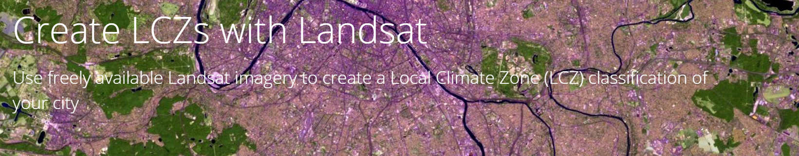
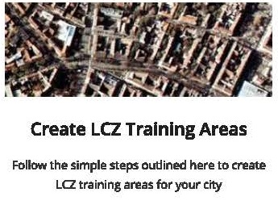
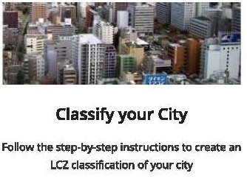
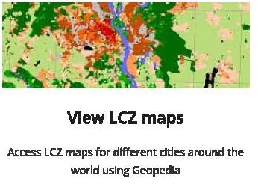
The World Urban Database and Access Portal Tools
  Local Climate Zone Classification Scheme
  The most recent report from the Intergovernmental Panel on Climate Change (IPCC) notes the dearth of information on urban areas. The goal of the WUDAPT initiative is to fill this demand.
SURFEX Users’ Workshop, Toulouse, 20170228

Slide 16
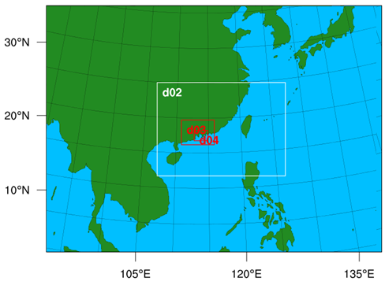
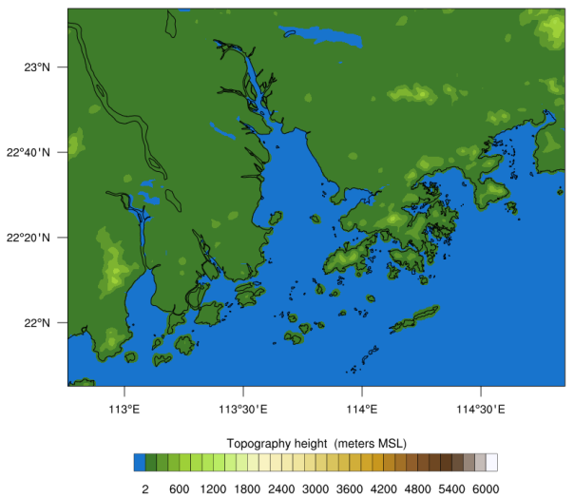
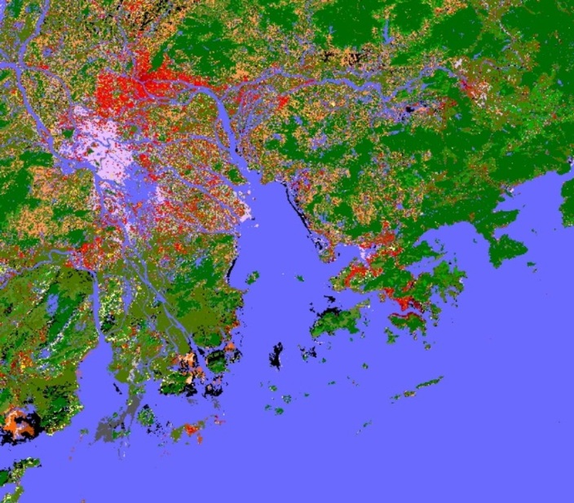
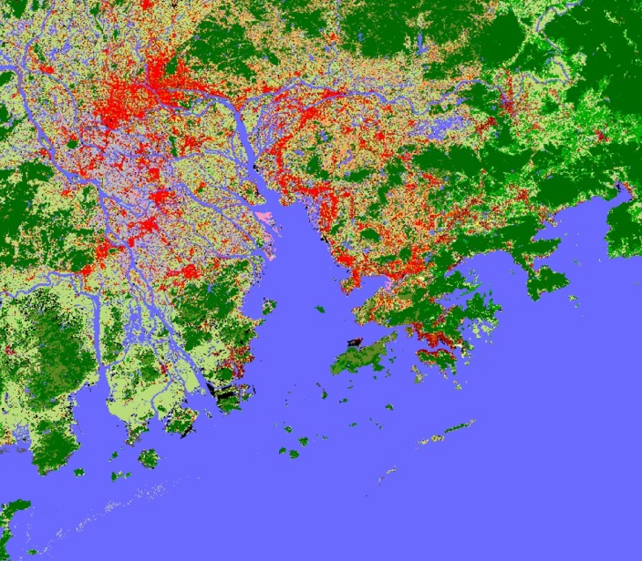
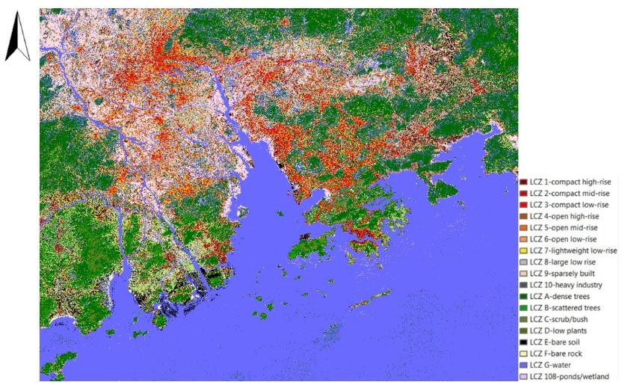
WRF Simulation
  1988
  1999
  2009
SURFEX Users’ Workshop, Toulouse, 20170228

Slide 17
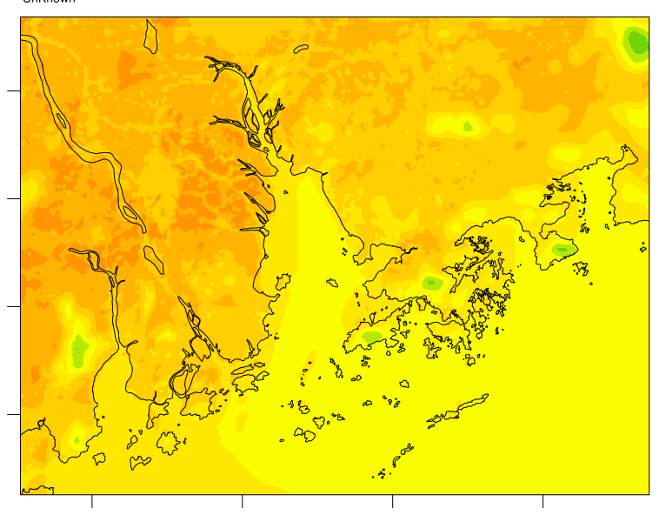
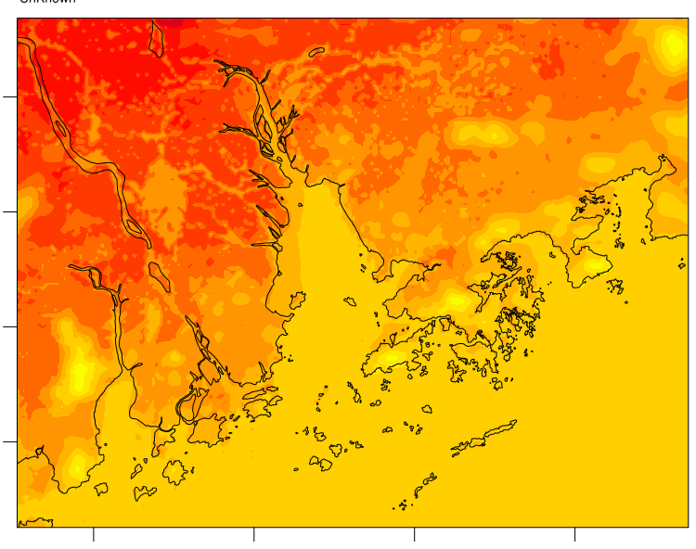
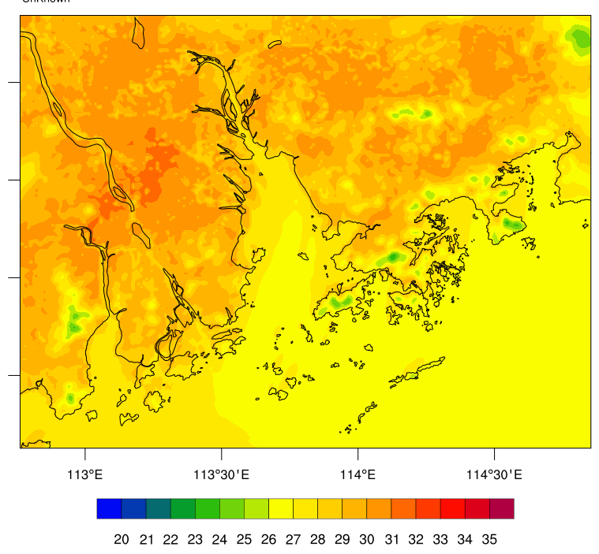
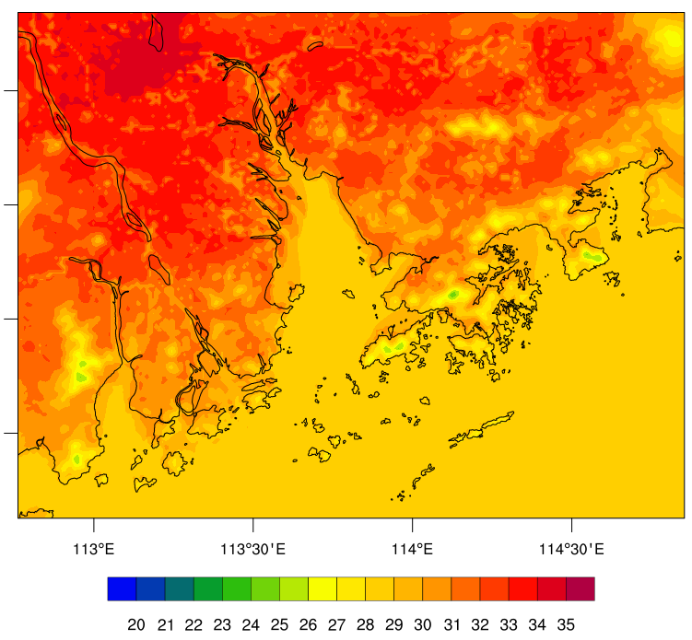
Daytime Air Temperature at 2m
1988
  June
  July
2010
  June
  July
SURFEX Users’ Workshop, Toulouse, 20170228

Slide 18
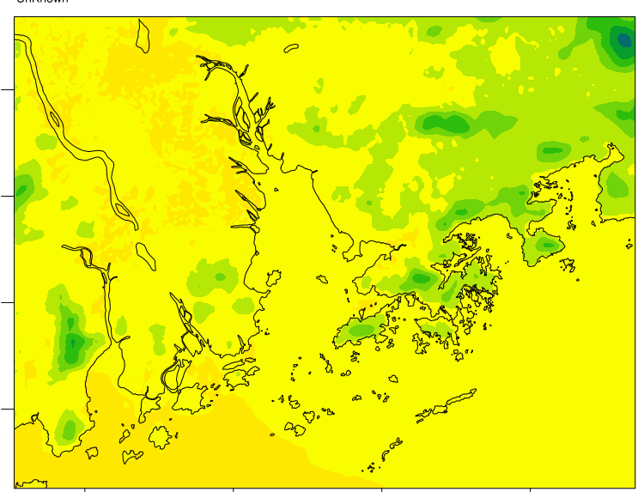
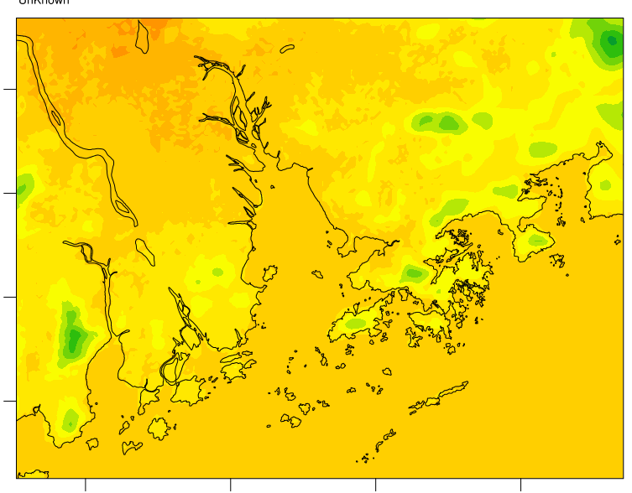
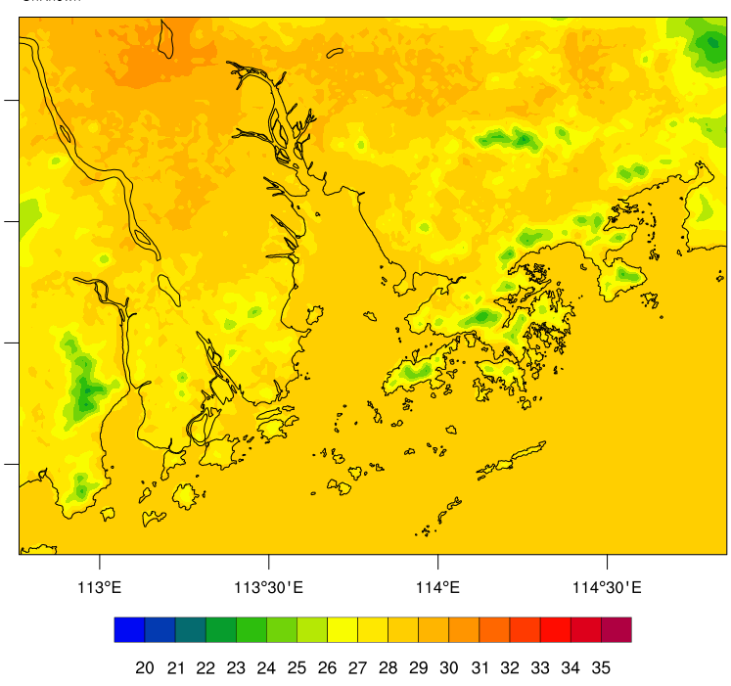
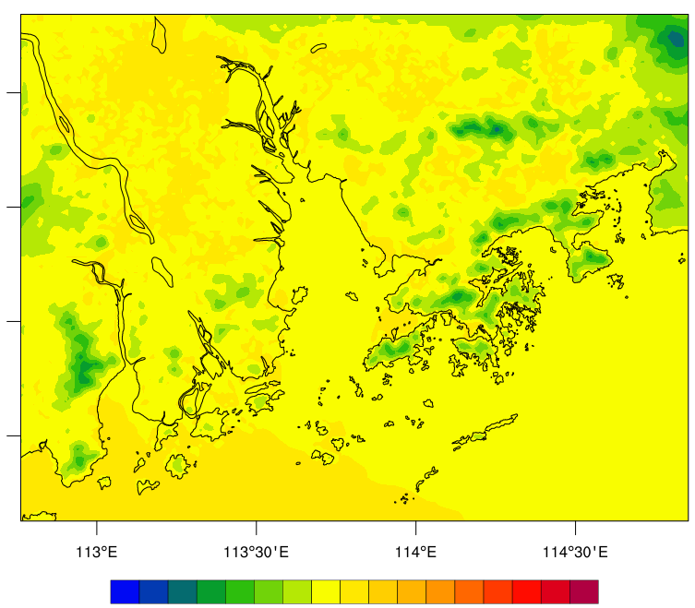
Night-time Air Temperature at 2m
1988
  June
  July
2010
  June
  July
SURFEX Users’ Workshop, Toulouse, 20170228

Slide 19
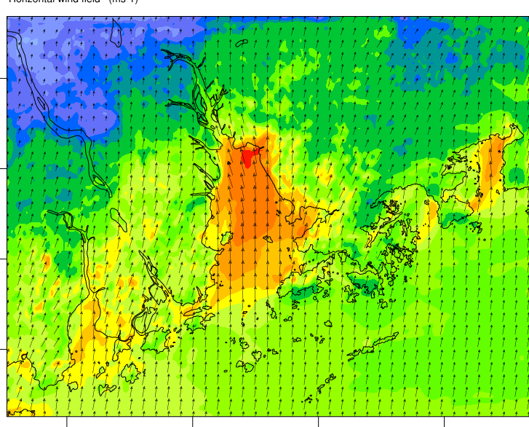



Daytime Wind Speed at 10m
1988
  June
  July
2010
  June
  July
SURFEX Users’ Workshop, Toulouse, 20170228

Slide 20




Night-time Wind Speed at 10m
1988
  June
  July
2010
  June
  July
SURFEX Users’ Workshop, Toulouse, 20170228

Slide 21
Next Stage
  WUDAPT products are able to improve the simulation by providing more urban categories than the one-category Noah land-surface model.
  Rapid urbanization in the last two decades increased the air temperature due to the heat storage within the building bulk and the ground. Sea breezes cannot penetrate to inland area due to the increase in surface roughness.
  Detailed building database can therefore be incorporated into the TEB scheme and improve modelling performance.
  The validity of the TEB scheme (e.g. street canyon concept) will be tested for high-density cities with complex surface characteristics.
  The optimal spatial resolution will also be determined by balancing the computational cost and model performance.
  Potential applications include heatwave-mortality analysis at fine spatial level and district-level variations of meteorological conditions for planning purpose.
SURFEX Users’ Workshop, Toulouse, 20170228

Slide 22
  Thank you very much for your attention.
  Your comments will be invaluable to our upcoming work.
  Kevin Ka-Lun Lau (kevinlau@cuhk.edu.hk)
  Margaret Yu-Ting Kwok (ytkwok@cuhk.edu.hk )
  Centre for Urban Sustainability, Institute of Future Cities
  The Chinese University of Hong Kong

